Slide 1
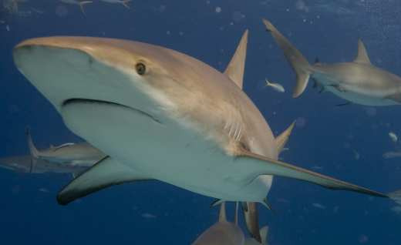
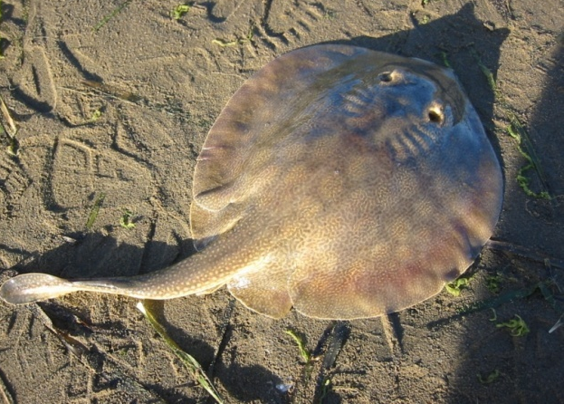
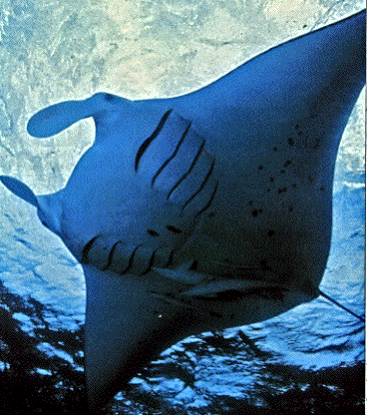
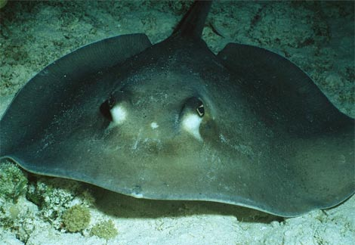
Class Chondrichthyes
“cartilage fish”
examples – sharks, rays, skates

Slide 2
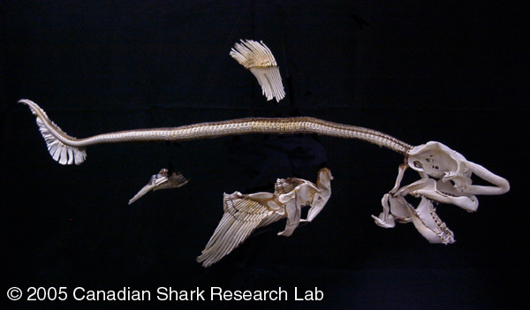
Traits
Skeletons entirely of cartilage

Slide 3
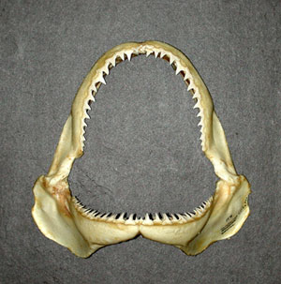
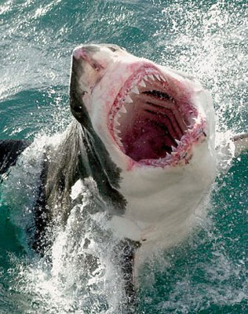
Traits
Have a jaw

Slide 4
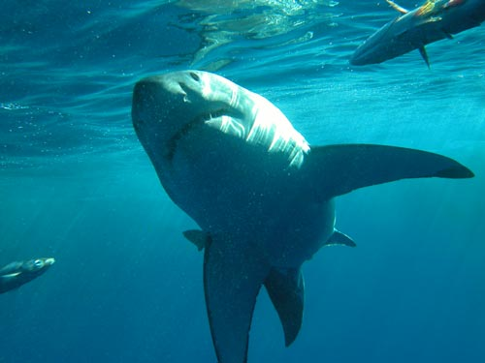
Traits
Paired fins

Slide 5
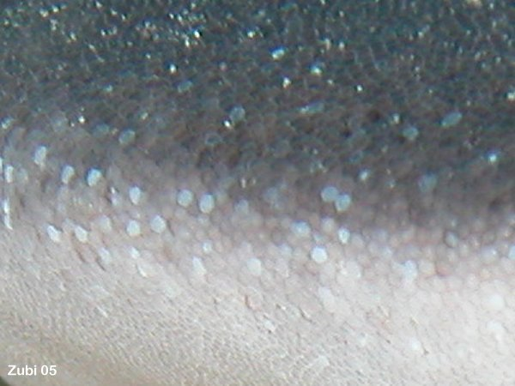
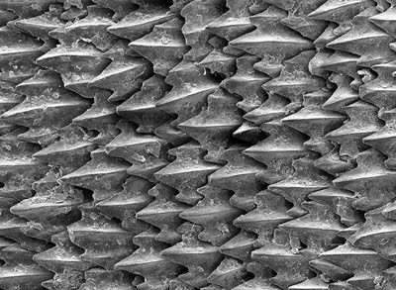
Traits
Mucousy skin with placoid scales

Slide 6
Traits
2 chambered heart

Slide 7
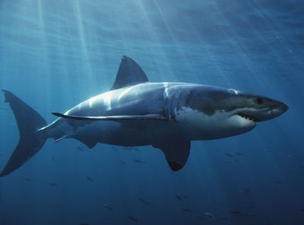
Traits
ectotherms

Slide 8
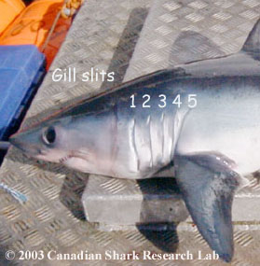
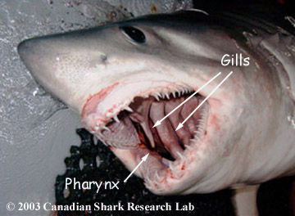
Traits
5-7 pairs of gill slits

Slide 9
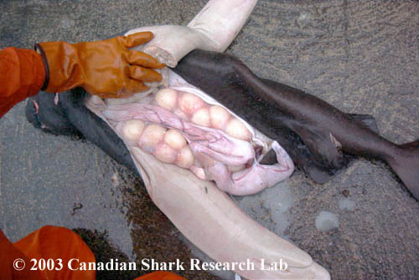
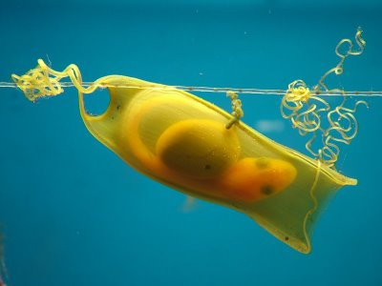
Traits
Most are oviparous or ovoviviparous
Mermaid’s Purse

Slide 10
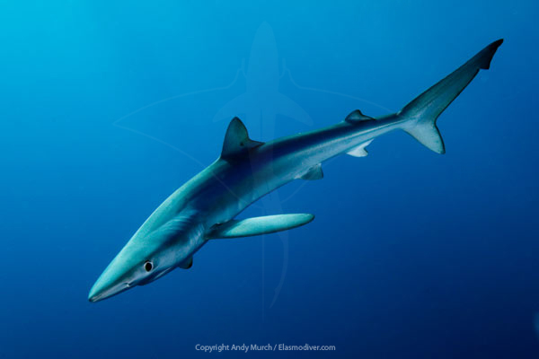
Traits
Heterocercal tail fin (top and bottom are different)

Slide 11
Shark structure
Skin – rough like sandpaper because of placoid scales

Slide 12
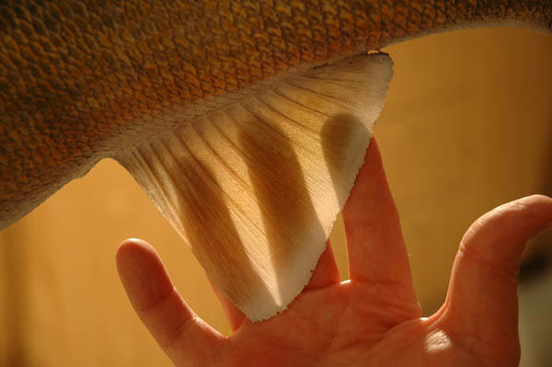
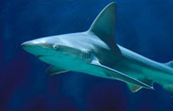
Fins
Thicker and less flexible than the bony fish

Slide 13
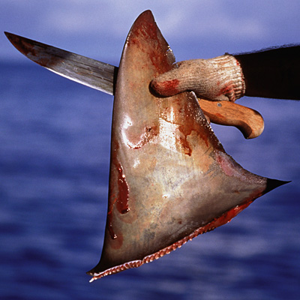
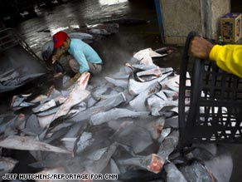
Nearly 40 million sharks are killed annually for their fins, which are considered a delicacy in Asia and prepared primarily in soups.

Slide 14
Dorsal
2 fins along the back

Slide 15
Caudal
Tail fin

Slide 16
Pelvic
Posterior paired fins

Slide 17
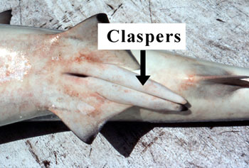
Claspers
Males only, used in mating

Slide 18
Pectoral
“chest,” anterior paired fins

Slide 19
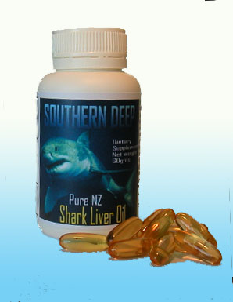
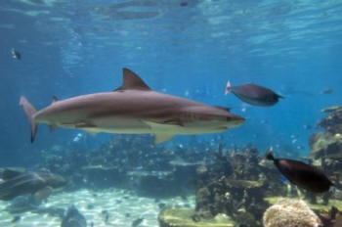
Liver
large and filled with oil to help with buoyancy

Slide 20
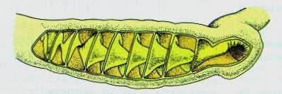
Spiral valve
Spiral flap of skin that increases the surface area in the intestines for better absorption of nutrients

Slide 21
Cloaca
Area common to the digestive, reproductive, and excretory systems

Slide 22
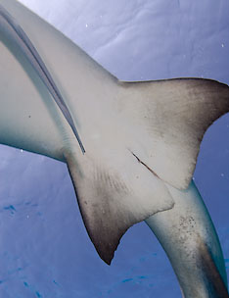
Vent
Exit from the cloaca

Slide 23
Sensory Organs
By themselves, none of a shark's sense organs would be adequate for effective hunting. But the combination of all these senses make the shark an incredible predator

Slide 24
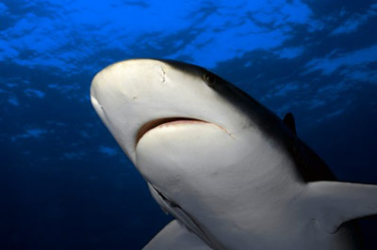
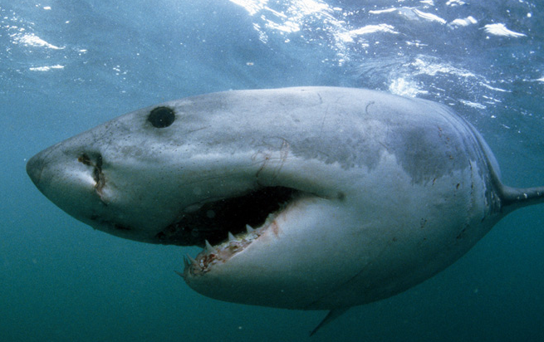
Nostrils – for smell only
Many sharks can detect even the slightest traces of blood in the water

Slide 25
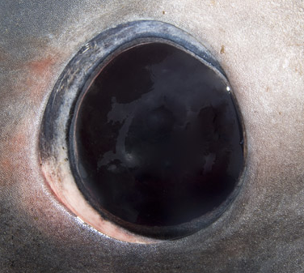
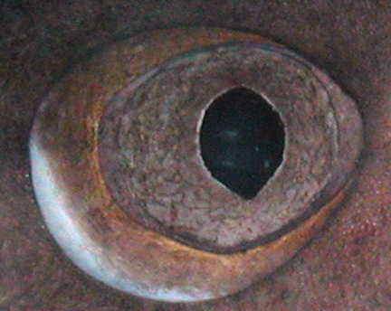
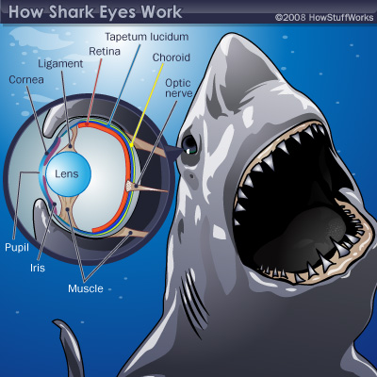
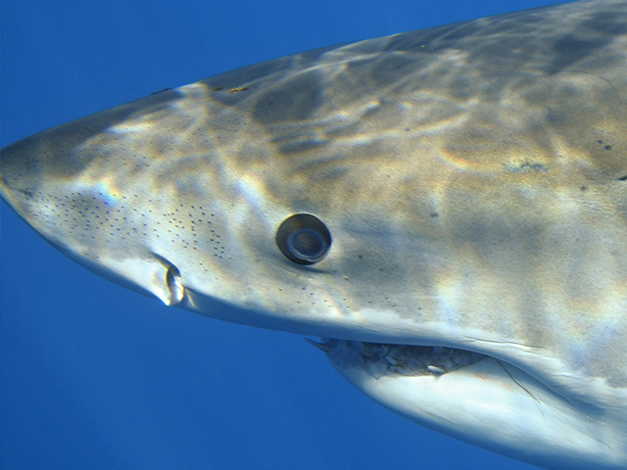
Eyes – spherical lenses, nearsighted

Slide 26
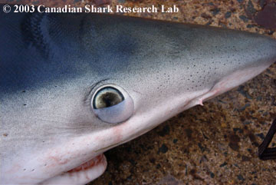
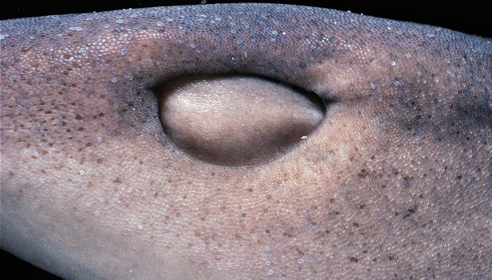
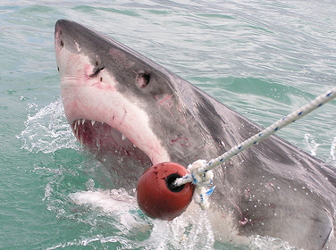
A few have a nictitating membrane
Those who don’t will roll their eyes back to protect them

Slide 27
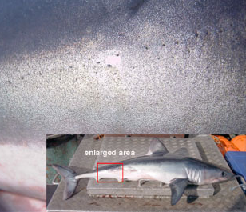
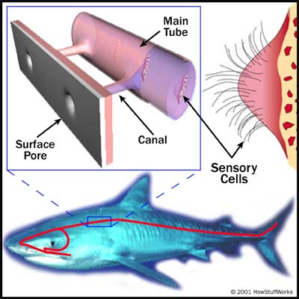
Lateral line – detects vibrations

Slide 28
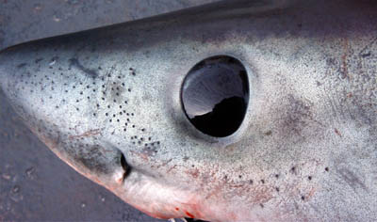
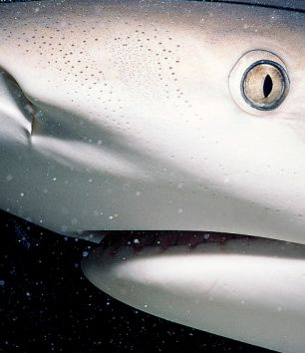
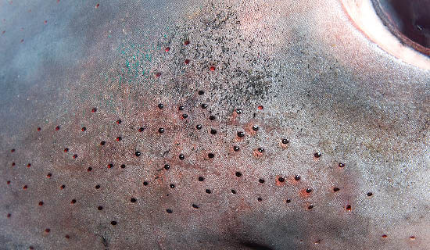
Ampullae of Lorenzini – detect weak electrical fields

Slide 29
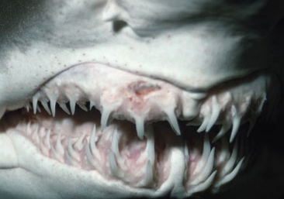
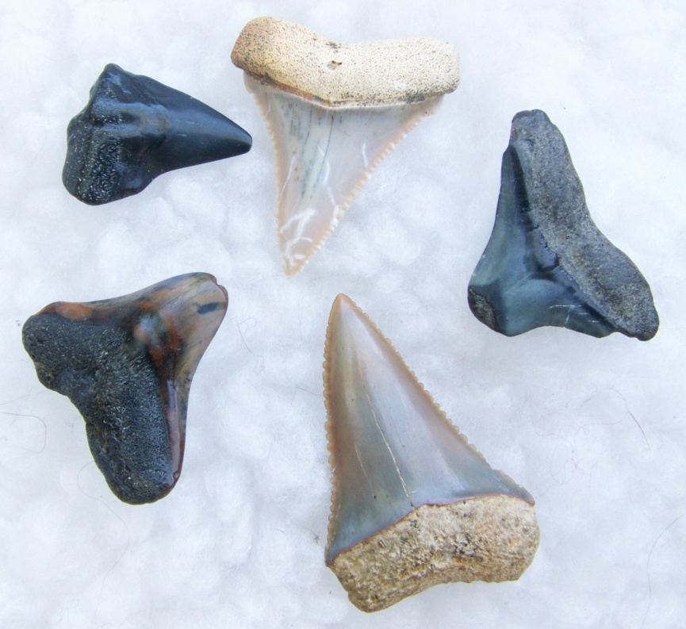
Teeth
Modified scales that grow from the skin into the jaw, can be used to identify the species

Slide 30
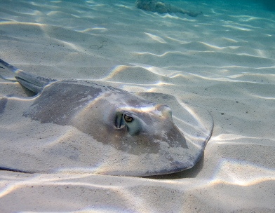
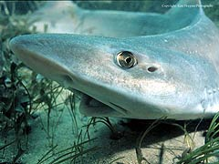
Spiracles
opening just behind the eye, supplies oxygen to eyes and brain
Spiracles in rays are larger and pump water over the gills to allow them to breathe while buried in the sand.

Slide 31
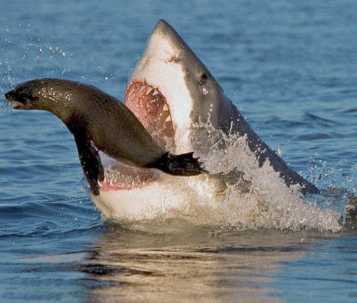
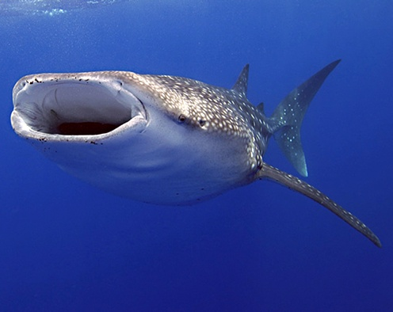
Feeding methods
Many are predators, some filter plankton

Slide 32
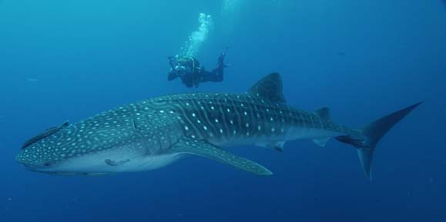
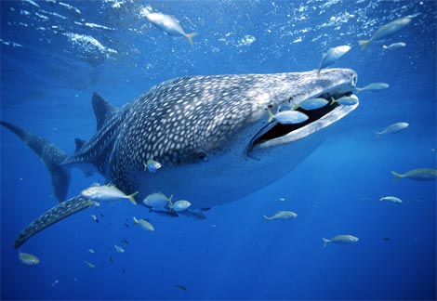
Whale shark
Largest living fish, 60 ft. long and 90,000 lbs.

Slide 33
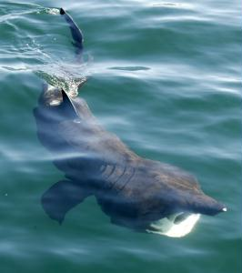
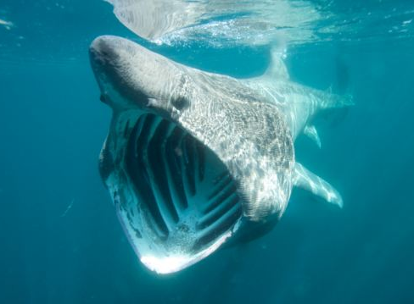
Basking Shark
Filter feeder

Slide 34
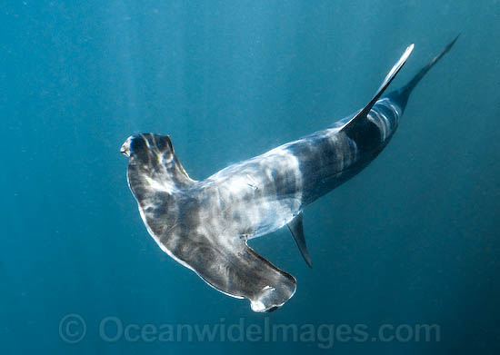
Hammerhead Shark

Slide 35
Great White Shark

Slide 36
Skates
A dorsoventrally flattened shark that lives on the ocean floor, oviparous (eggs outside)

Slide 37
Rays
Even more flattened, ovoviviparous (eggs inside)

Slide 38
Manta Ray
Can reach up to 9 meters across.
Feed on plankton and small fish and are harmless to humans

Slide 39
Stingrays

Slide 40
Do the stingray shuffle

Slide 41
Sawfish
A type of ray

