Slide 1
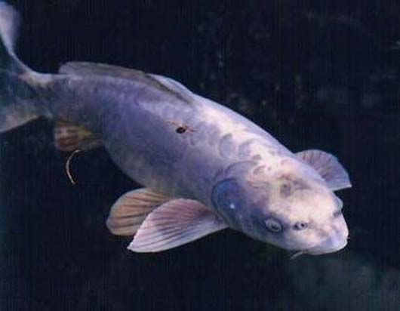
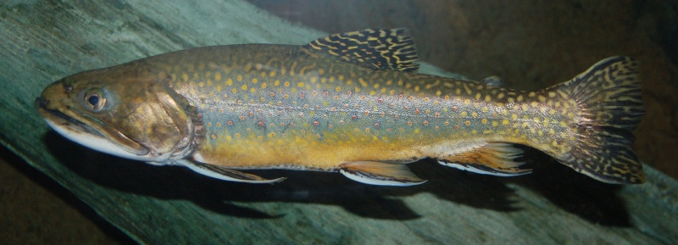
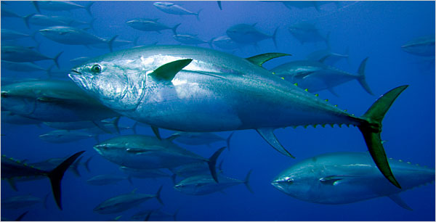
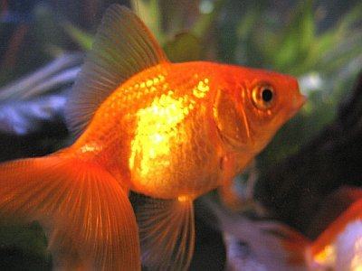
Osteichthyes – “bony fish”
Examples – trout, carp, goldfish, tuna

Slide 2
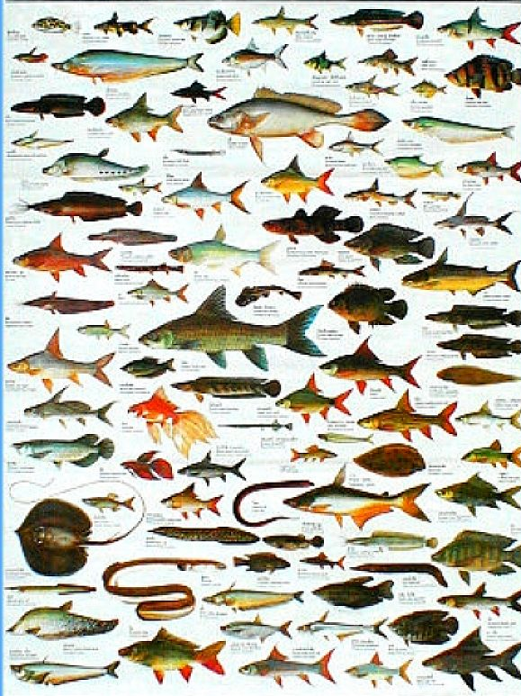
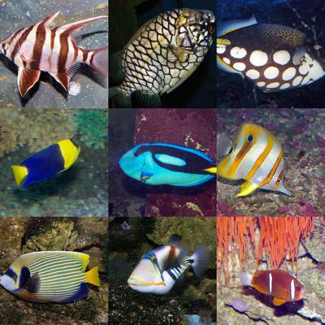
Success
Most successful among the vertebrates – largest # of species
over 29,000 species

Slide 3
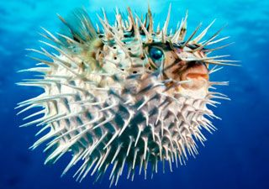
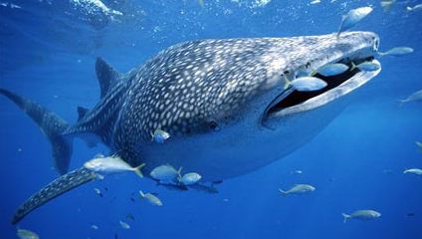
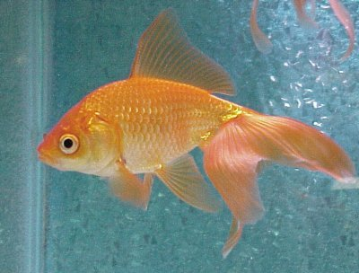
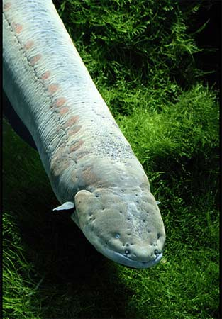
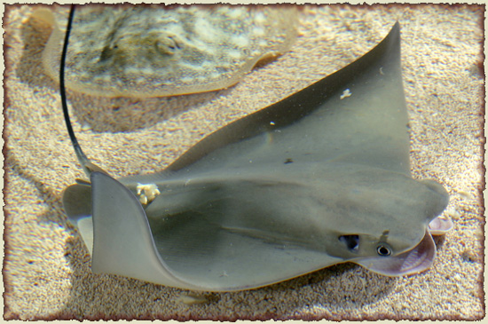
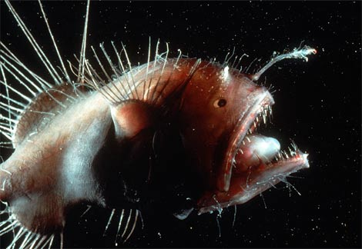
Ichthyology
Study of fish

Slide 4
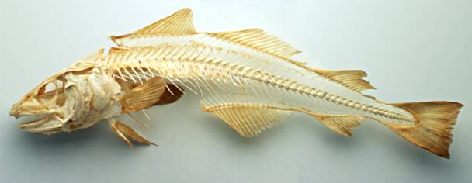
Traits
Skeleton of bone

Slide 5
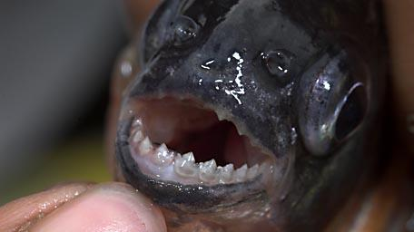
Traits
jaws

Slide 6
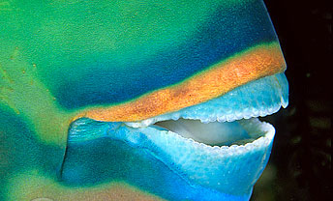
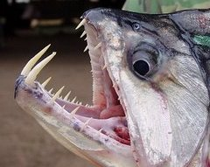
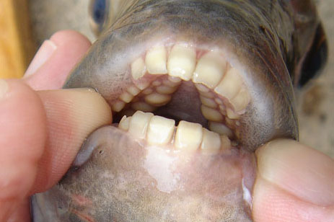
Parrot fish
Sheepshead fish

Slide 7
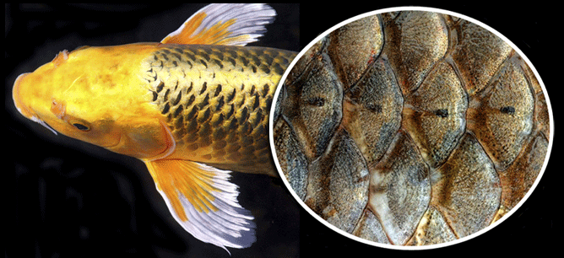
Traits
Mucousy skin with overlapping scales

Slide 8
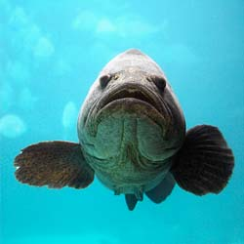
Traits
Paired fins

Slide 9
Traits
2 chambered heart

Slide 10
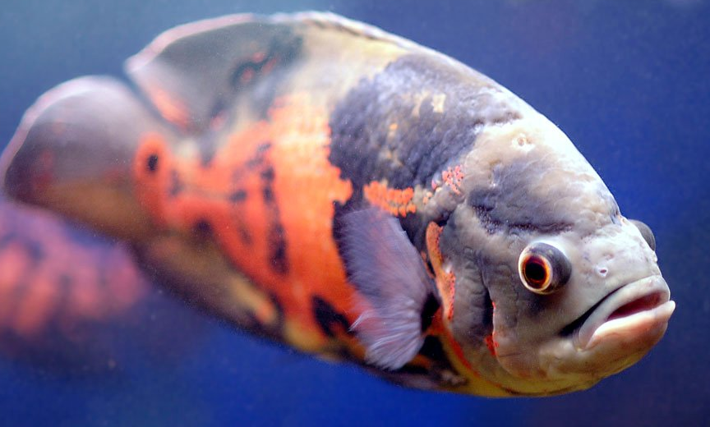
Traits
ectotherms

Slide 11
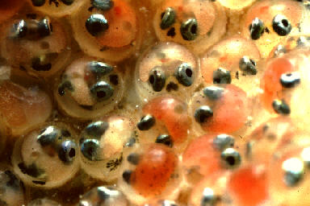
Traits
Most are oviparous or ovoviviparous

Slide 12
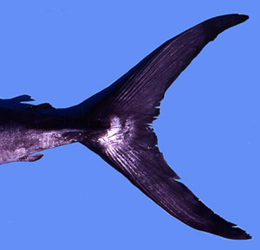
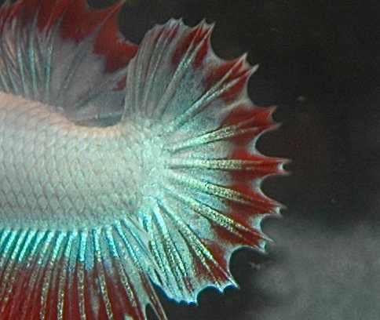
Traits
Homocercal tail fin

Slide 13
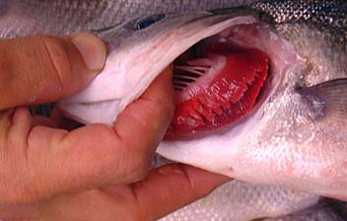
Traits
1 pair of gill slits covered by an operculum

Slide 14
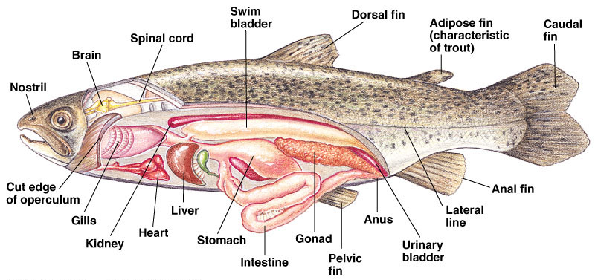
Traits
Swim bladder

Slide 15
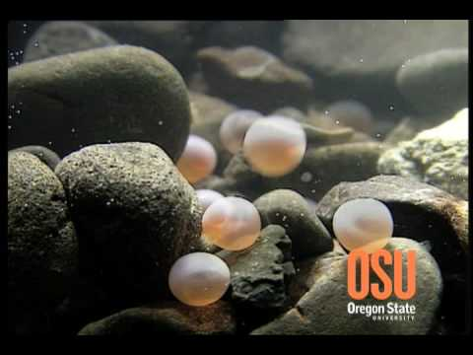
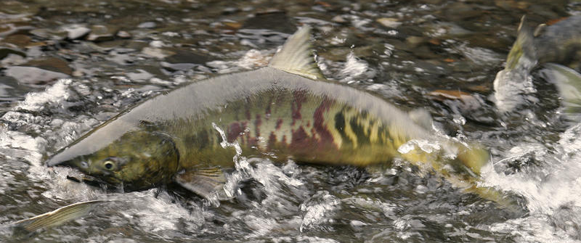
Spawning
Reproductive process of fish involving external fertilization

Slide 16
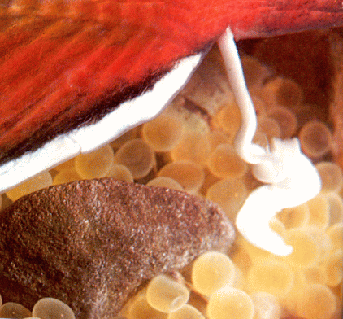
Roe – fish eggs
Milt – fish sperm
Fry – baby fish

Slide 17
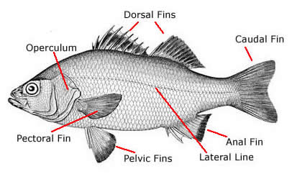
Fish structure

Slide 18
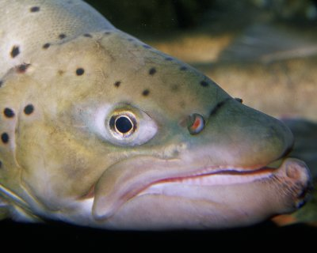
Nostrils
for smell only

Slide 19
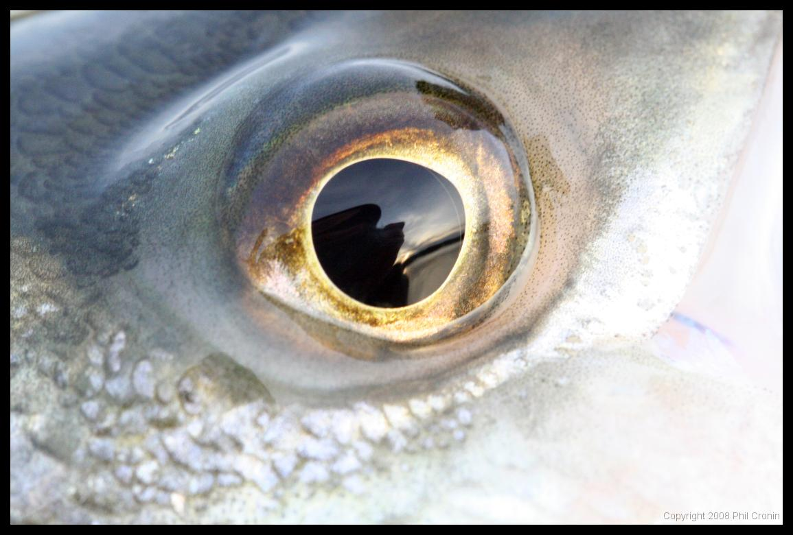
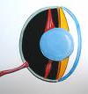
Eyes
Nearsighted, spherical lens

Slide 20
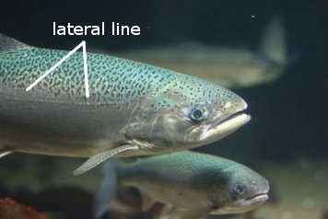
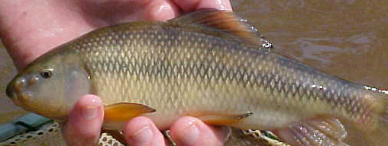
Lateral line
Detects vibrations

Slide 21
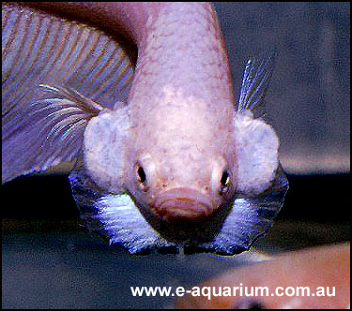
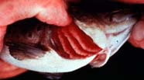
Operculum
Covers and protects gills, also pumps water over gills so they don’t have to swim constantly

Slide 22
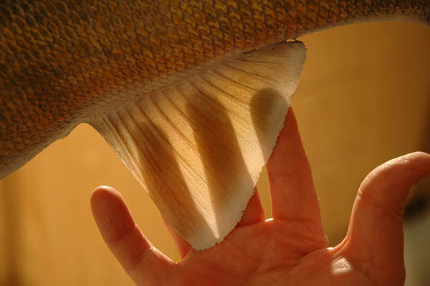
Fins
More flexible which allows more mobility

Slide 23
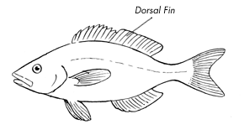
Dorsal
Fin along the back

Slide 24
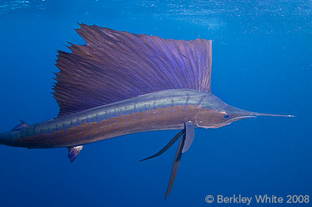
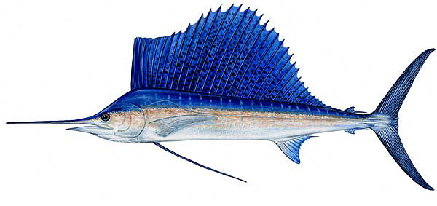
Sailfish

Slide 25
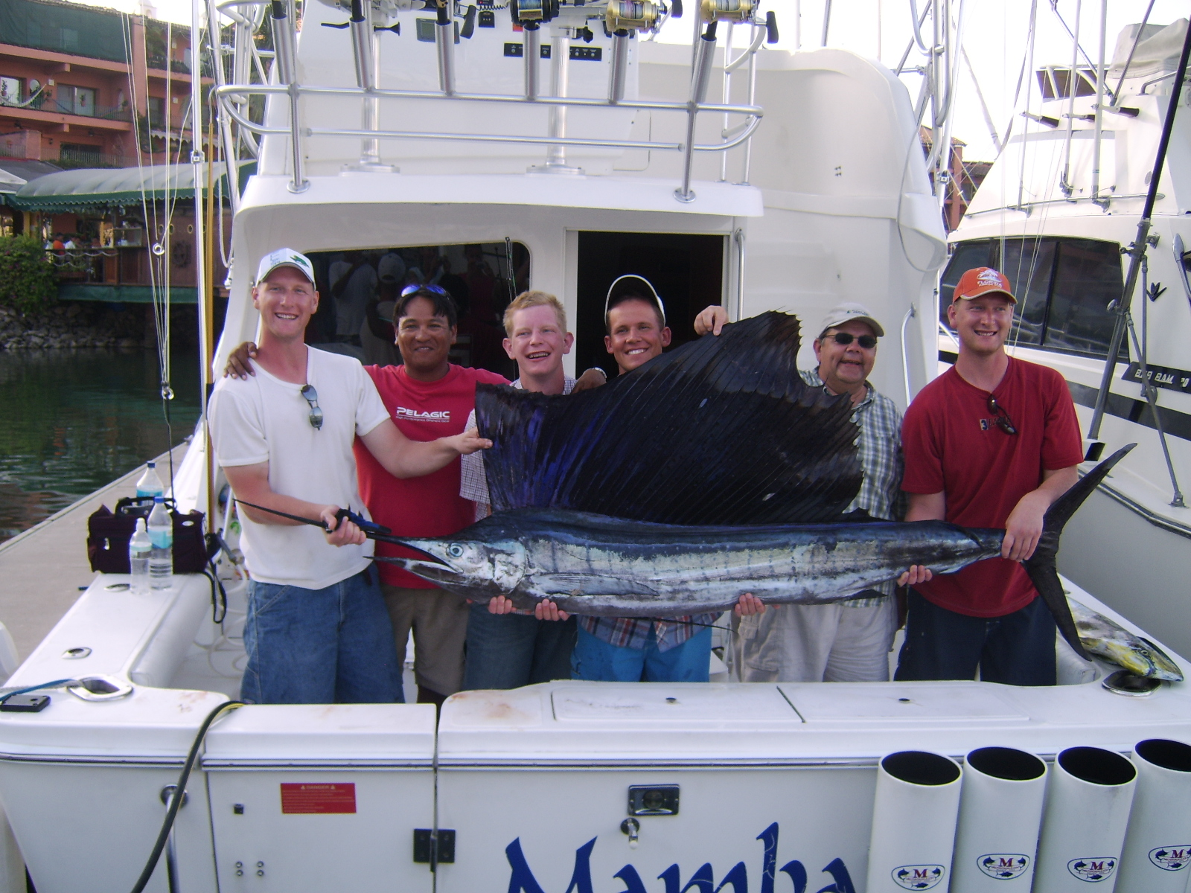

Slide 26
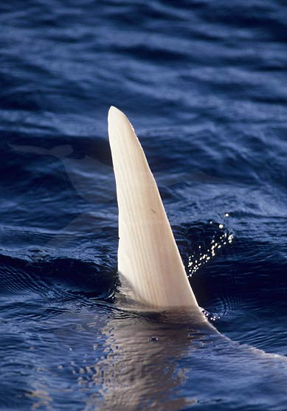
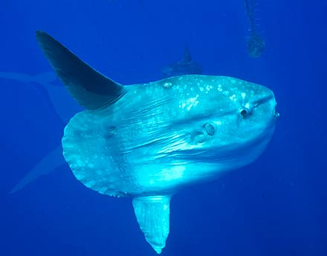
Ocean Sunfish – their large dorsal fin often gets mistaken for a shark’s

Slide 27
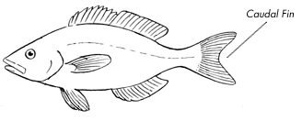
Caudal
Tail fin

Slide 28
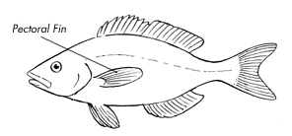
Pectoral
Anterior paired fins

Slide 29
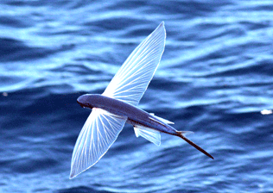
Flying fish

Slide 30
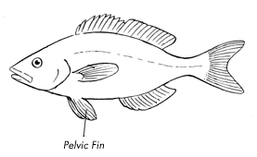
Pelvic
Posterior paired fins

Slide 31
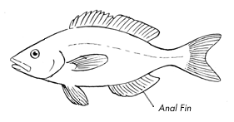
Anal
Fin behind the vent or anus

Slide 32
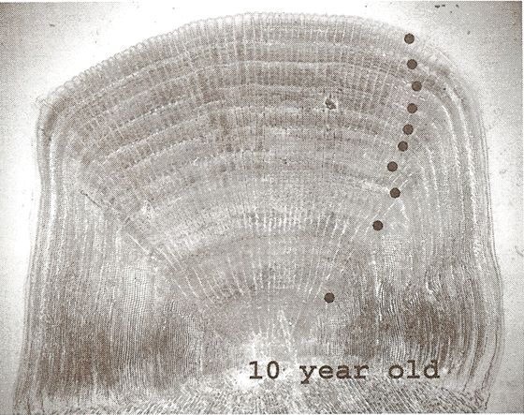
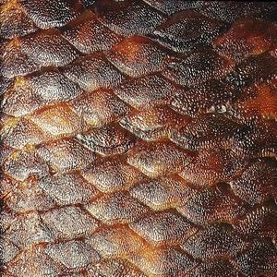
Scales
Can tell how old and what species it is

Slide 33
How old is the fish this scale came from?

Slide 34
Mucus
Escape predators, less water resistance, prevents skin infections

Slide 35
Swim bladder
Controls buoyancy
Dar

Slide 36
Lungfish

Slide 37
Puffer fish

Slide 38
Anglerfish

Slide 39
Seahorse

Slide 40
Mr. Mom

Slide 41
Gulper Eel

Slide 42
Moray Eel

Slide 43
Flounder

Slide 44
Barracuda

Slide 46
Cowfish

