Slide 1
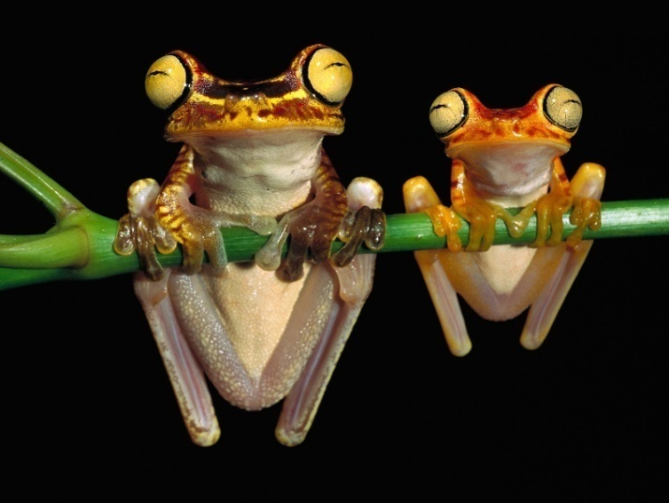
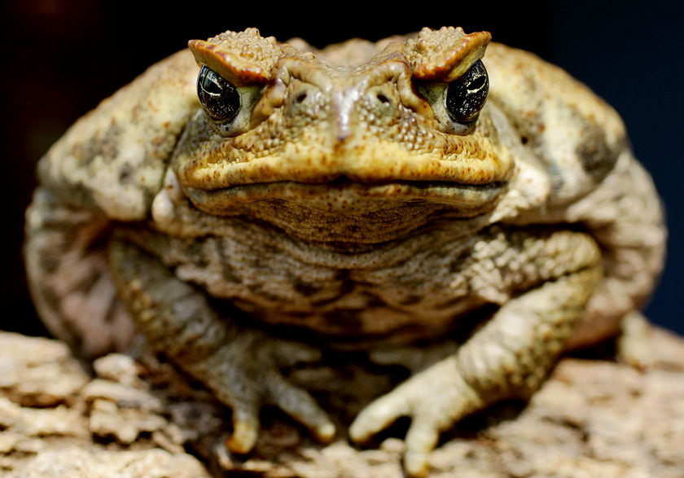
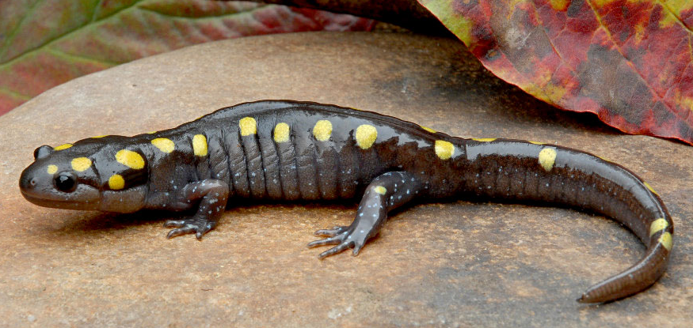
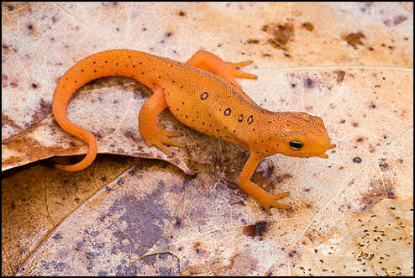
Amphibia – “both lives”
Examples: frogs, salamanders, toads, newts

Slide 2
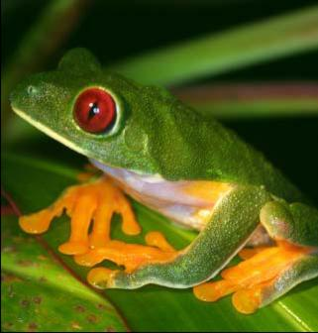
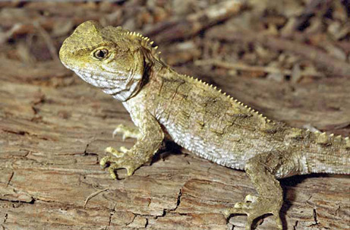
Herpetology
The study of amphibians and reptiles

Slide 3
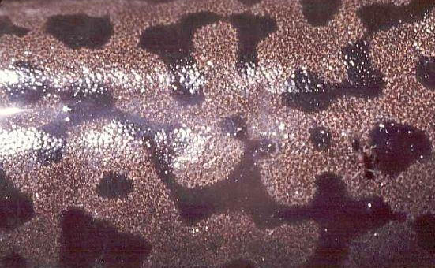
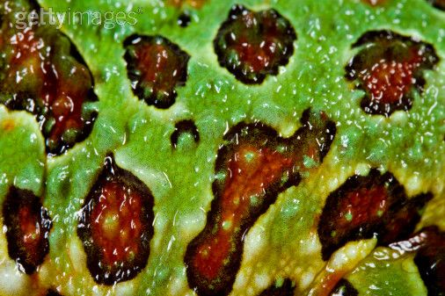
Traits
Mucousy, scaleless skin

Slide 4
Traits
2 chambered heart as larvae, 3 chambers as adults

Slide 5
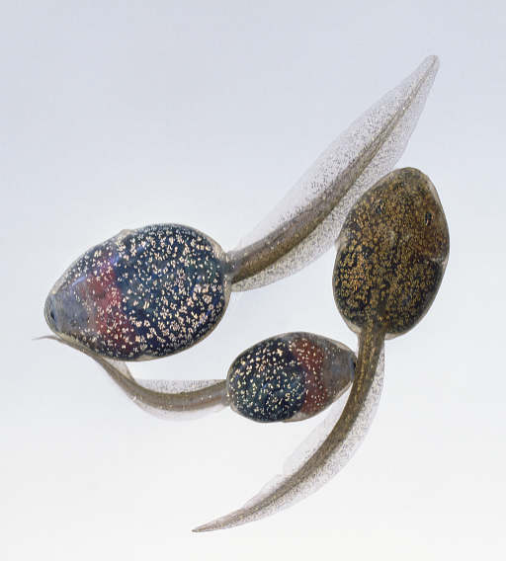
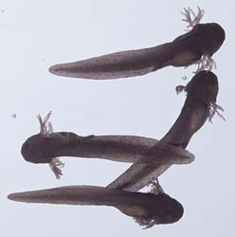
Traits
Gills as larvae, lungs as adults

Slide 6
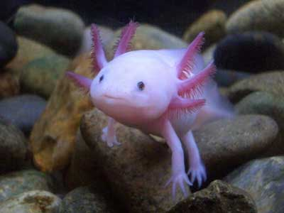
Axolotl keeps its gills and never leaves the water

Slide 7
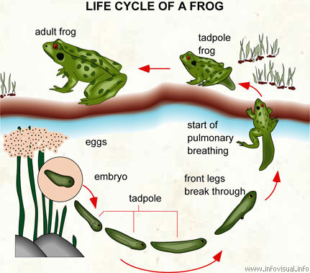
Traits
Metamorphosis

Slide 8
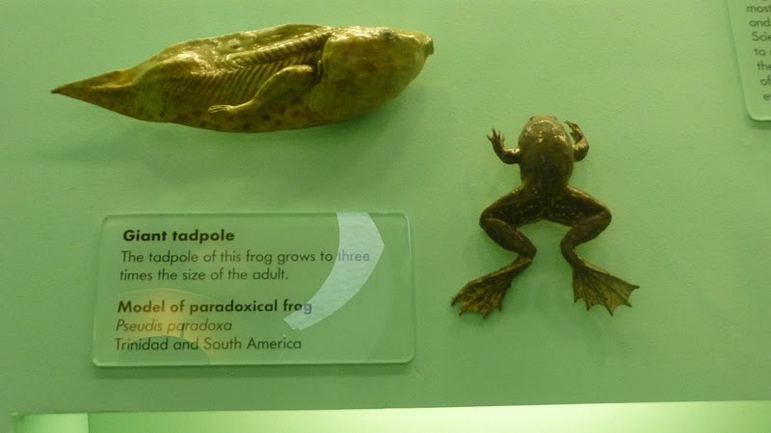
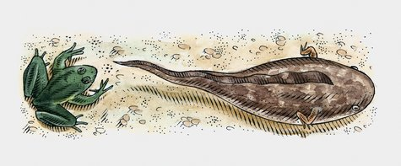
Big tadpole, little frog
The south American paradoxical frog is larger when it is a tadpole than when it becomes an adult

Slide 9
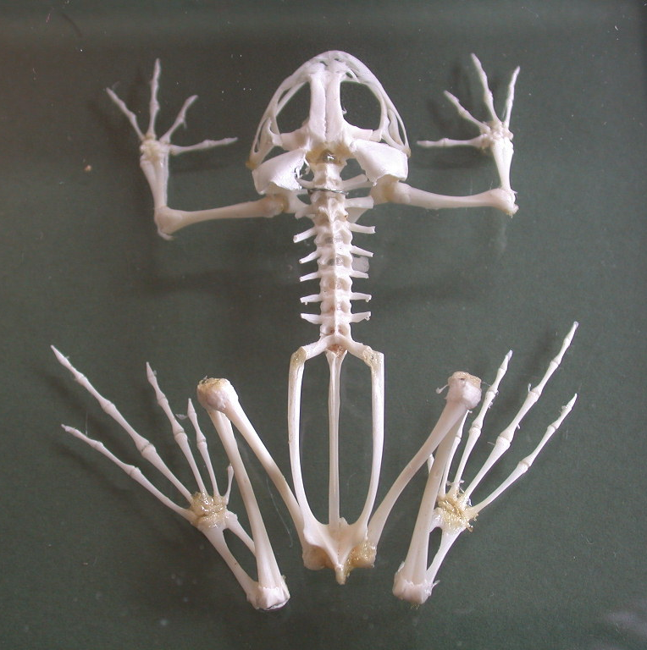
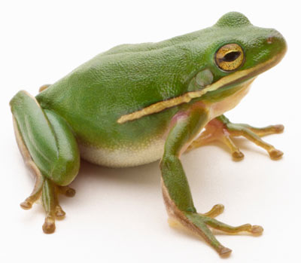
Traits
Bony, muscular legs

Slide 10
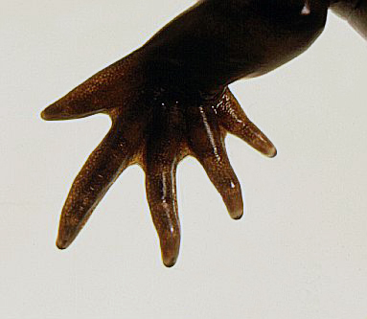
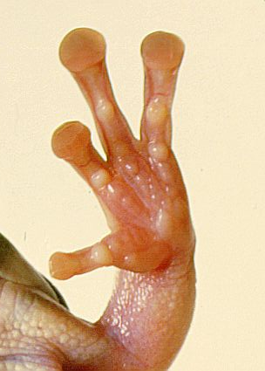
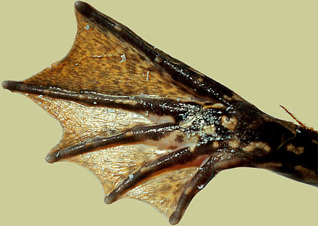
Traits
no claws

Slide 11
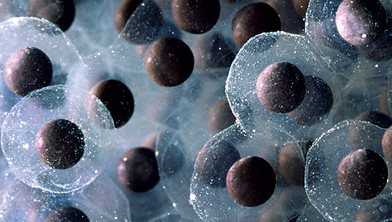
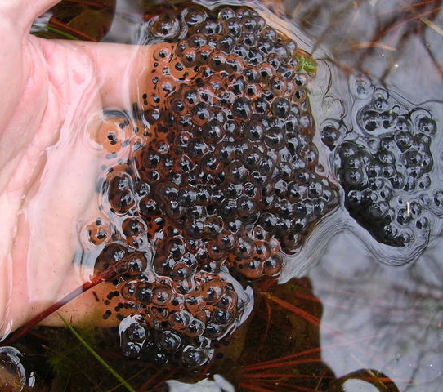
Traits
Oviparous – lay eggs in water

Slide 12
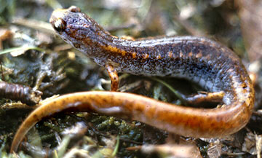
Traits
ectotherms

Slide 13
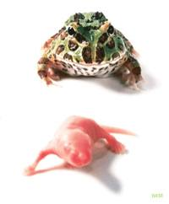
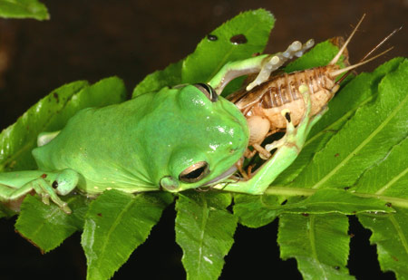
Traits
Carnivores

Slide 14
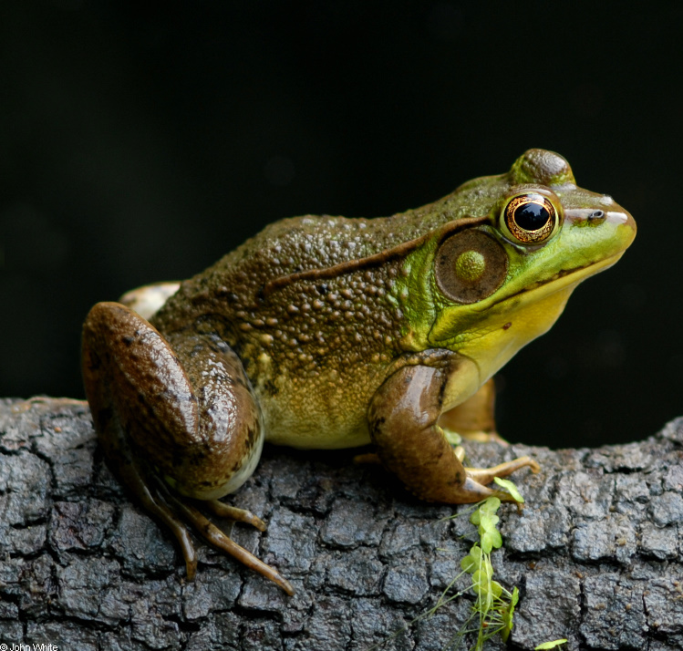
Typical vertebrates
Frogs are about halfway between the simplest and most complex vertebrates

Slide 15
Amphibian heart
3 chambers – good blood pressure to body, but oxygenated and deoxygenated bloods mix
Low metabolism and oxygen also diffuses through their skin

Slide 16
Problems with a terrestrial environment or living on land
Respiration
Support and movement
Dehydration
Temperature
Reproduction

Slide 17
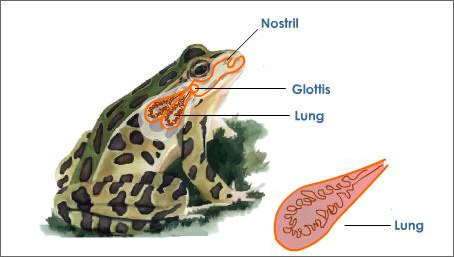
Respiration
develop lungs and breathing skin

Slide 18
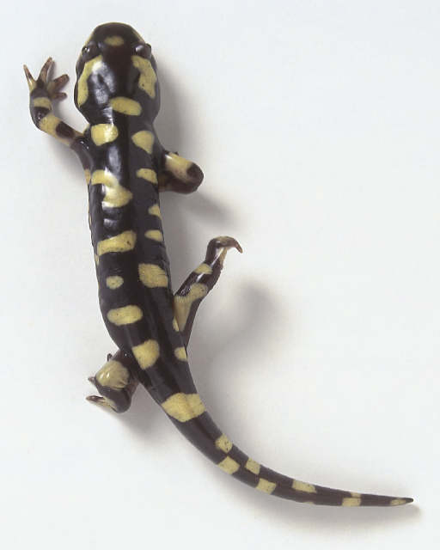
Support and movement
develop bony muscular legs

Slide 19
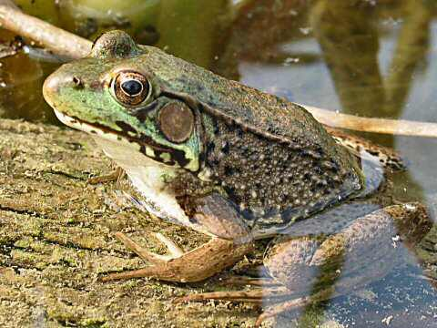
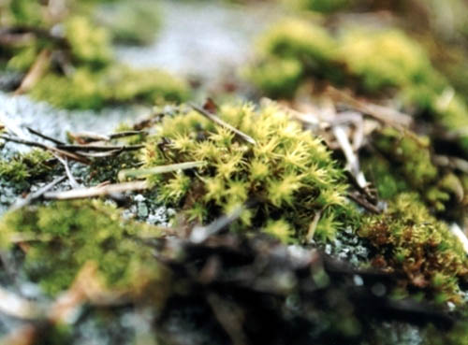
Dehydration
live in moist areas

Slide 20
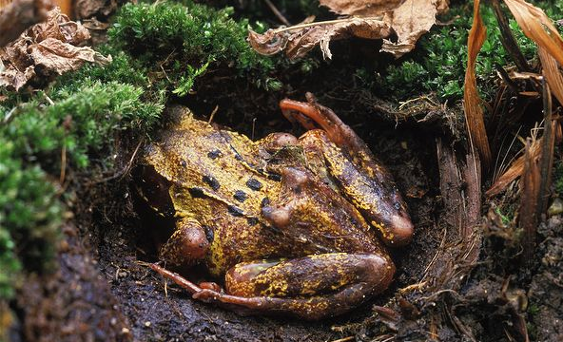
Temperature
become dormant when it’s too hot or too cold

Slide 21
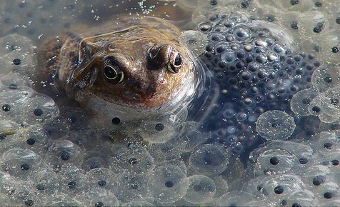
Reproduction
must return to water

Slide 22
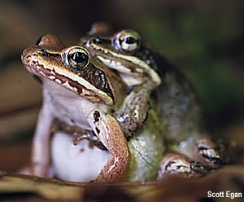
Amphibian reproduction
Amplexus – reproductive process of frogs involving external fertilization
Advantages
eggs and sperm mixed together better, higher % of eggs get fertilized

Slide 23
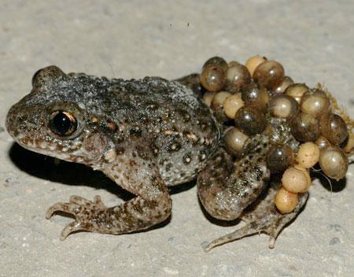
Parental care
Many lay their eggs and leave the young to fend for themselves, but others protect them.
Male midwife toads carry their eggs around their back legs until they hatch

Slide 24
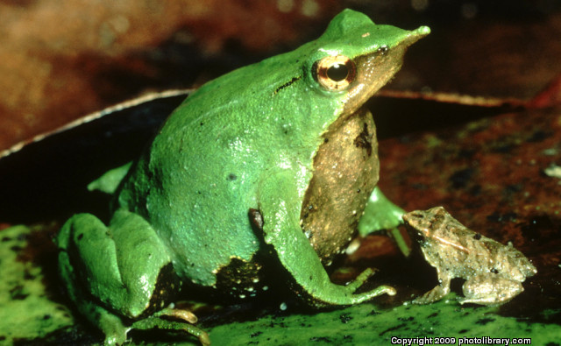
The male Darwin’s frog swallows his tadpoles in his vocal sac for protection. When they become froglets, he spits them out.

Slide 25
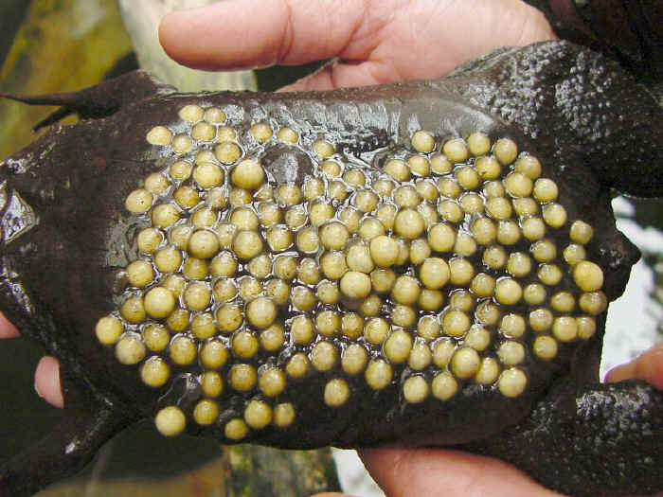
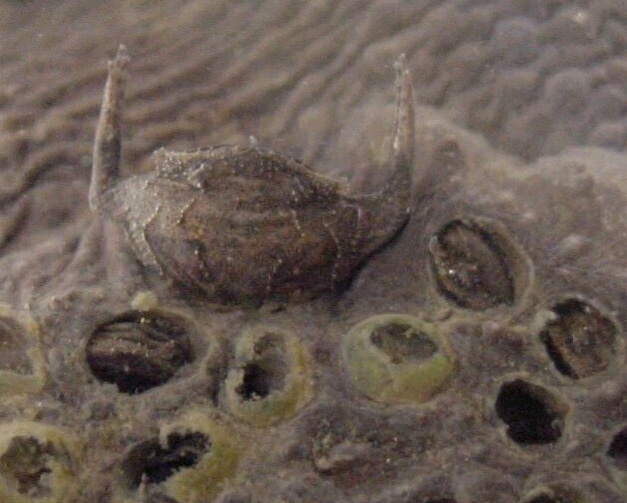
The surinam toad’s eggs are placed on the female’s back. Her skin swells around them until they are almost covered. The young develop into toadlets under the skin and hatch out of her back

Slide 26
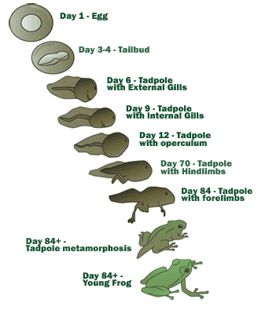
Amphibian metamorphosis
Change in body form controlled by hormones

Slide 27
Hibernation
Period of dormancy when it’s too cold

Slide 28
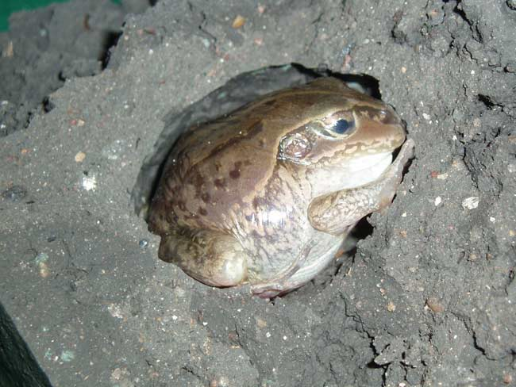
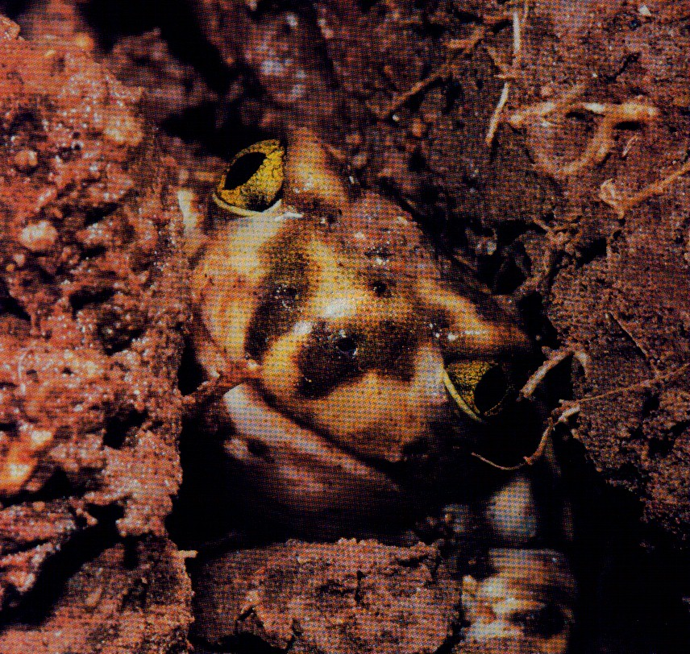
Estivation
Period of dormancy when it’s too hot or dry

Slide 29
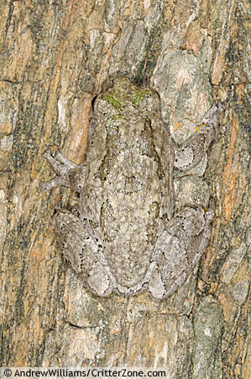
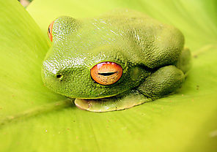
Amphibian defenses
Camouflage - common colors are green or brown

Slide 30
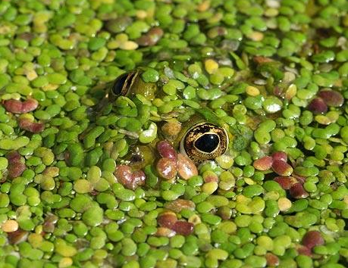
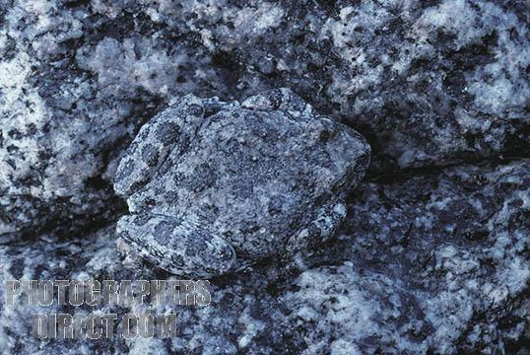
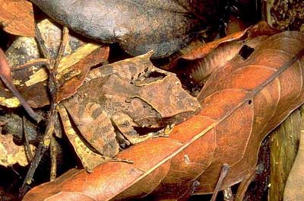
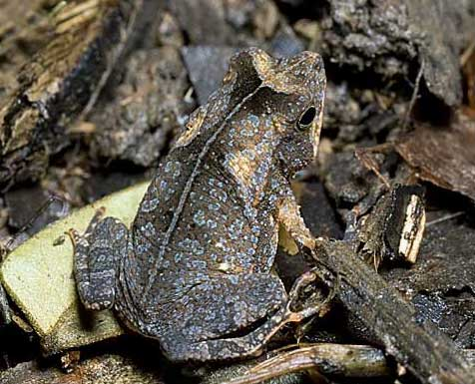

Slide 31
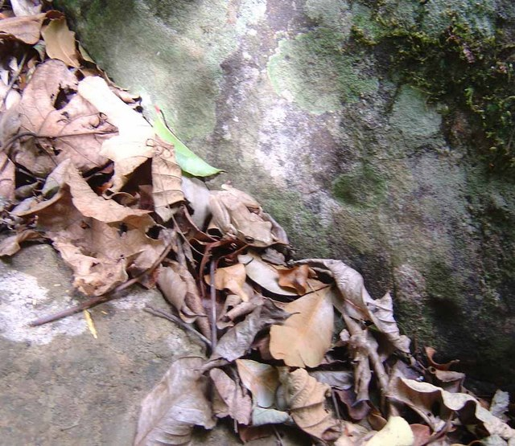

Slide 32
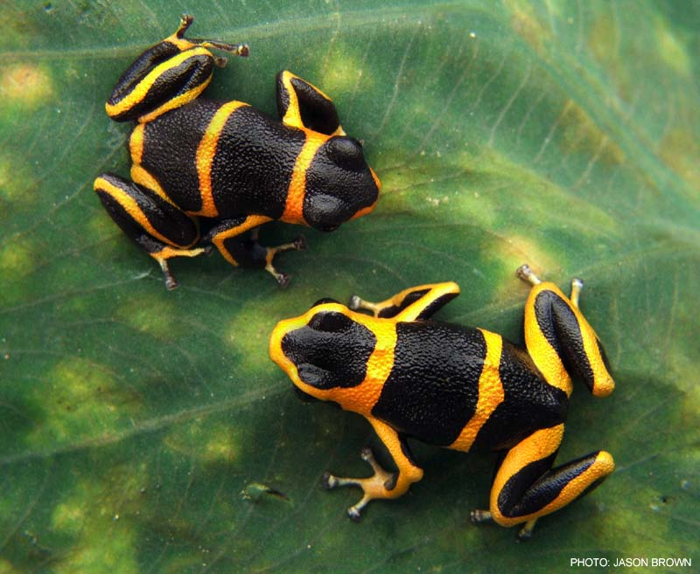
Amphibian defenses
mimicry
Imposter

Slide 33
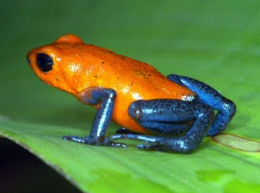
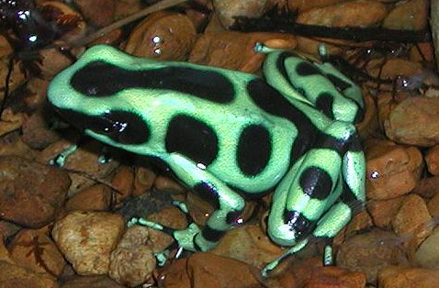
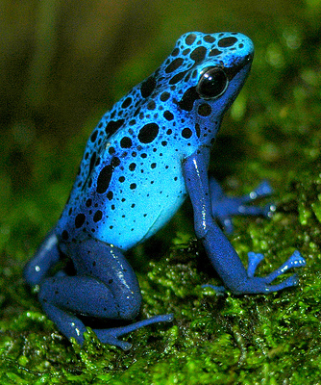
Amphibian defenses
Poisonous mucus

Slide 34
Amphibian defenses
Hop or jump

Slide 35
Amphibian defenses
slippery

Slide 36
Orders of Amphibia
Anura
Caudata
Apoda

Slide 37
Anura – no tails as adults, jumping hind legs
Examples: frogs and toads

Slide 38
Difference between frogs and toads
Frogs have long legs for jumping, toads have shorter legs for hopping

Slide 39
Frogs have moist smooth skin,
toads have drier bumpy skin

Slide 40
Frog or Toad?

Slide 41
Frog or Toad?

Slide 42
Frog or Toad?

Slide 43
Frog or Toad?

Slide 44
Caudata – have tails as adults, all 4 legs about the same size
Examples: salamanders, newts

Slide 45
Giant Chinese Salamander

Slide 46
Salamanders in Idaho
Western long-toed salamander
Blotched tiger salamander

Slide 47
Apoda – no feet (legs)
Examples: caecilians

Slide 49
Indicator species
Very sensitive to changes in the environment, thin skin absorbs any chemicals in the water or air

