Slide 1
Cell Division

Slide 2
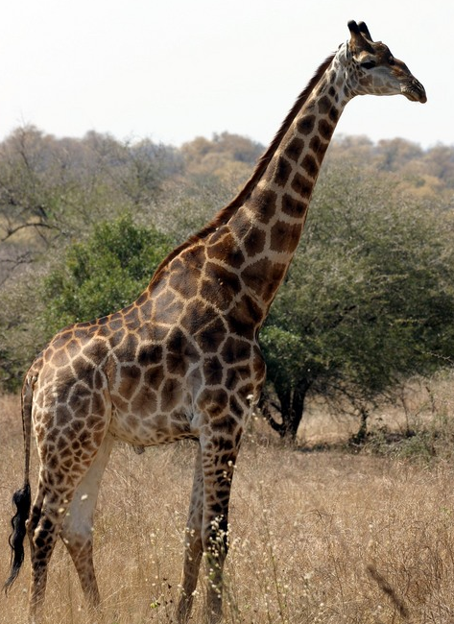
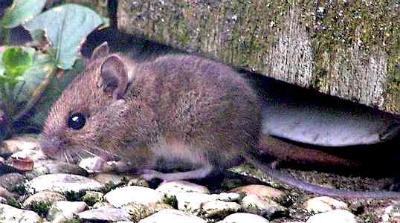
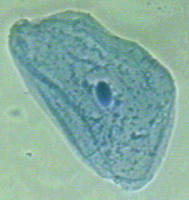
Who’s cells are larger?

Slide 3
One of the most important factors affecting cell size…
Cell membrane size – a cell must have a membrane surface large enough for all the needed exchanges (food and waste) to take place
As cells increase in size, their need for nutrients increases, as does their production of wastes

Slide 4
Calculating Surface Area to Volume Ratio
Surface area = 6 x height x width
Volume = height x width x depth
1
4
1
1
1
1
1
4
1
4
1
1
1
1

Slide 5
Cell membrane size
Small cells have larger surface area to volume ratios
Large cells have smaller surface area to volume ratios

Slide 6
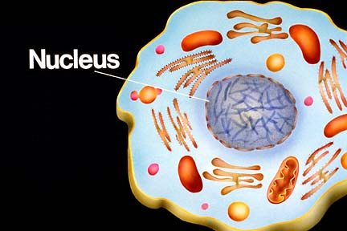
Also limits cell size…
Nuclear control – can control only a limited amount of active cytoplasm

Slide 7
Reasons for cell division
When a cell reaches its maximum size, the nucleus initiates cell division.
Cell division is important for:
- Growth
- Repair
- Reproduction

Slide 8
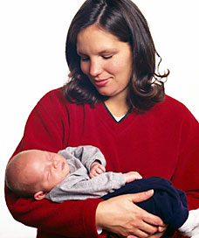
Growth
The bigger you are, the more cells you have

Slide 9
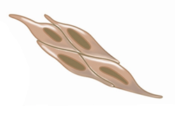
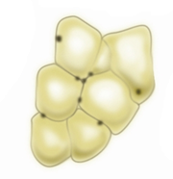
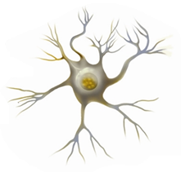
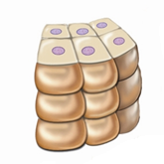
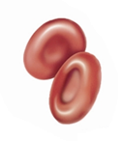
Growth
Differentiation – developing into specialized shapes and functions
Muscle cells
Fat cells
Nerve cell
Red blood cells
Skin cells

Slide 10
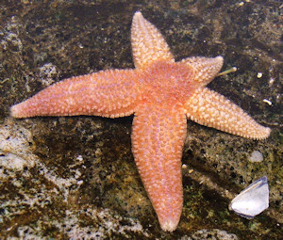
Repair
Regeneration – replacing a missing body part (starfish)

Slide 11
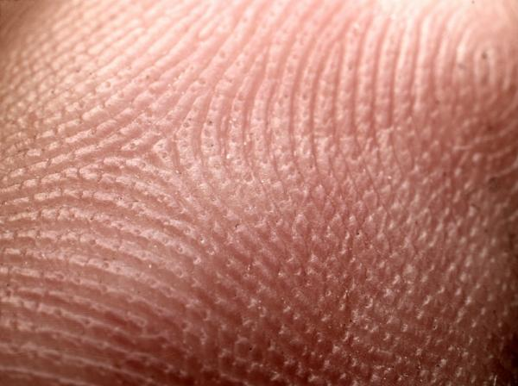
Repair
Regeneration to the extent seen in starfish is not possible in humans. However, cell division is responsible for repairs that your body requires – mending of skin, blood vessels, and bone if they are injured. Regeneration also replaces cells that die.
Skin cells are replaced by regeneration every 28 days

Slide 12
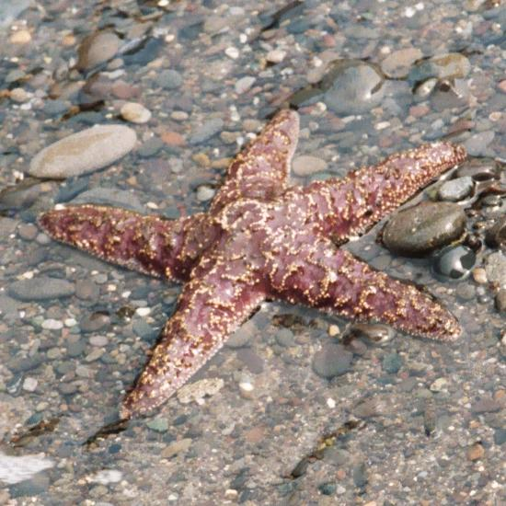
Reproduction
Asexual reproduction – offspring is produced by only one parent

Slide 13
Asexual reproduction
Genetically identical to parent
No variation in genes

Slide 14
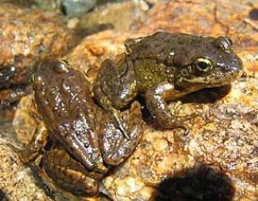
Reproduction
Sexual reproduction – offspring is produced from two parents

Slide 15
Sexual reproduction
Combination of genetic material
Variation in genes

Slide 16
The Cell Cycle
Interphase
Cell Division
Mitosis (nuclear division)
Cytokinesis (cytoplasm division)

Slide 17
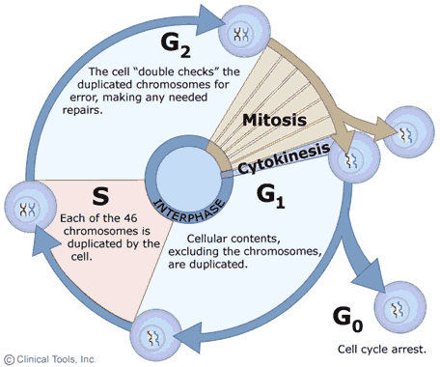
Interphase – phase of growth and preparation – 90% of total time

Slide 18
Interphase
G1 – first growth stage
S – synthesis stage – chromosomes are copied
G2 – second growth stage – other organelles are copied

Slide 19
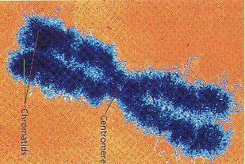
Chromosomes
Chromatin – thin, fibrous form of DNA and proteins that make up a chromosome
Sister chromatids – two identical structures that result from chromosome replication
Centromere – the point where sister chromatids are joined together

Slide 20
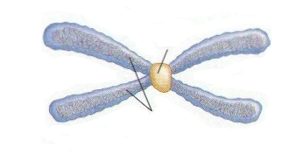
Chromosome
centromere
chromatid

