Slide 1
The Nature of Chemical Bonds

Slide 2
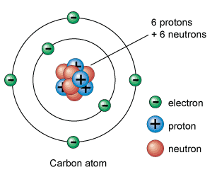
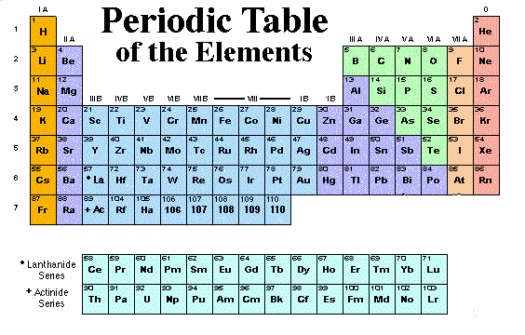
Atomic Structure and Organization of the Periodic Table
Elements and the atoms that make them up are most often found in nature as combinations

Slide 3
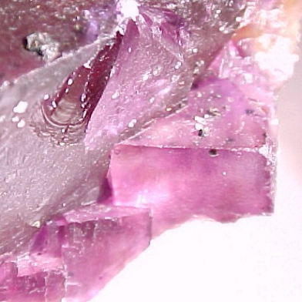
Calcium fluoride is made up of calcium and fluorine ions which are held together by strong chemical bonds, giving it a high melting point
Calcium fluoride occurs naturally as the mineral fluorite in drinking water of some communities where it is a good source of the teeth-strengthening fluorine ion

Slide 4
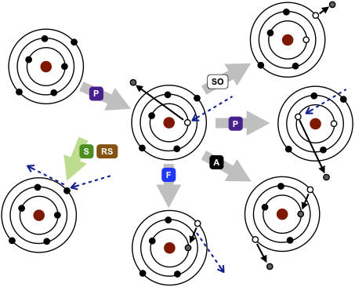
“Ecology” of atoms
interactions

Slide 5
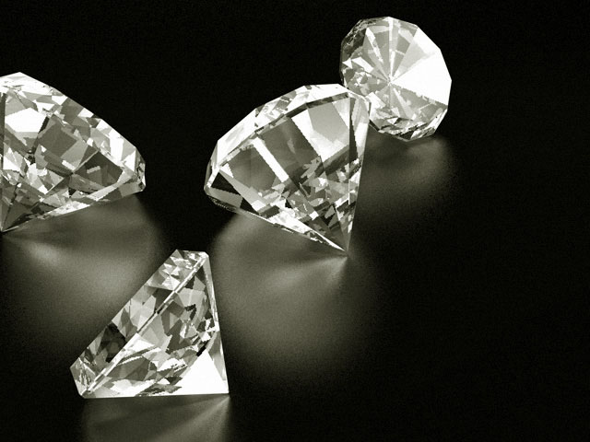
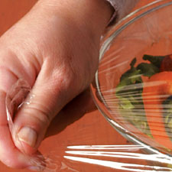
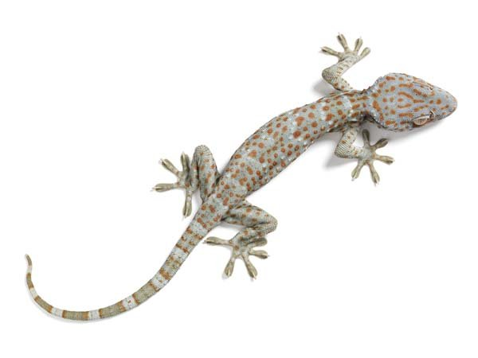
Atom Interactions explain…
Hardness of diamonds
Clinginess of plastic wrap
Gecko’s ability to walk on walls
Spherical shape of water drops

Slide 6
Review
How would you draw an atom?

Slide 7
Review
What is the shell model of the atom?

Slide 8
Putting Electrons in Their Shells

Slide 9
Putting Electrons in Their Shells
Helium
Oxygen
Chlorine

Slide 10
Valence Electrons?
Electrons in the outer most shell that are responsible for chemical bonding

Slide 11
REMEMBER…
This whole unit is on chemical bonding so it is really important to keep track of the valence electrons

Slide 12
To make it easier… Electron Dot Structure
Map out only the valence electrons

Slide 13
Electron Dot Structure
Chlorine
Silver

Slide 14
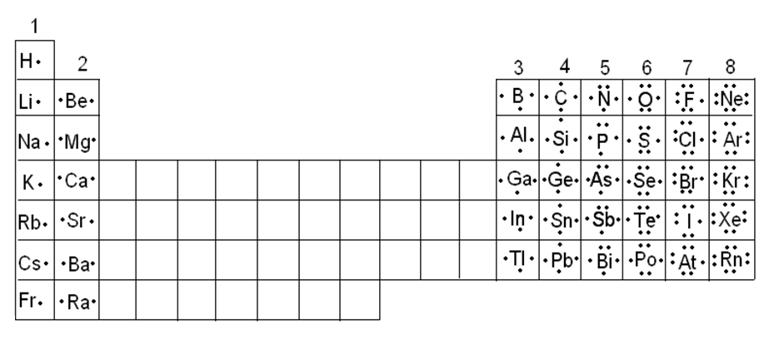
Periodic Trends

Slide 15
Electron Dot Structure Tells You 2 Important Things
How many valence electrons it has
How many of these are paired
Cl C

Slide 16
Paired Valence Electrons
Stable and resistant to change
Usually do not form bonds with other atoms
Cl

Slide 17
Unpaired Valence Electrons
Unstable and want to be stable
Quickly form bonds with other atoms
Cl

Slide 18
Ultimate Goal
To Be STABLE! Have the entire outer shell filled and paired up
Xe

Slide 19
Filling the Valence Shell
Share or Transfer electrons with other atoms through bonding
Ionic Bonds
Covalent Bonds
Metallic Bonds

Slide 20
Noble Gases
Chemically nonreactive, almost never bond with other atoms
WHY?

Slide 21
Octet Rule
Atoms tend to gain, lose, or share electrons to have a filled outer valence shell

Slide 22
Periodic Trends
What stability trends do you see as you move across the Periodic Table?

Slide 23
Chemical Bonding Behavior of Sodium
Has 1 valence electron
Has to either lose 1 or gain 7

Slide 24
Questions?
How many electrons must element 8 gain or lose to get an electron configuration similar to a noble gas?

Slide 25
Groups 1-3 will give up electrons
Groups 5-7 will gain electrons
Group 4 will do either

