Slide 1
ECOLOGY

Slide 2
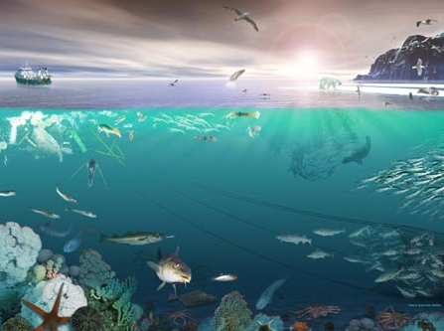
Ecology – interaction between living and non-living things

Slide 3
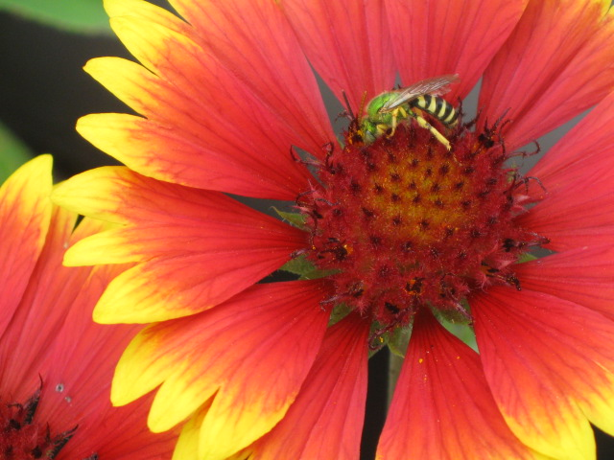
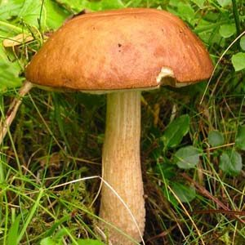
Living Things – known as biotic
Animals
Plants
Fungi
Bacteria

Slide 4
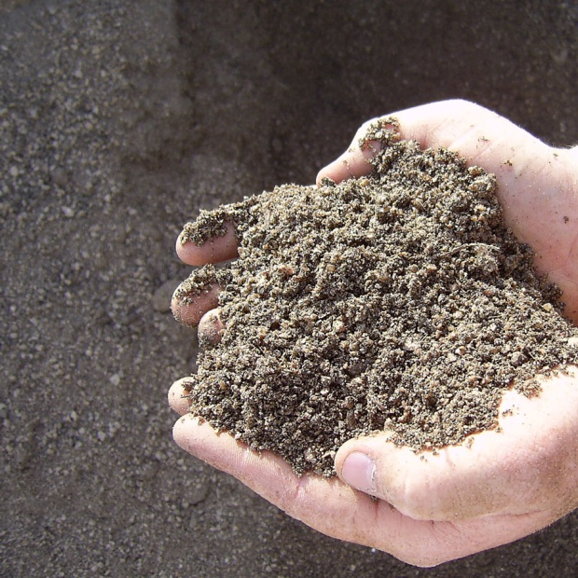
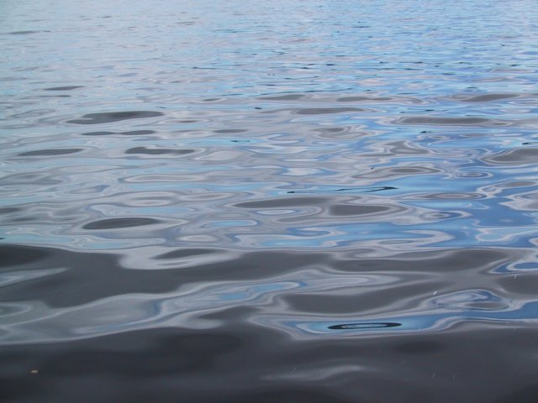
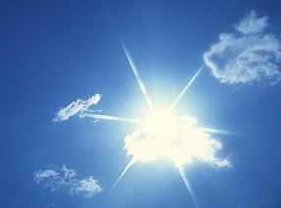
Non-living Things – known as abiotic
Water
Soil
Rocks
Light
Temperature

Slide 5
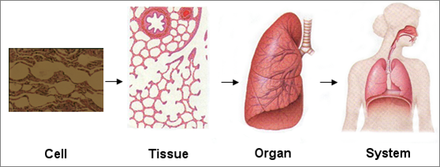
Levels of Organization
What is the smallest unit of living things?

Slide 6
5 levels of environmental organization:
Cells Organism
Tissues Population
Organs Community
Systems Ecosystem
Organism Biosphere

Slide 7
Organism
an individual from a species

Slide 8
Population
Members of a single species that live in one area

Slide 9
Community
all the different populations of species that interact in the same area.

Slide 10
Ecosystem
a community of organisms and their non-living environment

Slide 11
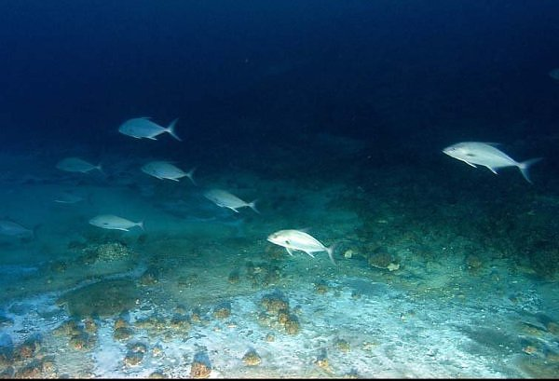
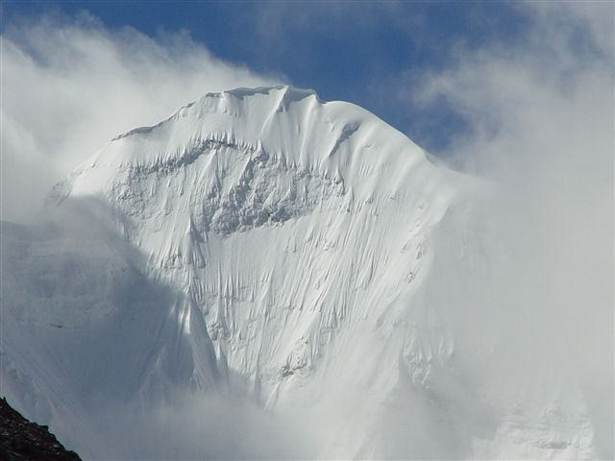
Biosphere
all the ecosystems, the part of Earth where life exists.
Darkest depths of the ocean floor to about 8 km into the atmosphere

Slide 12
5 levels of environmental organization:
Organism
Population
Community
Ecosystem
Biosphere
Notes:
Biospheres are made of what? Ecosystems are made of what? Communities are made of what?... Which is larger, a population or a community?...

Slide 13
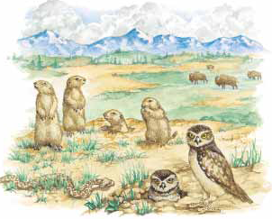
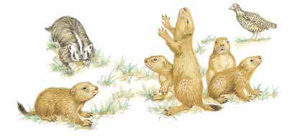
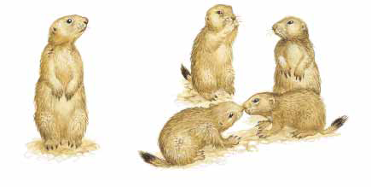
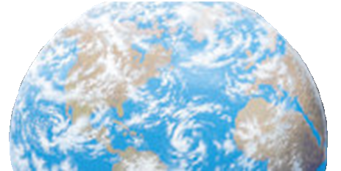
What level is it?
Ecosystem
Community
Biosphere
Population
Organism

Slide 14
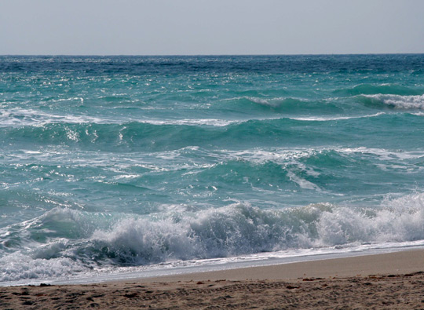
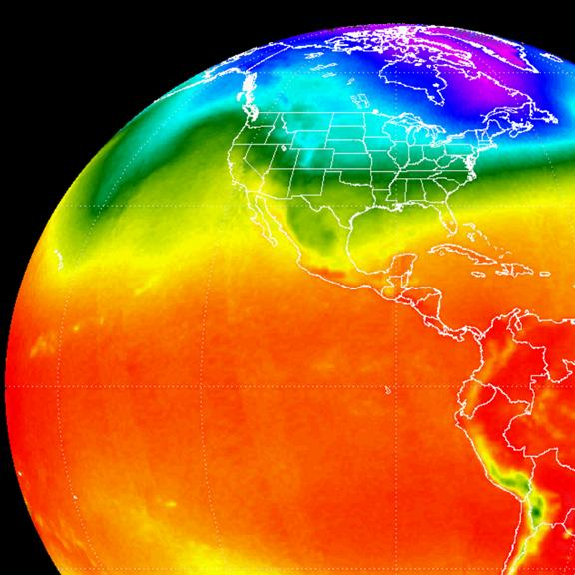
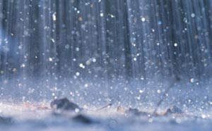
Forces that Shape Life
Wind
Sunlight
Precipitation
Temperature

Slide 15
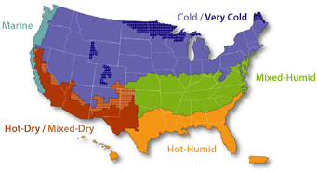
Climate – typical weather pattern of an area over time
How is climate different than weather?

Slide 16
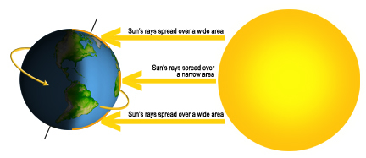
What causes different climates?
Because the Earth is curved, radiation from the sun hits the Earth at different angles which changes the temperature of the area

Slide 17
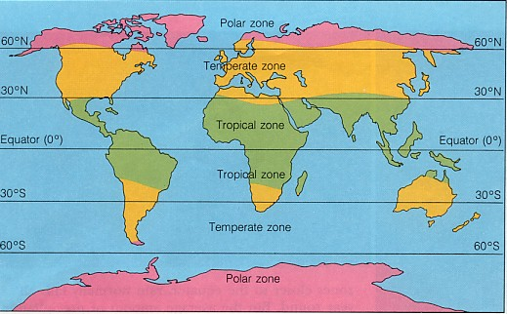
3 Main Climate Zones

Slide 18
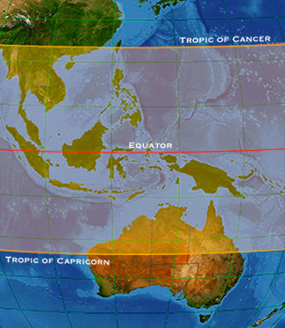
Tropical Zone
Covers about 30° N and S of the Equator
Hot temperatures, very little change with seasons

Slide 19
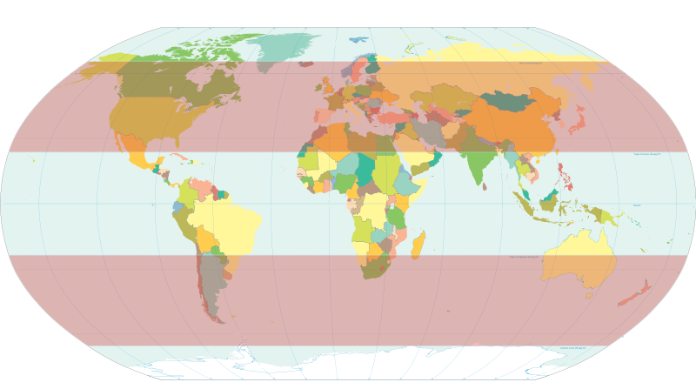
Temperate Zone
Covers 30-60°N and S latitudes
Cooler temperatures, change with seasons
We live here!

Slide 20
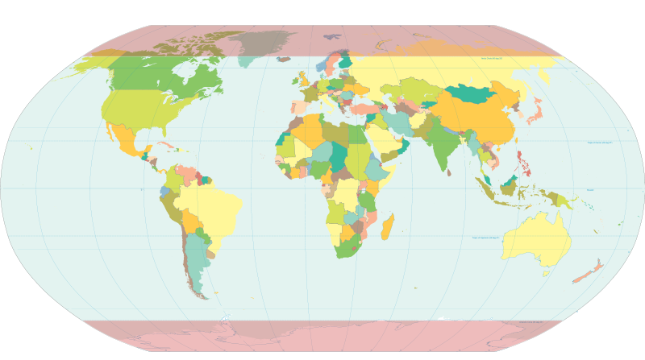
Arctic Zone
Covers 60° N and S and beyond, North and South poles
Very cold temperatures, not much change with seasons

Slide 21
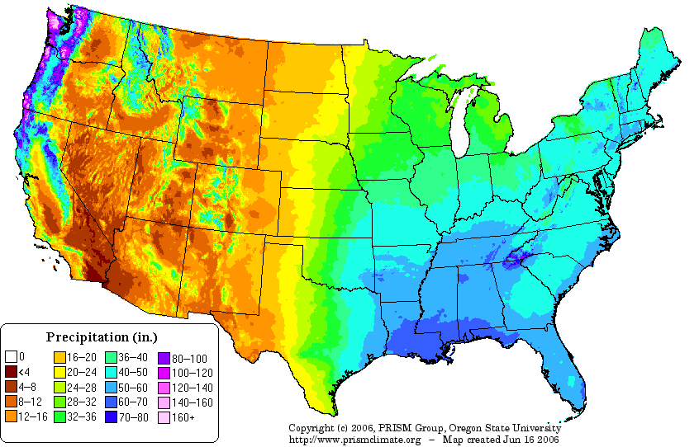
Closer to home!
Most of the US is in the same temperate zone, so shouldn’t it be the same?

Slide 22
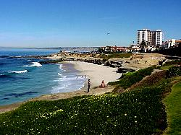
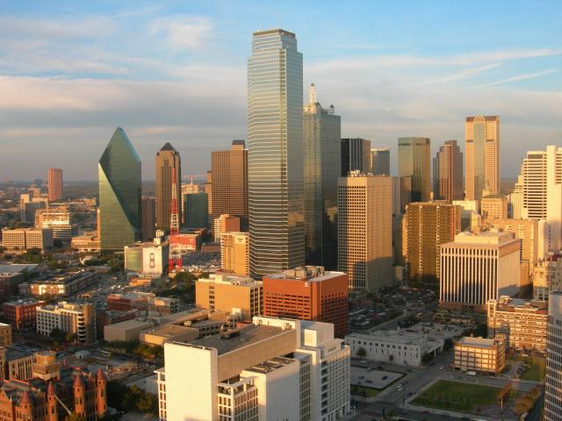
Things that affect regional climates
Distance to nearest body of water
- breezes from an ocean or lake create cooler summers and milder winters
San Diego
Dallas

Slide 23
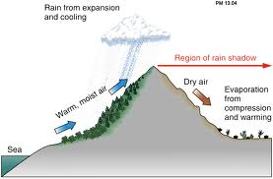
Things that affect regional climates
2. Mountain ranges
- rain shadow – lack of rainfall on one side of a mountain

Slide 24
Things that affect regional climates
3. Altitude
- as you increase in altitude, the temperature decreases

