Slide 1
ENERGY

Slide 2
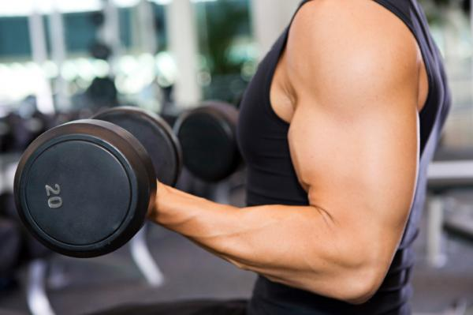
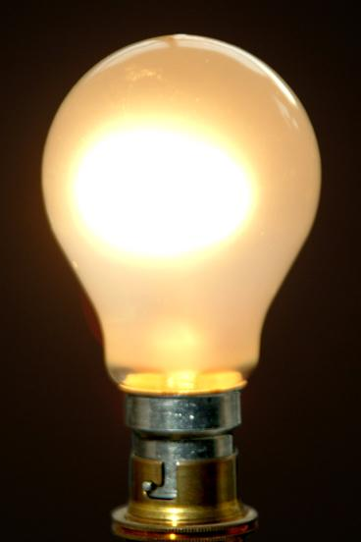
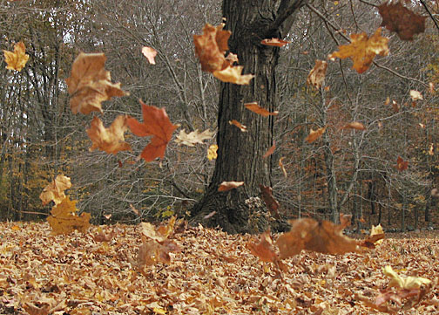
Every change that occurs involves ENERGY!

Slide 3
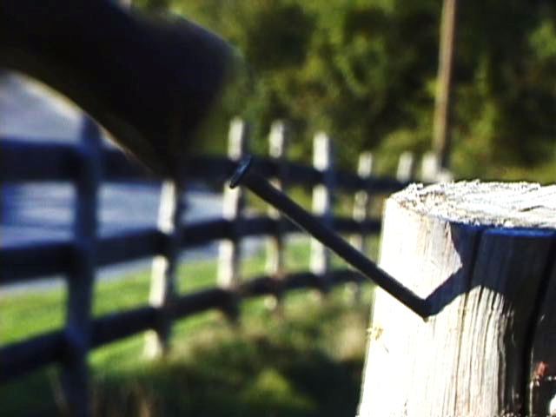
What is Energy?
The ability to cause change

Slide 4
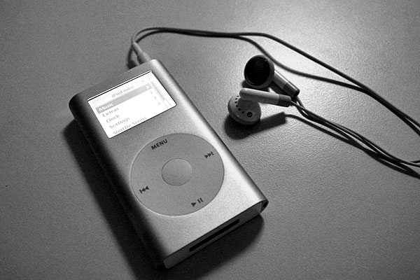
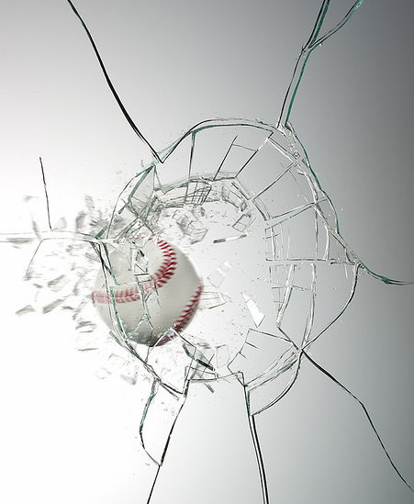
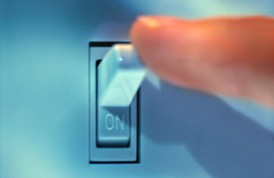
How is the energy different?
Turn on ipod and sound comes through headphones
Turn on light and a dark room becomes bright

Slide 5
Forms of Energy Include:
Electrical
Chemical
Radiant

Slide 6
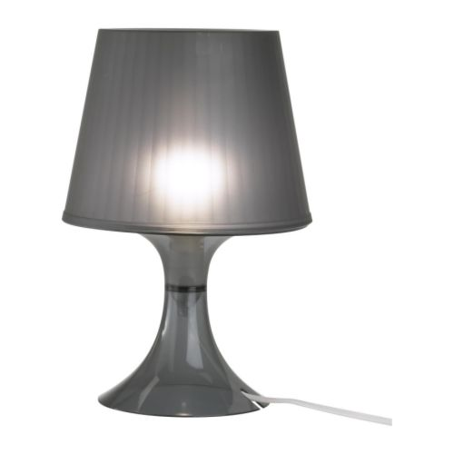
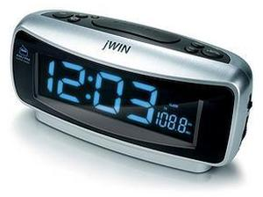
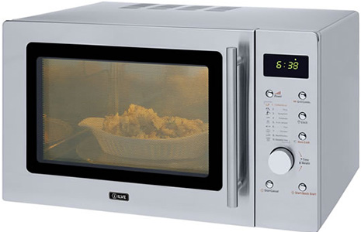
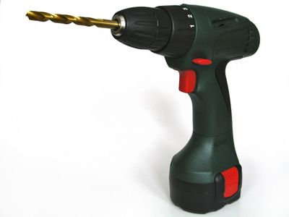
Electrical

Slide 7
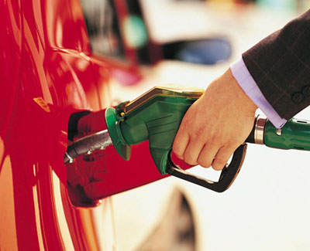
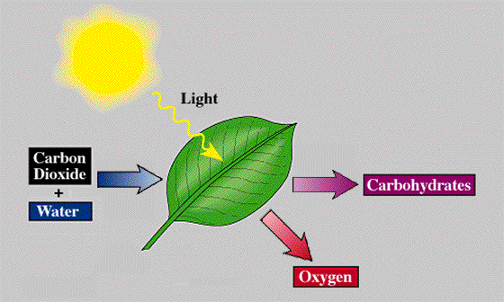
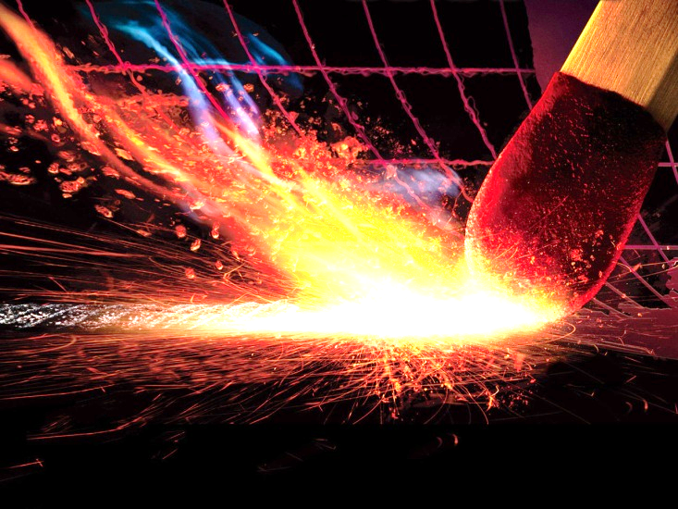
Chemical

Slide 8
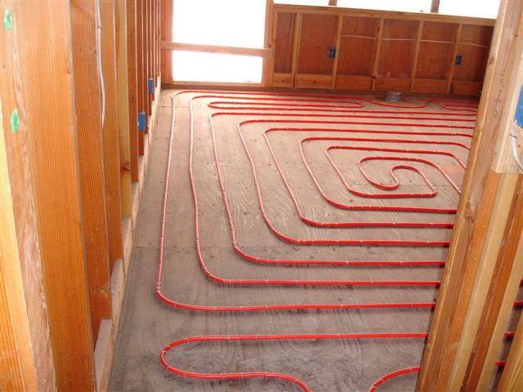
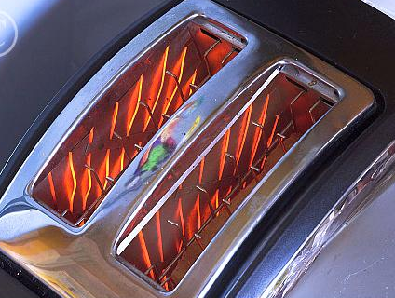
Radiant
Thermal and Light

Slide 9
Energy is Like Money… How?

Slide 10
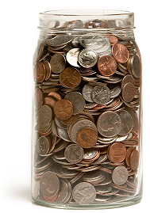
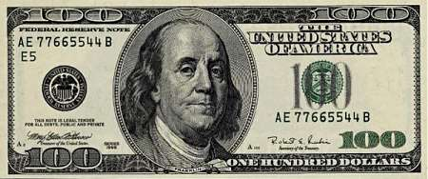
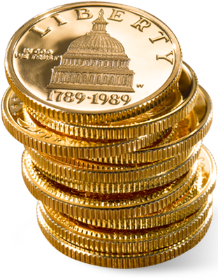
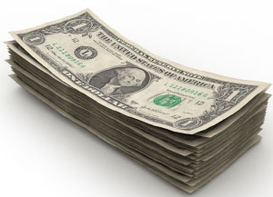
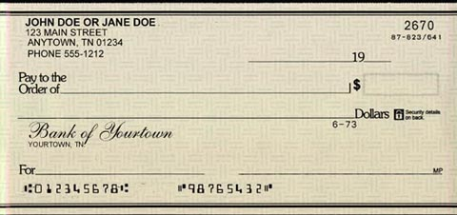
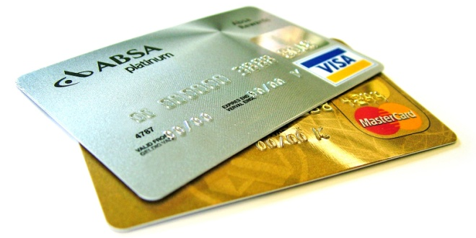
You have $100
You can store it or transfer it in a variety of different forms, but it is still money

Slide 11
Usually when you think of energy, you think of action – or some sort of motion taking place

Slide 12
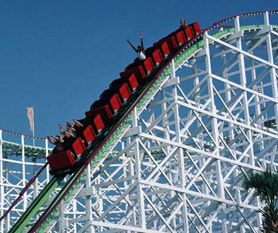
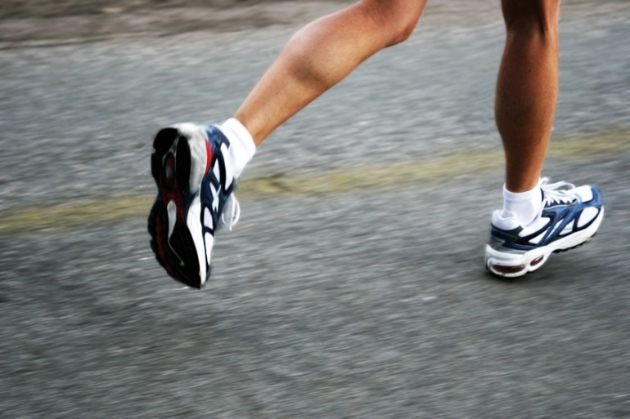
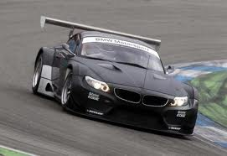
Kinetic energy
Energy in motion

Slide 13
Kinetic Energy depends on two things:
An object’s mass and velocity

Slide 14
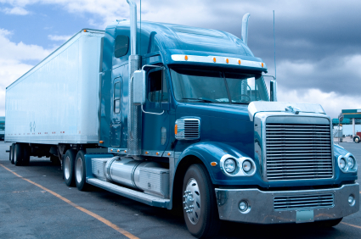
The greater the mass or velocity, the greater the kinetic energy

Slide 15
Calculating Kinetic Energy
Kinetic Energy = ½ mass X velocity²
kg m/s²

Slide 16
Energy is measured in units called Joules (J)
Named after James Prescott Joule who discovered in 1842 the amount of work it took to produce a unit of heat. He decided that heat is a form of energy and energy comes in different forms. In his honor, the unit for energy was named joule.

Slide 17
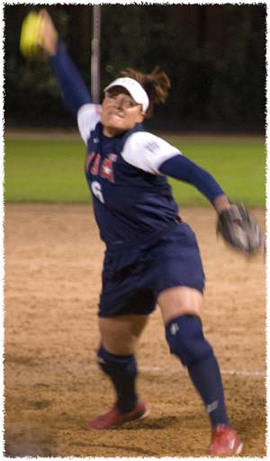
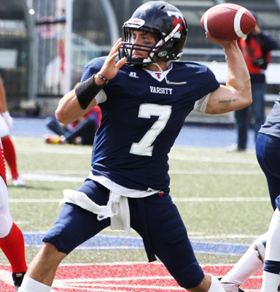
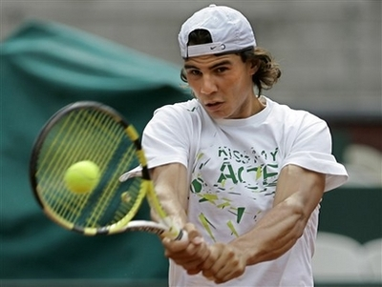
How much is a joule?
The amount of energy required to lift an apple one meter
Serve of a tennis ball 75 J
Forward pass 150 J
Fastball pitch 120 J

Slide 18
Practice
How much kinetic energy does an object have if its mass is 2.08 kg and its moving at a constant speed of 5.51 m/s?
Kinetic Energy = ½ mass X velocity²

Slide 19
Which has a bigger effect on Kinetic Energy…Mass or Velocity?
What is the Kinetic Energy (in Joules) of an object with a mass of 10 kg and a velocity of 10 m/s?

Slide 20
Mass
When mass is doubled, Kinetic Energy is doubled

Slide 21
Velocity (speed)
When velocity is doubled; Kinetic Energy is quadrupled!!

Slide 22
Kinetic Energy = ½ mass X velocity²
A large truck has more kinetic energy than a motorcycle moving at the same speed. But speed is squared, so speed has a greater effect on kinetic energy than mass does.

Slide 23
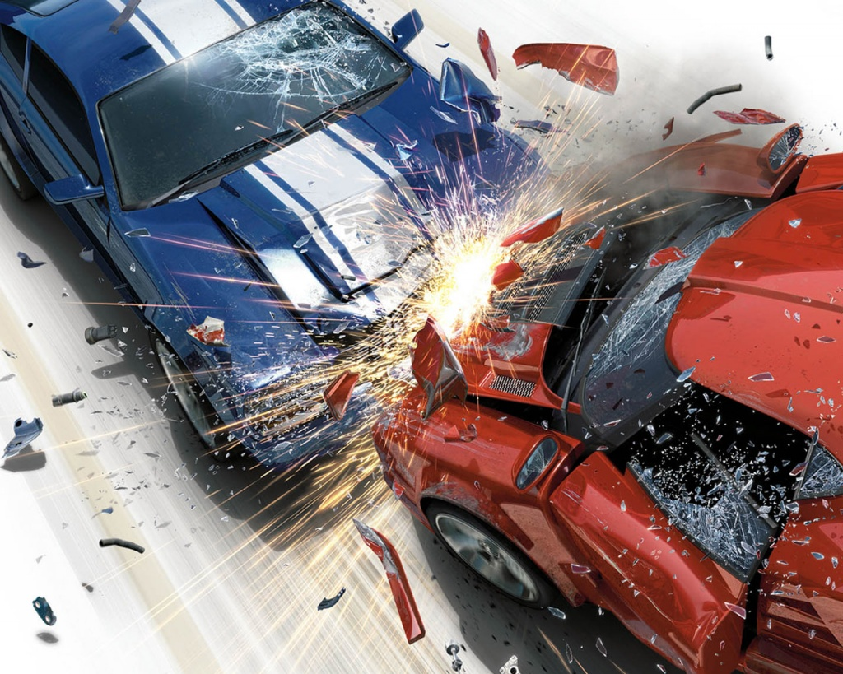
Car crashes…
More dangerous at higher speeds than at lower speeds. A moving car has 4 times the kinetic energy of the same car going half the speed. It is going twice the speed and speed is squared to make 4.

Slide 24
Smart car crash test

Slide 25
Practice
KE = ½ mv²
What is the kinetic energy of a car with a mass of 500 kg and a speed of 5 m/s?
What is the mass of an object with a speed of 30 m/s and a kinetic energy of 400 J?

Slide 26
Assignment!
Worksheet practicing Kinetic Energy

