Slide 1
Human Anatomy and Physiology

Slide 2
1. Anatomy - study of the structures and parts of the body
2. Physiology – study of how the body and its parts work or function

Slide 3
Form follows function
3. What a structure can do depends on its specific form

Slide 4
Levels of Organization
4. Life can be broken down into physical and chemical levels. We will discuss seven different levels

Slide 5
ATOMS
ATOMS →
A. Atoms- considered part of the chemical level. (e.g. C, H, O, N)

Slide 6
MOLECULES
→ MOLECULES →
B. molecules- One or more atoms. Also known as the chemical level. (e.g. H₂0 CO₂)

Slide 7
CELL
→ CELL →
C. Cells- The smallest living unit in the human body (e.g. cyto-, -cyte)

Slide 8
TISSUE
→ TISSUE →
D. Tissues- A collection of cells that perform a specific function.
(e.g. muscle)

Slide 9
ORGAN
→ ORGAN →
E. Organs- Combination of tissues that perform complex functions. (e.g. heart, liver)

Slide 10
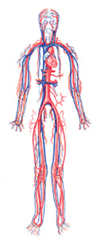
SYSTEMS
→ SYSTEM →
F. Organ Systems- A group of organs that work together to perform one or more functions. (e.g. Nervous system, digestive)

Slide 11
ORGANISM
→ ORGANISM
G. Organism- Human being. All systems work together. (e.g. you)

Slide 12
Review
Atom → Molecule →
Cell → Tissue →
Organ → System →
Organism

Slide 13
Levels of Structural Organization
Smooth muscle cell
Molecules
2
Cellular level Cells are made up of molecules
Atoms
1
Chemical level Atoms combine to form molecules
Smooth muscle tissue
Tissue level Tissues consist of similar types of cells
Heart
3
Cardiovascular system
Blood vessels
Epithelial tissue
Smooth muscle tissue
Blood vessel (organ)
6
Organismal level The human organism is made up of many organ systems
Connective tissue
4
Organ level Organs are made up of different types of tissues
Organ system level Organ systems consist of different organs that work together closely
5

Slide 14
Terminology

Slide 15
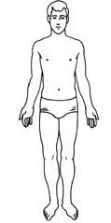
Anatomical Position
A. Anatomical Position- standing erect, face forward, arms at side, palms facing forward

Slide 16
Body Terminology
B. Superior – higher than or above
C. Inferior – lower than or below
Superior
Inferior

Slide 17
Superior or Inferior?
The nose is ________________ to the mouth.
The chin is ________________ to the forehead.
The shoulder is ______________ to the hip.
The neck is _________________ to the chest.
The foot is _________________ to the knee.
The waist is _________________ to the eyes.

Slide 18
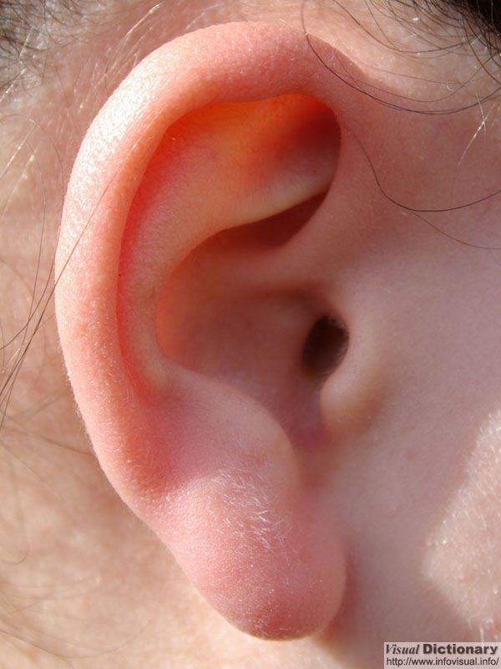
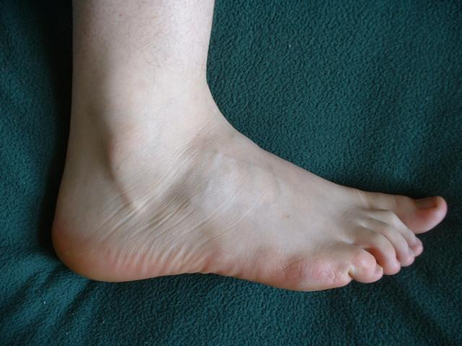
Superior or Inferior?
C
D
A
B

Slide 19
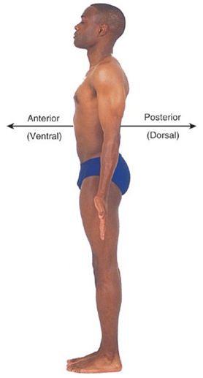
Body Terminology
D. Anterior or ventral – toward the front
E. Posterior or dorsal – toward the back

Slide 20
Anterior or Posterior?
Your facial features are on which side of your head?
Your spine is found on which side of your body?
Your fingernails are on which side of the body?
Your eyes are ____________ to your ears.

Slide 21
Body Terminology
F. Proximal – nearer to the point of origin
G. Distal – further from point of origin
Points of origin

Slide 22
Proximal or Distal?
The fingers are ___________ to the palm.
The knee is _____________ to the calf.
The thigh is _____________ to the knee.
The elbow is _____________ to the hand.
The toes are ______________ to the ankle.
The shoulder is _____________ to the elbow.

Slide 23
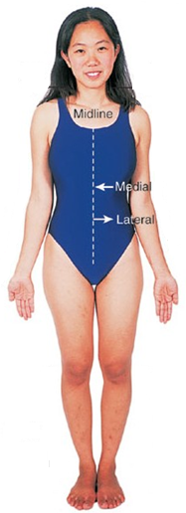
Body Terminology
H. Medial – toward the midline of the body
I. Lateral – away from the midline of the body

Slide 24
Medial or Lateral?
The arms are __________ to the chest
The ears are __________ to the eyes
The eyes are __________ to the nose
The heart is __________ to the lungs

Slide 25
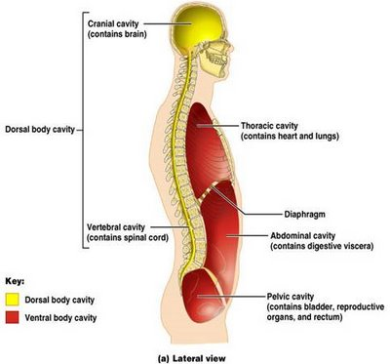
Body Cavities
Dorsal
Ventral

Slide 26
Dorsal Cavities
a. Cranial – contains brain

Slide 27
Dorsal Cavities
b. Vertebral (spinal) –contains spinal cord

Slide 28
Ventral Cavities
a. Thoracic cavity – chest area

Slide 29
Thoracic cavity
Pleural cavities – each contains a lung
Mediastium – trachea, esophagus,…
Pericardial cavity – encloses the heart

Slide 30
Diaphragm
b. Thin layer of muscle used in breathing that separates the Thoracic and Abdomiopelvic cavities

Slide 31
Abdominopelvic Cavity
Abdominal Cavity – contains the stomach, intestines, spleen, liver…
Pelvic Cavity – contains the bladder, reproductive organs, and rectum

Slide 32
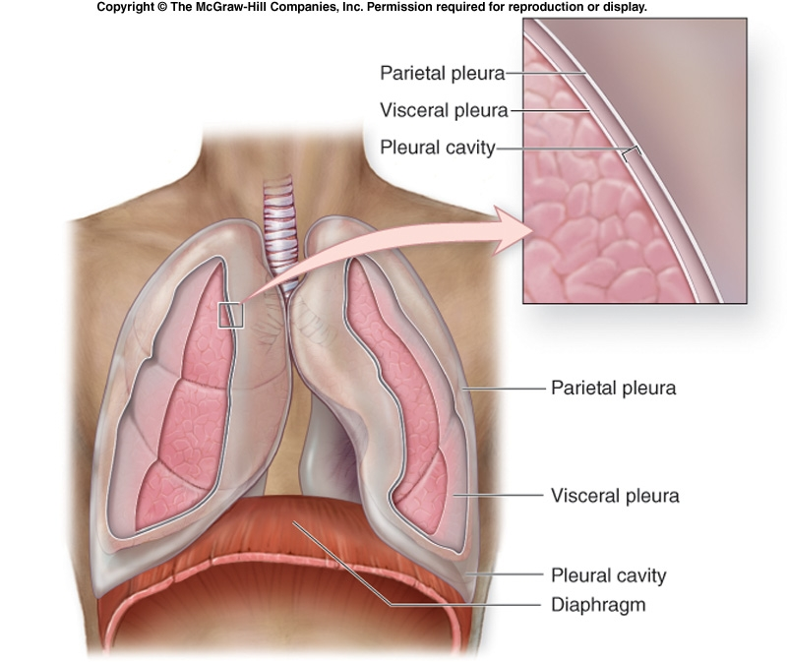
A double membrane lines the organs in the cavities and separates them from other cavities

Slide 33
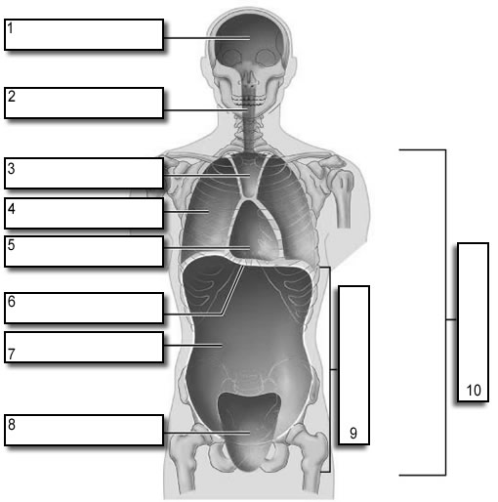
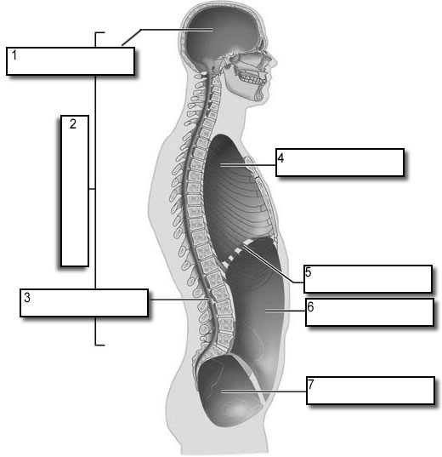
Body Cavities

