Slide 1
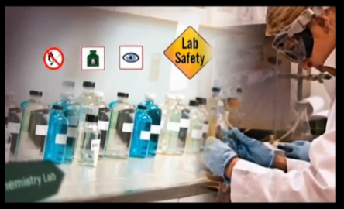
LAB SAFETY

Slide 2
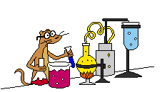
Chemistry is a HANDS ON laboratory class.

Slide 3

Safety in the LAB is the #1 priority for teachers, students, and parents.

Slide 4
To ensure a safe lab, a list of rules has been developed and provided to you in this Student Safety Code of CONDUCT (SSCC).

Slide 5

The SSCC must be signed by both you and your parent or guardian BEFORE you may PARTICIPATE in the lab to earn credit.

Slide 6
This SSCC is to be kept in your BINDER and brought to class daily as a constant reminder of the lab safety rules.

Slide 7

This SSCC will be turned in at the end of the year for points in the FINAL notebook.

Slide 8

Student Safety Code of Conduct

Slide 9
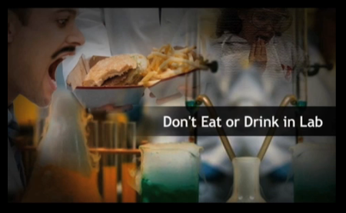
Do NOT eat, drink, chew GUM or apply MAKE UP in the lab.

Slide 10

When first entering the LAB, do NOT touch any equipment or materials until INSTRUCTED to do so.

Slide 11
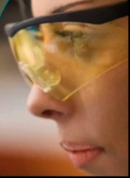
ALL students will wear safety GOGGLES whenever you are working with chemicals, heat, or any substance that might get into your eyes.

Slide 12

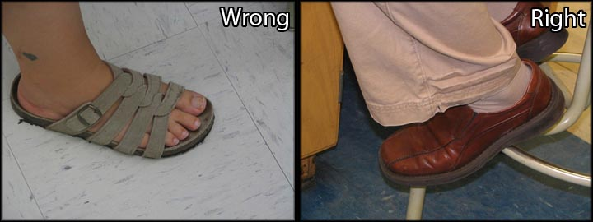
Dress appropriately. Hair must be TIED BACK and loose jewelry REMOVED. SANDALS will not protect the feet are not allowed in the lab.
Hairspray is flammable!

Slide 13

Know the locations and PROCEDURES for all lab safety equipment including: first aid kit, FIRE BLANKET, fire extinguisher, eye wash station, and SHOWER.

Slide 14
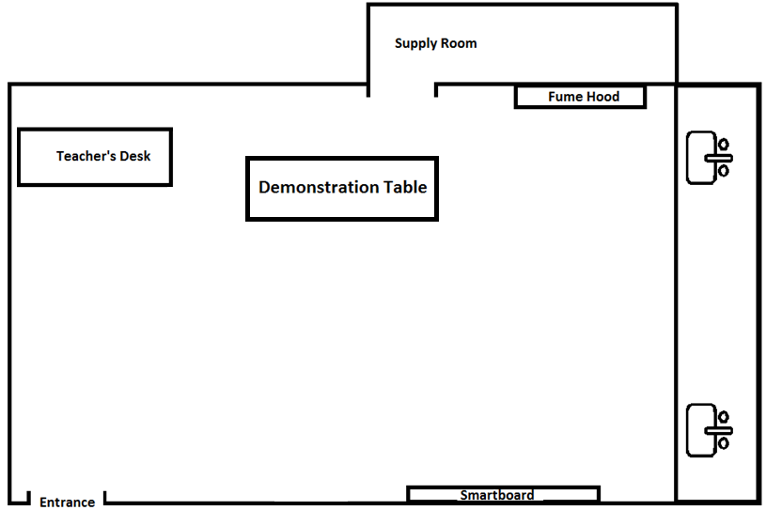
Lab Room

Slide 15

Conduct yourself in a RESPONSIBLE manner at all times in the lab.

Slide 16

Horseplay, pranks, and other acts of mischief are DANGEROUS and consequently prohibited.

Slide 17
Lab stations and TABLES need to be kept clean at ALL times. Bags and purses will be left in the CLASSROOM before coming to the lab.
Even if you aren't clumsy, someone else in the lab probably is.

Slide 18
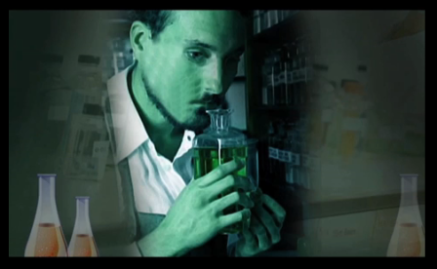
Do NOT TASTE or directly sniff chemicals.
This is not a cooking class – don’t taste your experiments!

Slide 19
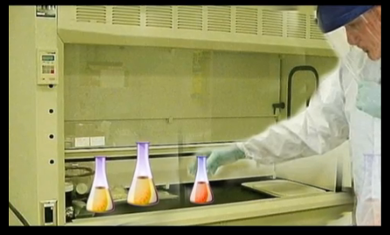
For many chemicals, if you can smell them then you are exposing yourself to a dose that can harm you! If the safety information says that a chemical should only be used inside a fume hood, then don't use it anywhere else.
Fume Hood

Slide 20

Make sure you grab the correct chemicals. Read labels TWICE.

Slide 21

NEVER return excess chemicals to the ORIGINAL bottle. You can always get MORE but any extra is wasted.
Only grab what you need!

Slide 22
Carefully follow ALL instructions – both written and VERBAL. If you do not understand a direction, part of a procedure, or how to use a piece of equipment, ASK the instructor BEFORE proceeding.

Slide 23

Perform ONLY those experiments authorized by the INSTRUCTOR. NEVER do anything not called for in the lab PROCEDURES or by the instructor.

Slide 24
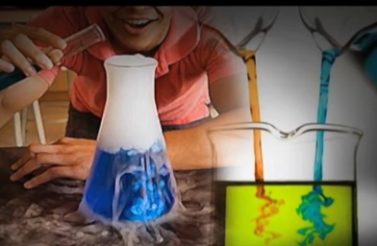
Pay attention to the order in which chemicals are to be added to each other and do not deviate from the instructions. Even chemicals that mix to produce seemingly safe products should be handled carefully.
hydrochloric acid and sodium hydroxide will give you salt water, but the reaction could break your glassware or splash the reactants onto you if you aren't careful!

Slide 25

NEVER work alone. Students are assigned lab PARTNERS for each lab. No student may work in the lab without an INSTRUCTOR present.

Slide 26
Experiments must be personally monitored at all times. Do NOT WANDER around the room, distract other students, or interfere with the lab experiments of others.

Slide 27

Examine glassware before each use. NEVER use chipped or CRACKED glassware.

Slide 28
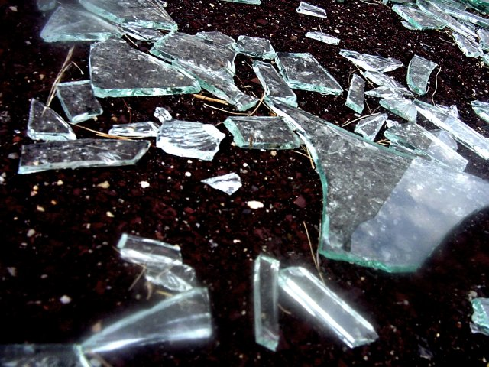
Do NOT handle BROKEN glass with your bare hands. Advise your instructor of the breakage so the glass may be cleaned up with a DUSTPAN and brush.

Slide 29
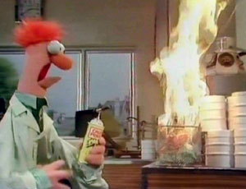

Report ANY accident, no matter how trivial it may appear, to the instructor IMMEDIATELY.

Slide 30
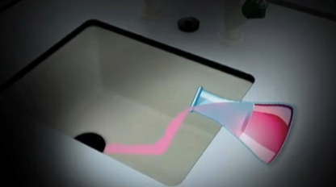
Don’t casually dispose of chemicals DOWN THE DRAIN. Some are allowed down the sink while others are not, so read INSTRUCTIONS. Use plenty of WATER if the sink can be used.
Chemical leftovers…

Slide 31
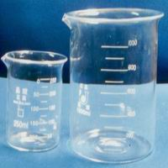
When an experiment is completed, always CLEAN your work area and RETURN all equipment to its proper place. Always WASH your hands with soap and water.

Slide 32

CONSEQUENCES of Violating the Student Safety Code of Conduct

Slide 33
An immediate zero will be AWARDED to any student who violates the Safety Code of Conduct. These POINTS CANNOT be made up.

Slide 34
Repeated violations will result in loss of LAB privileges and administrative action.

