Slide 1
THE MOLE

Slide 2
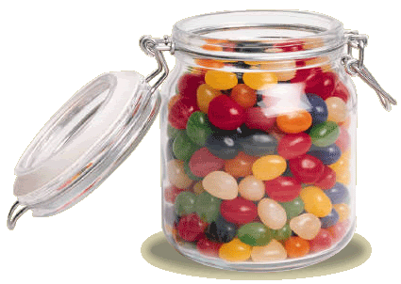
How many jelly beans are in the jar?
The smaller an object is, the harder it is to count

Slide 3
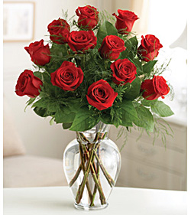
If you were buying a bouquet of roses for a special occasion…
You wouldn’t ask for twelve roses, you would probably ask for a dozen

Slide 4
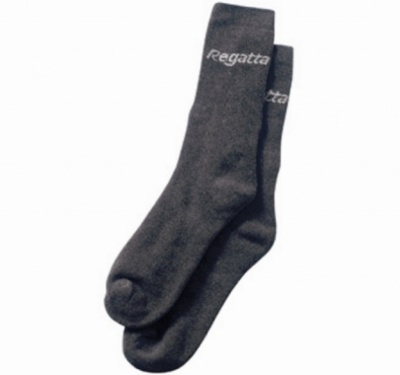
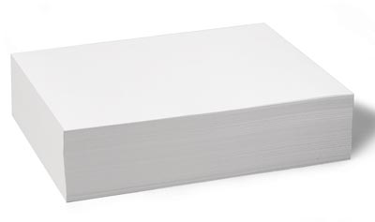
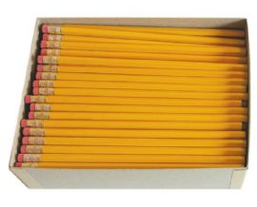
Units represent a specific amount
2
Pair of socks =
Ream of paper =
Gross of pencils =
500
144

Slide 5
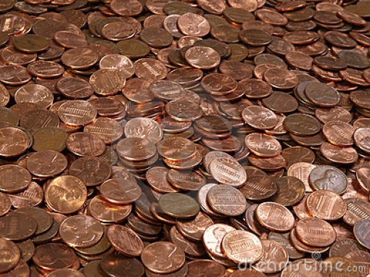
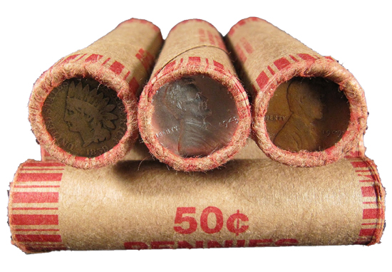
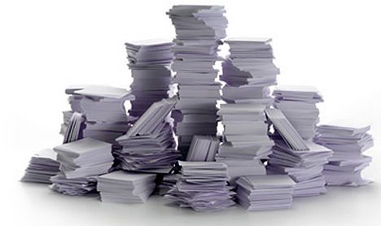
Units make counting objects easier

Slide 6
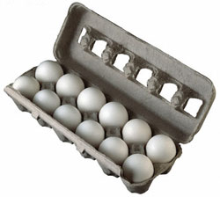
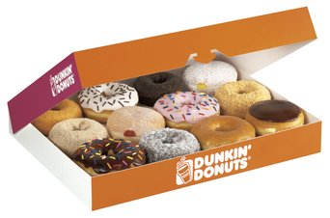
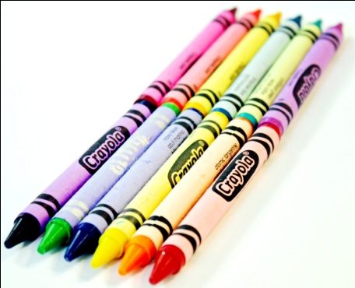
Different units are used to count different things, but the number it represents is always constant
Dozen
Ream of roses ($272.72)

Slide 7
Chemists also needed a convenient method for counting the number of atoms, molecules, or formula units in a sample of a substance

Slide 8
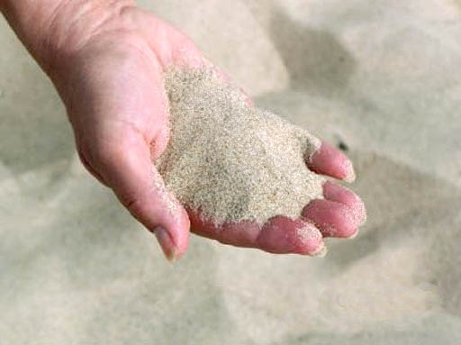
How small are atoms?
Similar to counting grains of sand…
Now imagine those grains of sand 3000 miles away. From that distance the grains of sand would seem terribly small and require an amazing microscope with 3000 mile long tweezers

Slide 9
Mole
SI base unit to measure the amount of a substance
Abbreviated = mol

Slide 10
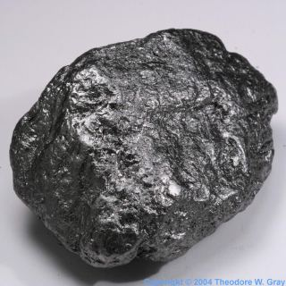
Mole
Number of Carbon atoms in exactly 12 g of pure Carbon-12
Why is Carbon-12 important?
Notes:
Amu = 1/12 the mass of a carbon-12 atom

Slide 11
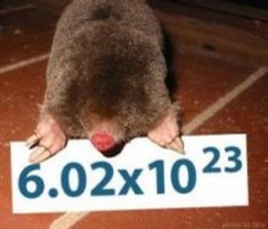
Mole
Number = 6.0221367 x 10²³
602,213,670,000,000,000,000,000

Slide 12
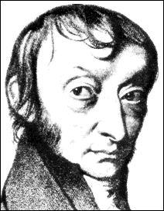
6.02 x 10²³
Called Avogadro’s number
Amedeo Avogadro Italian Physicist
(1776-1856)

Slide 13
Keep It Straight…
Unit to measure Dozen Mole an amount
How much?
Name of number?
12
6.02x10²³
Avogadro’s
Number
Twelve

Slide 14
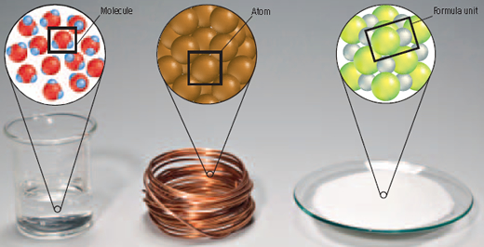
Moles counts representative particles in that substance
Molecules, atoms, formula units, etc.
Mole of water mole of copper mole of sodium chloride

Slide 15
Converting Between Moles and Particles

Slide 16
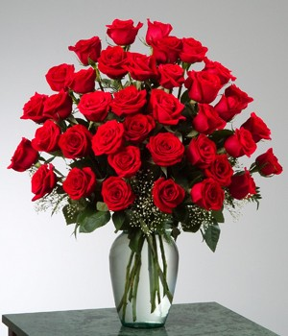
If you buy 3 ½ dozen roses, how many individual roses do you have?
3.5 x 12 =
42
Going from dozen to individual roses
Similarly… go from moles to particles

Slide 17
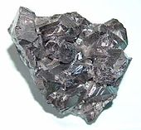
If you have 3 ½ moles of Zinc, how many individual Zinc atoms do you have?
3.5 x (6.02x10²³) =
2.107x10²⁴

Slide 18
Moles to particles
How many sucrose atoms are in 2.50 moles of sucrose?
How many molecules are in 11.5 moles of water (H₂O)?
How many formula units of AgNO₃ are in ½ mole of AgNO₃?

Slide 19
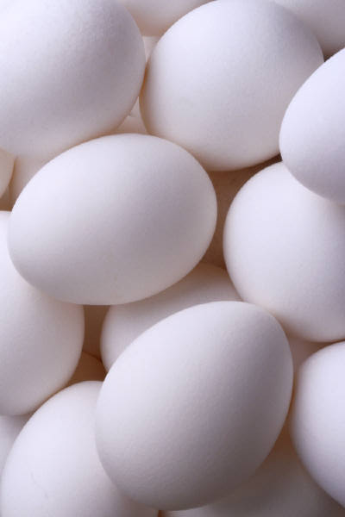
You collected 48 eggs. How many dozen eggs do you have?
48 / 12 =
4
Going from individual eggs to dozen
Similarly… go from particles to moles

Slide 20
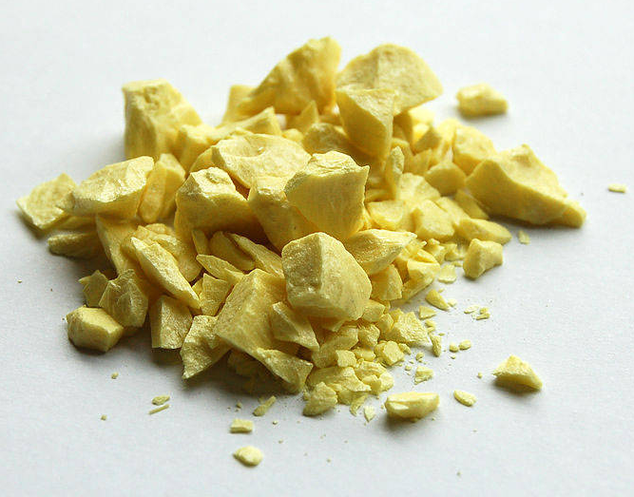
If you had 4.50 x 10²⁴ atoms of Sulfur, how many moles of Sulfur do you have?
4.50 x 10²⁴ / 6.02 x 10²³ =
7.48 mol S

Slide 21
Particles to moles
How many moles contain 5.75 x 10²⁴ atoms Al?
How many moles contain 2.50 x 10²⁴ atoms Fe?
How many moles contain 3.58 x 10²³ formula units ZnCl₂?

