Slide 1
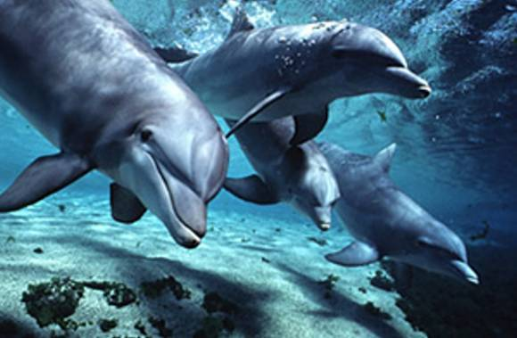
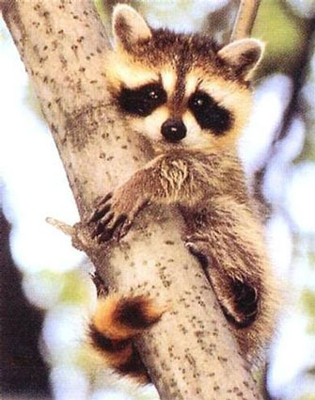
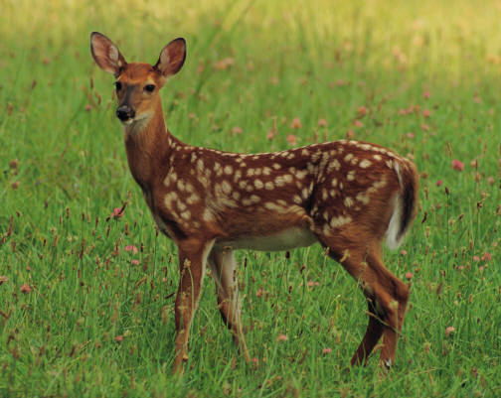
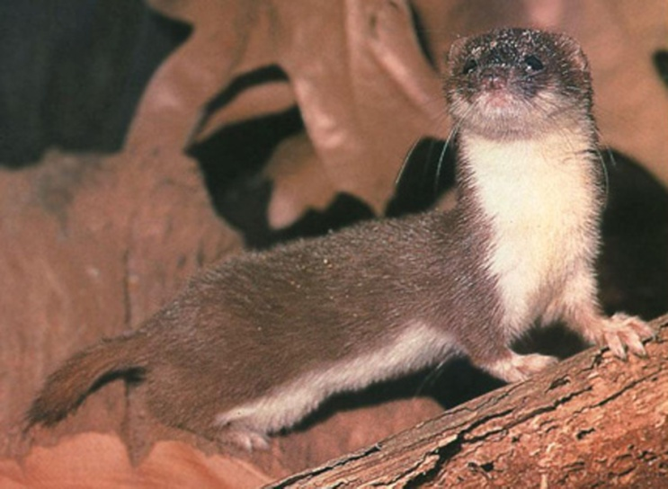
Class mammalia – “breasted” animals

Slide 2
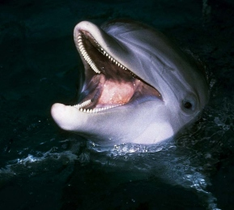
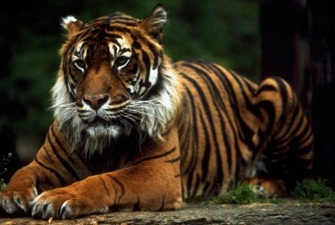
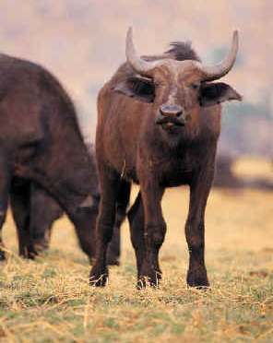
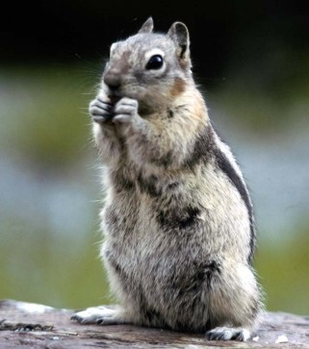
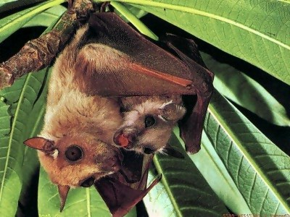
Mammalogy
study of mammals

Slide 3
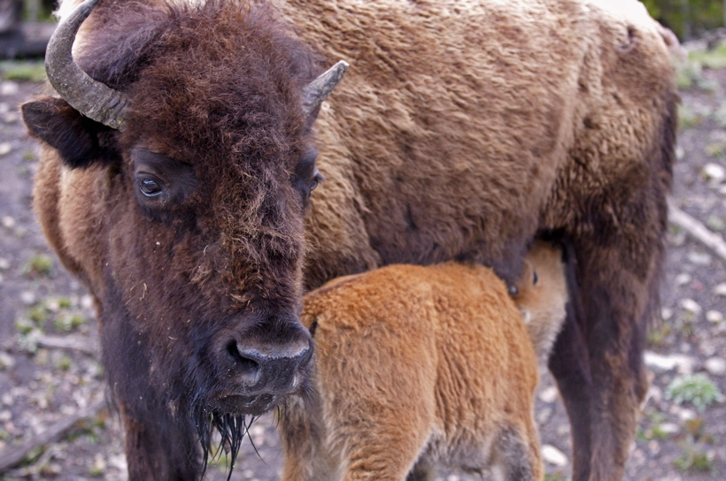
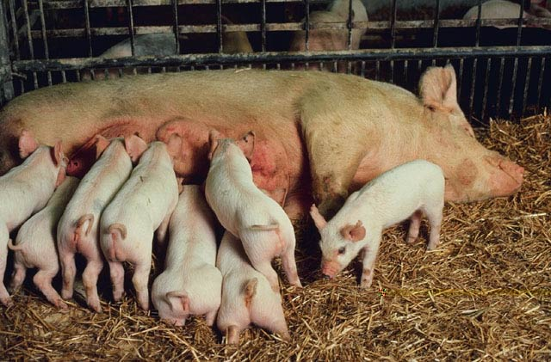
Traits
Mammary glands – produce milk

Slide 4
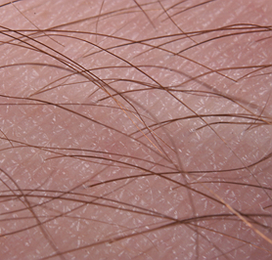
Traits
Hair (or fur)

Slide 5
Traits
4 chambered heart

Slide 6
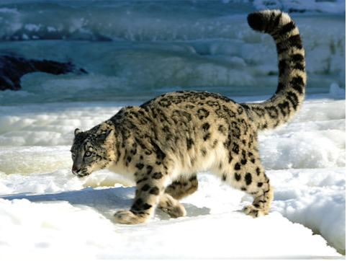
Traits
endotherms

Slide 7
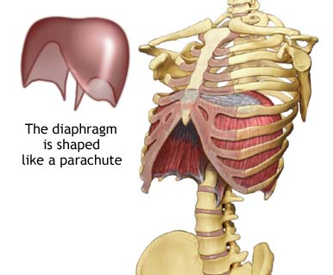
Traits
Diaphragm

Slide 8
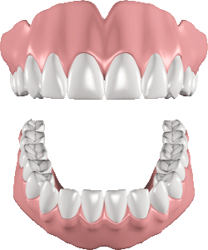
Traits
Heterodonts – different teeth

Slide 9
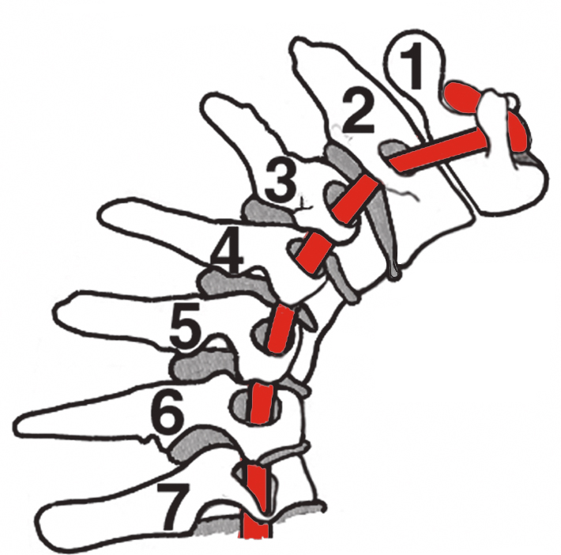
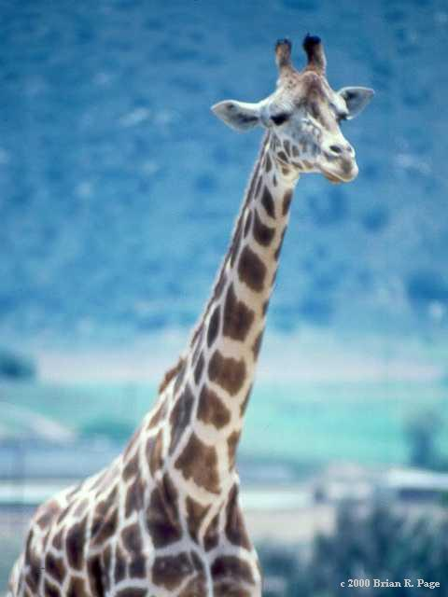
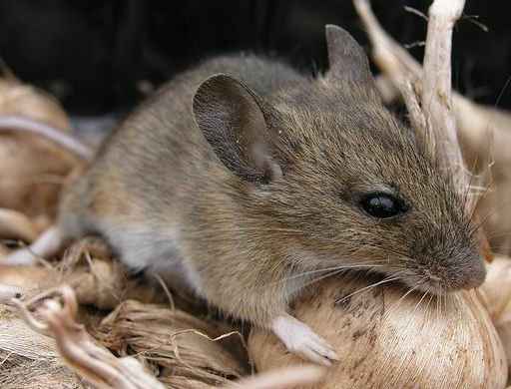
Traits
7 neck vertebrae

Slide 10
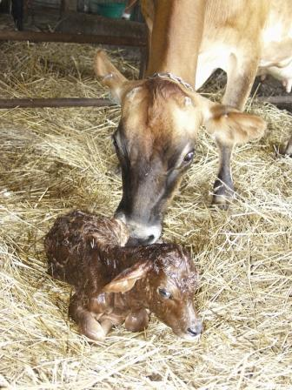
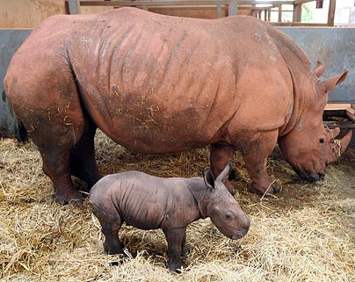
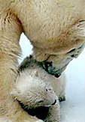
Traits
Viviparous – live birth

Slide 11
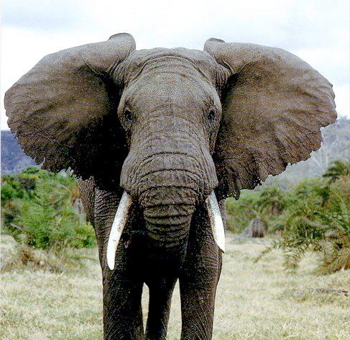
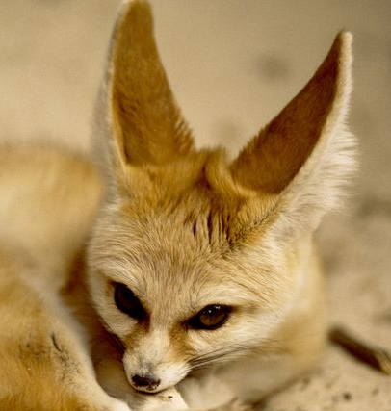
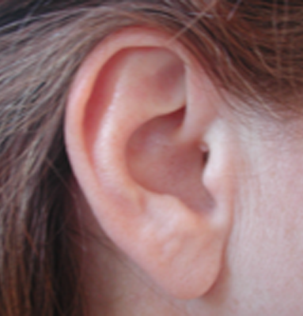
Traits
External fleshy ear lobes

Slide 12
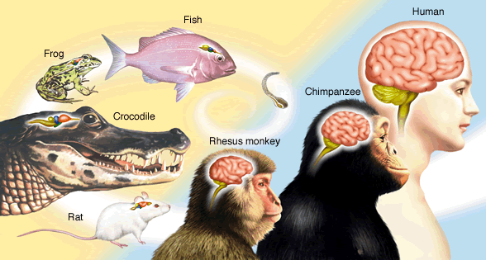
Traits
Well developed brain

Slide 13
Advantages of mammals

Slide 14
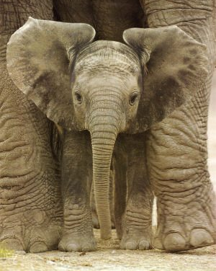
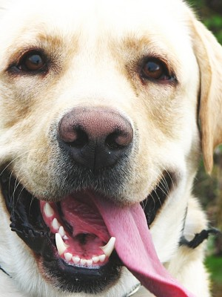
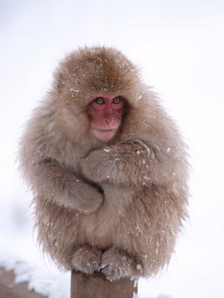
Temperature regulation
Allows mammals to be active at any time, fur and fat keep heat in, sweat, panting, and ears cool them off

Slide 15
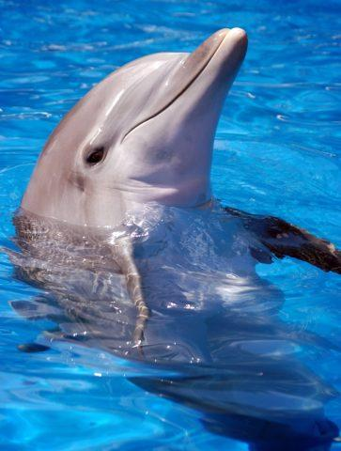
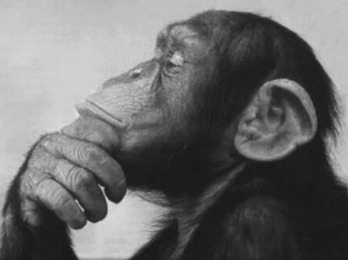
Intelligence
Smartest animals, can learn from experience

Slide 16
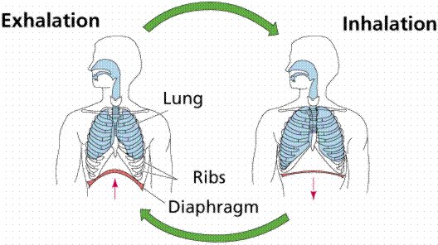
Respiration
Good lungs, diaphragm can move air in and out more efficiently

Slide 17
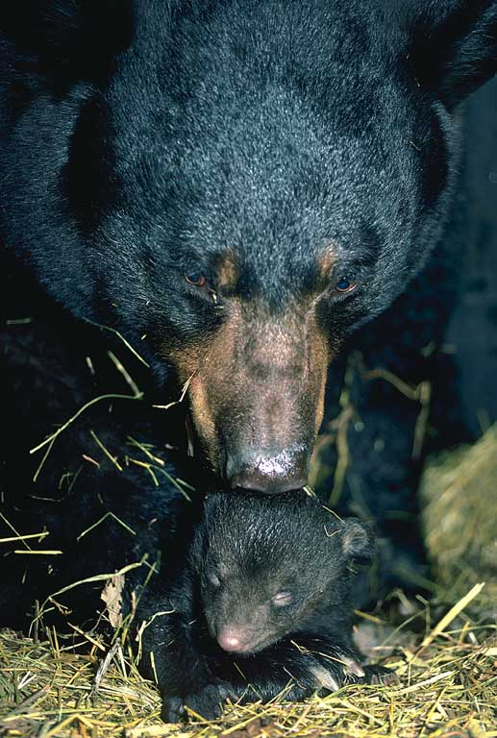
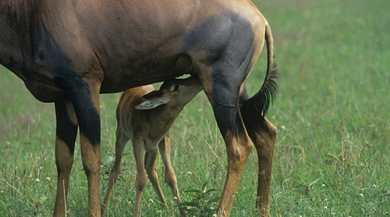
Care for young
Provide milk, teach young how to get food and escape predators

Slide 18
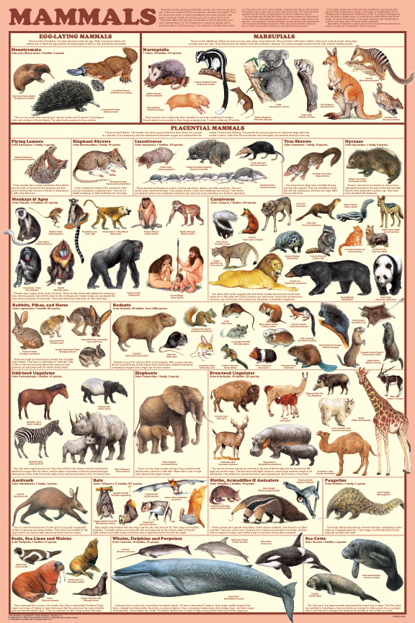
Classification
Based on teeth, limbs, and reproduction

Slide 19
Teeth
Heterodonts – have different kinds of teeth to eat different things

Slide 20
Canines
Fangs for tearing (usually meat)

Slide 21
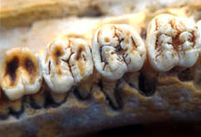
Molars
Chewing and grinding

Slide 22
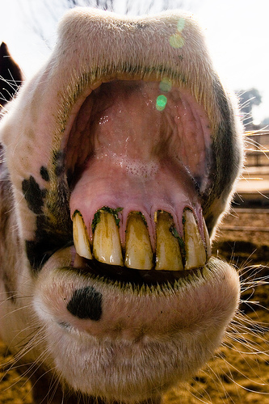
Incissors
front teeth for biting things off

Slide 23
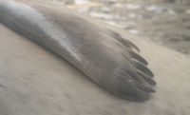
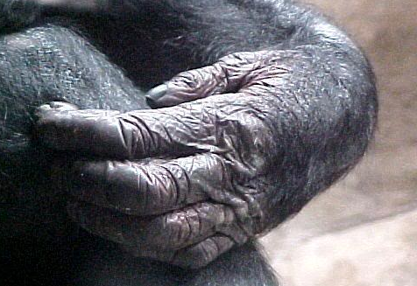
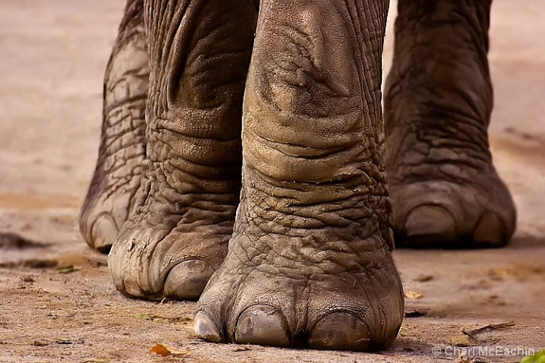
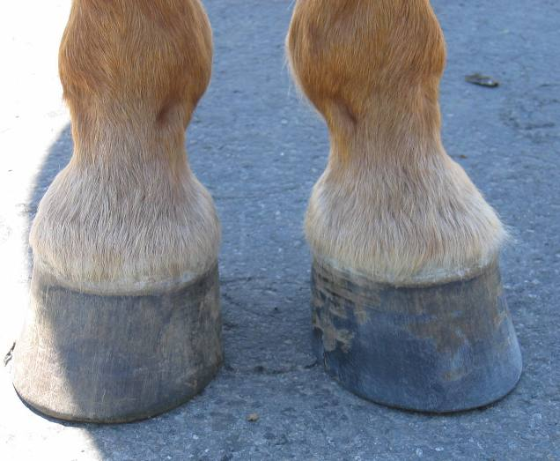
Limbs
Vary greatly within the class depending on their use

Slide 24
Reproduction
1st consideration in classifying
Monotremes
Marsupials
Placentals

Slide 25
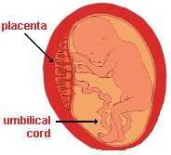
Gestation
Period of time the embryo is in the uterus receiving nutrients from the mother

Slide 26
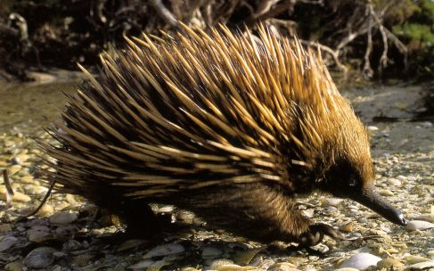
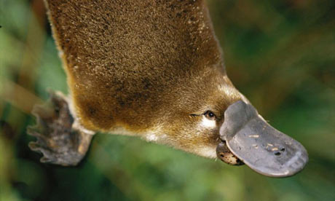
Monotremes
“one opening” cloaca – egg laying mammals, no gestation
E.g. – platypus, echidna

Slide 27
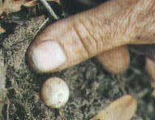
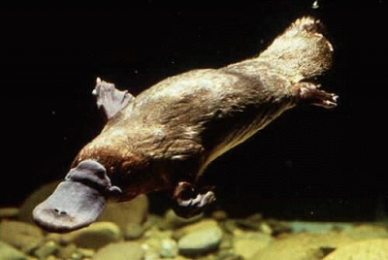
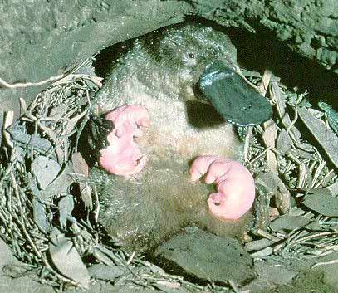
Platypus

Slide 28
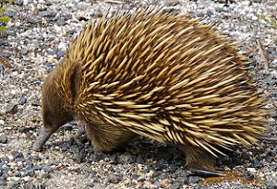
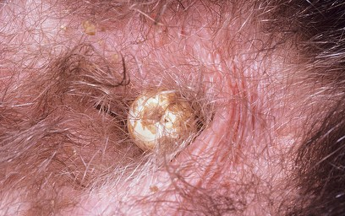
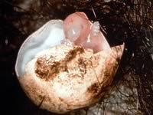
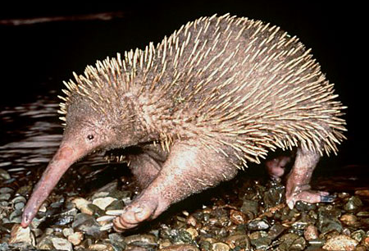
Echidna (spiny anteater)
Short beak Echidna
Long beak Echidna

Slide 29
Marsupials
Pouch mammals, brief gestation, born very immature and then develop in a pouch
E.g. – kangaroo, koala, opossum

Slide 31
Placentals
(95% of mammals), long gestation, born better developed
Humans, dogs, deer

Slide 32
Orders of Placental Mammals
Insectivora
Lagomorphia
Cetacea
Chiroptera
Carnivora
Proboscidea
Edentata
Pinnipedia
Ungulates
Rodentia
Sirenia
Primates

Slide 33
Insectivora
“insect eaters” – most primitive placentals
E.g. – shrews, moles

Slide 34
Star-nosed mole

Slide 35
Chiroptera
“hand wings” – only flying mammals
E.g. - bats

Slide 36
Vampire bats

Slide 37
Flying foxes – worlds largest bats
5 foot wingspan

Slide 38
Edentata
“no teeth” – reduced teeth, large claws
E.g. – anteaters, sloths, armadillos

Slide 39
Anteater skull

Slide 40
Rodentia
“gnawing teeth” – 2 pairs of continuously growing gnawing incisors, largest order of mammals
E.g. – beaver, ground hog, mice, rats

Slide 41
Hard foods file the teeth down – what would happen if they ate only soft foods?

Slide 42
Naked mole rat

Slide 43
Lagomorpha
4 pairs of gnawing incisors, jumping hind legs
E.g. – rabbits, hares, pika

Slide 44
Rather than chew the cud…
Reinjest their own droppings to get the most nutrients from their food

Slide 45
Carnivora
“meat eaters” – prominent canines, claws
E.g. – cats, dogs, bears

Slide 46
Pinnipedia
“feather foot” – carnivores, amphibious, have flippers
E.g. – seals, walruses

Slide 47
Fighting Walruses

Slide 48
Sirenia
“temptress” – aquatic, flippers, fluke, herbivores, blubber
E.g. – manatees

Slide 49
Protected

Slide 50
Cetacea
Aquatic, flippers, fluke, blubber, blowhole, high intelligence (whales and dolphins)
Toothed whales – killer whales
Baleen whales – gray whales

Slide 51
Blowhole

Slide 53
Blue whale
largest animal to live on Earth, 100 ft. and 250 tons

Slide 54
Proboscidea
“nose” – have a trunk and tusks, largest living land animal
E.g. - elephants

Slide 55
Ungulates
“hoofed” mammals – modified claws for running on hard ground

Slide 56
Artiodactyla
“even number of toes”
E.g. – cows, goats, deer, camels, giraffes

Slide 57
Rumen
A specialized region of the digestive tract allowing more efficient digestion of plant matter
Microbes ferment the plant matter and allow it to be digested

Slide 58
Perissodactyla
“odd number of toes” or hoof
E.g. – horse, donkey, zebra, rhino

Slide 59
Primates
“1st” – grasping thumb, high intelligence, upright posture, binocular vision
E.g. – humans, chimps, orangutans

