Slide 1
REVIEW

Slide 2
What is matter?

Slide 3
States of Matter
State | Volume | Shape | Particle Spacing
Solid
Liquid
Gas
Compressibility?

Slide 4
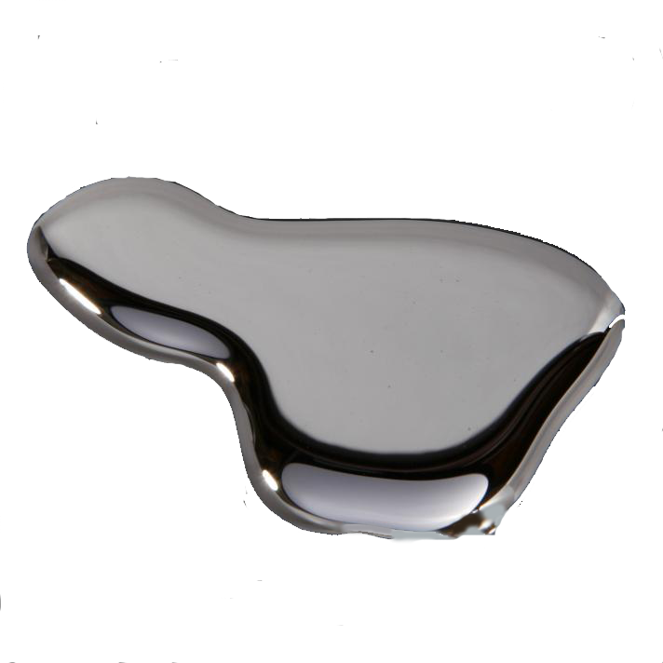
What are 3 physical properties of matter?
1.
2.
3.

Slide 5
Physical Properties
Intensive
Extensive
Which depends on the amount of matter?
Which doesn’t depend on amount?
Includes mass, length, volume?
Includes density, color, odor?

Slide 6
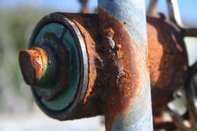
What is 1 chemical property of matter?
1.

Slide 7
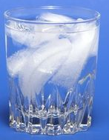
What happens to the physical and chemical properties when matter changes states?

Slide 8
Changes in Matter

Slide 9
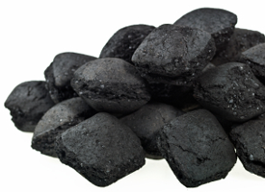
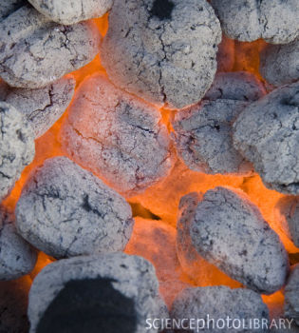
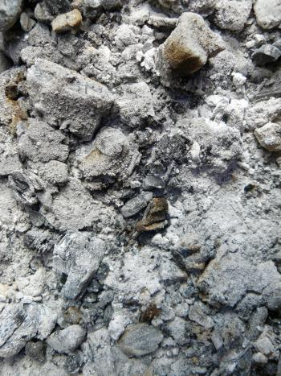
Black solid
Glowing red color
Charcoal Briquettes
It changes as a result of its physical and chemical properties
Ashes, CO₂, and water

Slide 10
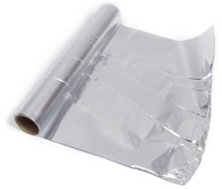
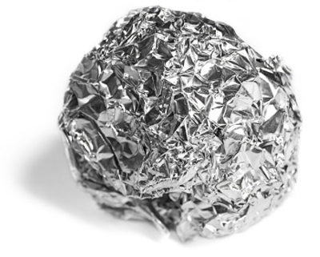
Smooth, flat, sheet of aluminum
What is it now?

Slide 11
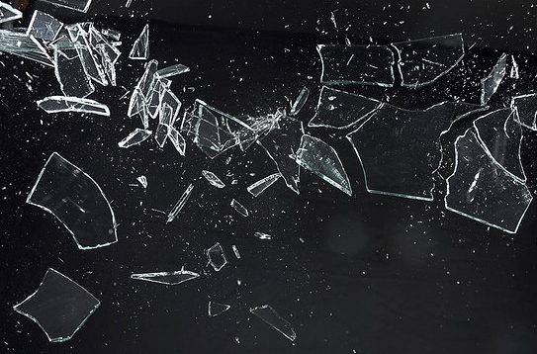
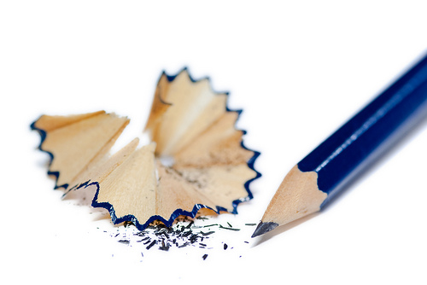
Physical Change
Alters a substance without changing the composition

Slide 12
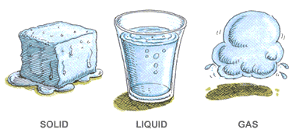
Change of State – change from one physical form to another
the substance does not change (ice, liquid water, and steam are still all water in different forms)

Slide 13
Change of State
to change a state, you must add or remove energy
How do you change energy?

Slide 14
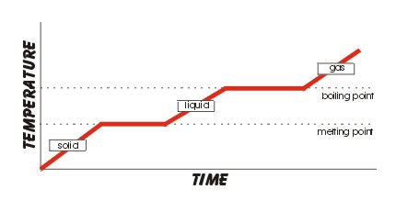
Change of State
Temperature
Pressure

Slide 15
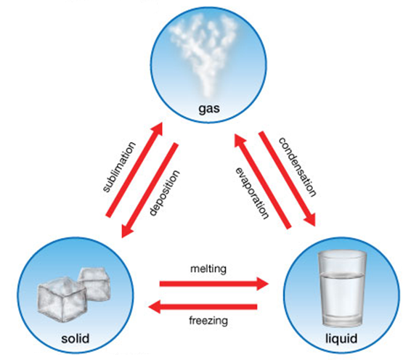
Phase Changes

Slide 16
Adding Energy

Slide 17
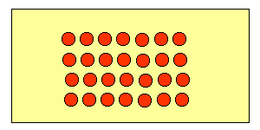
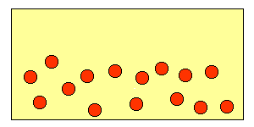
Melting – change from a solid to a liquid
Speed
Up

Slide 18
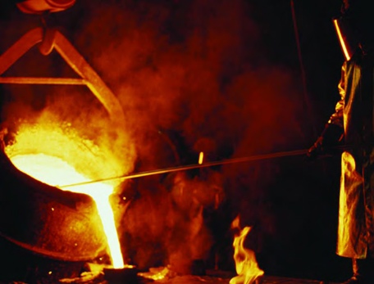
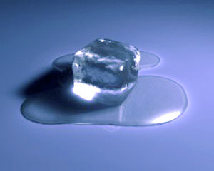
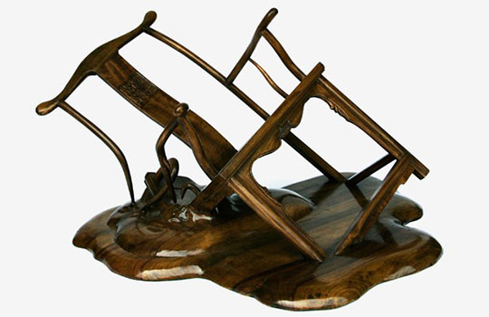

Slide 19
Melting
melting point – temp. at which a solid will change to a liquid
Water – 0°C

Slide 20
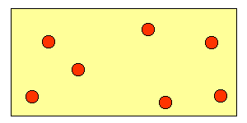
Vaporization – change from liquid to gas
Speed
Up

Slide 21
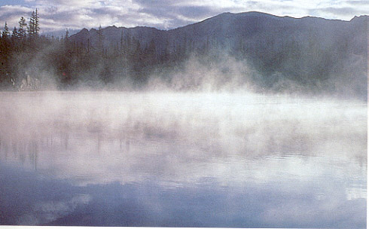
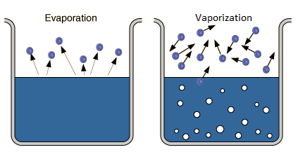
Evaporation
When vaporization occurs only on the surface of a liquid

Slide 22
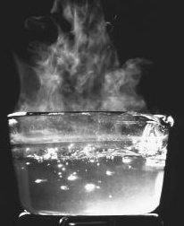
Vaporization
boiling point – temp. at which a liquid changes to a gas throughout
Water – 100°C

Slide 23
Sublimation – change from solid to gas
Speed
Up

Slide 24
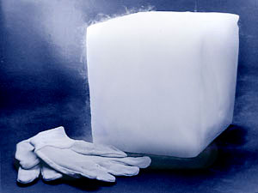
Sublimation Examples
Dry ice
carbon dioxide in a solid state

Slide 25
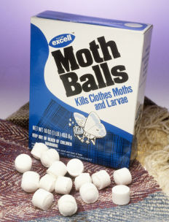
Sublimation Examples
Moth balls
Naphthalene or
p-dichlorobenzene

Slide 26
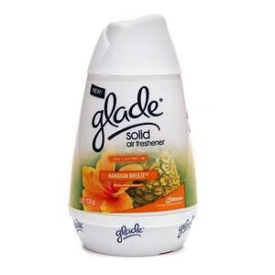
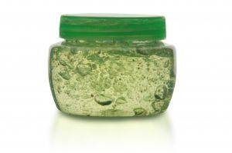
Sublimation Examples
Solid Air Fresheners

Slide 27
Phase Changes

Slide 28
Removing Energy

Slide 29
Freezing – change from liquid to solid
Slow
Down

Slide 30
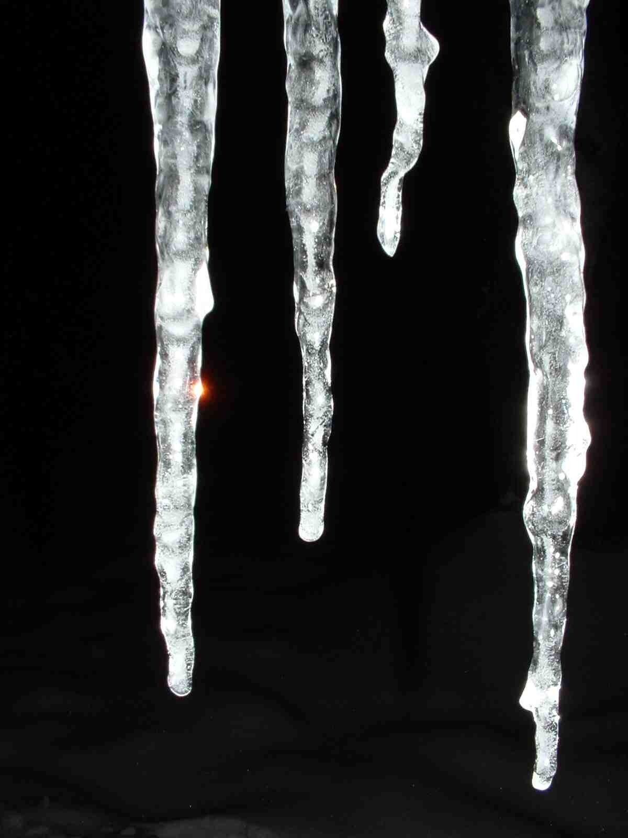
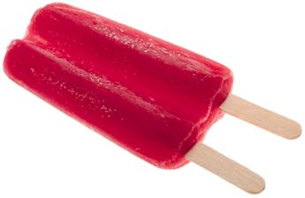
Freezing

Slide 31
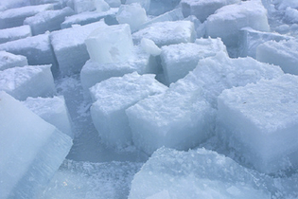
Freezing
freezing point – temp. at which a liquid turns into a solid
Water – 0°C

Slide 32
Condensation – change from gas to liquid
Slow
Down

Slide 33
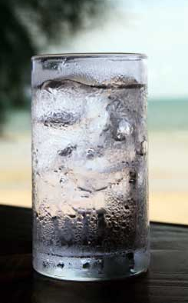
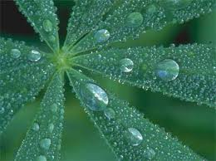
Condensation

Slide 34
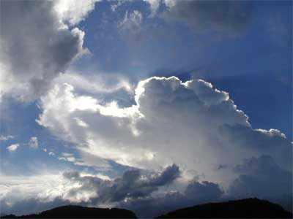
Condensation in Atmosphere

Slide 35
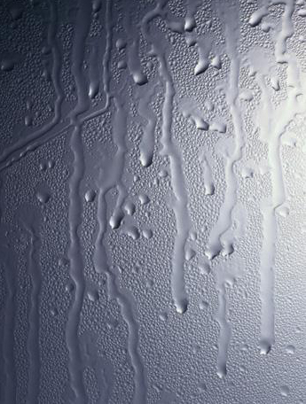
Condensation
condensation point – temp. at which a gas changes to a liquid
Water – 100°C

Slide 36
Deposition
Change from a gas to a solid
Slow
Down

Slide 37
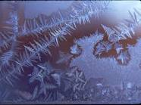
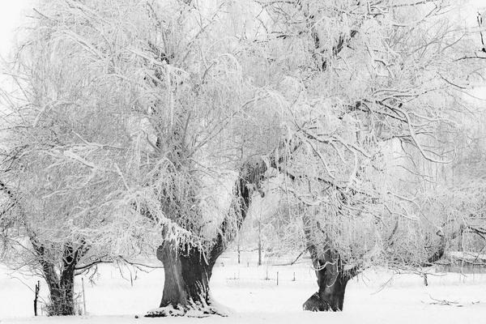
Deposition Examples
Frost

Slide 38
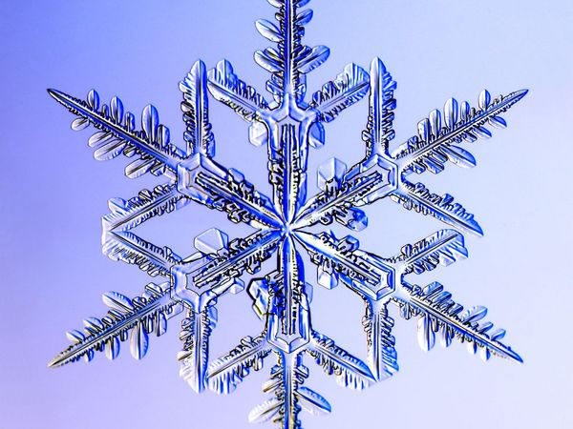
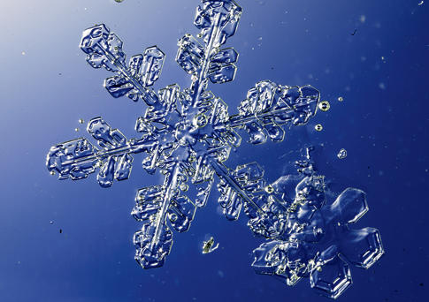
Deposition Examples
Snowflakes

Slide 39
Phase Changes

