Slide 1
Newton’s Laws of Motion

Slide 2
1st Law
An object at rest stays at rest and an object in motion stays in motion unless acted upon by an unbalanced force

Slide 3
Objects at rest…
Won’t move until an unbalanced force moves them
Example:

Slide 4
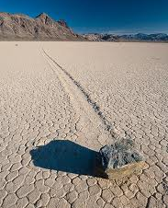
Sliding Rocks of Death Valley California

Slide 5
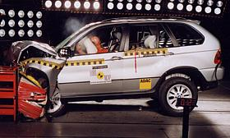
Objects in motion…
will continue to move at a constant speed and in a straight line unless acted upon by an unbalanced force
Example:

Slide 6
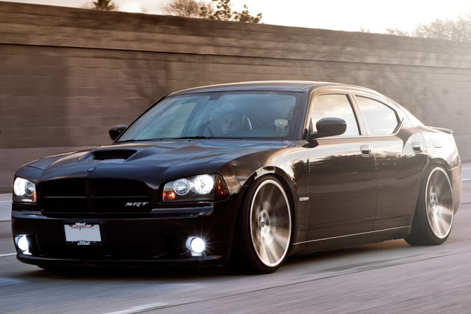
Why don’t objects keep moving forever?
A common unbalanced force acting on moving objects = friction

Slide 7
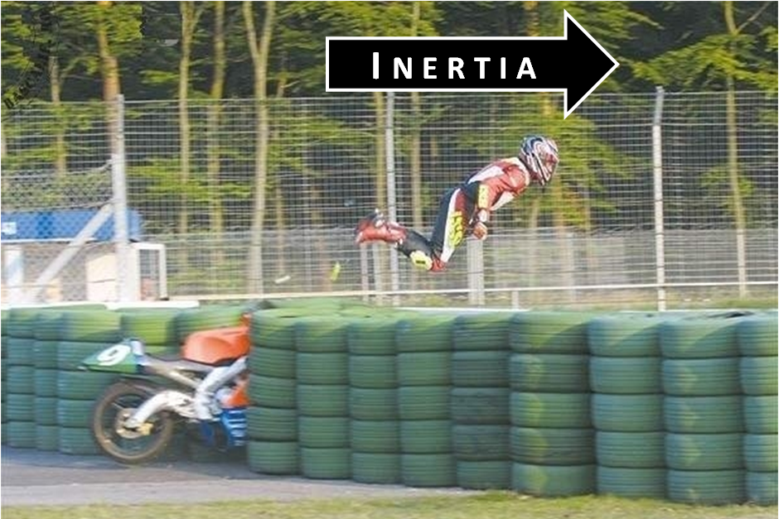
Also called the Law of Inertia
Inertia – the tendency of an object to resist a change in motion

Slide 8
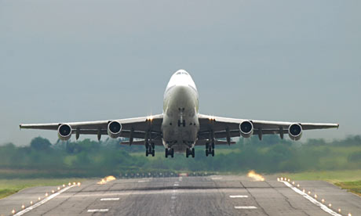
Why can’t a plane stop immediately?

Slide 9
https://www.youtube.com/watch?v=6gzCeXDhUAA

Slide 10
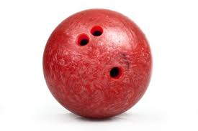
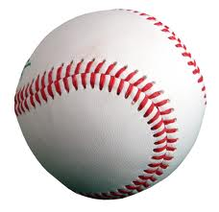
Mass is a measure of inertia
The more mass an object has, the more inertia it has

Slide 11
2nd Law
The acceleration of an object depends on the mass of an object and the amount of force applied

Slide 12
MASS
Acceleration decreases as mass increases
acceleration
mass

Slide 13
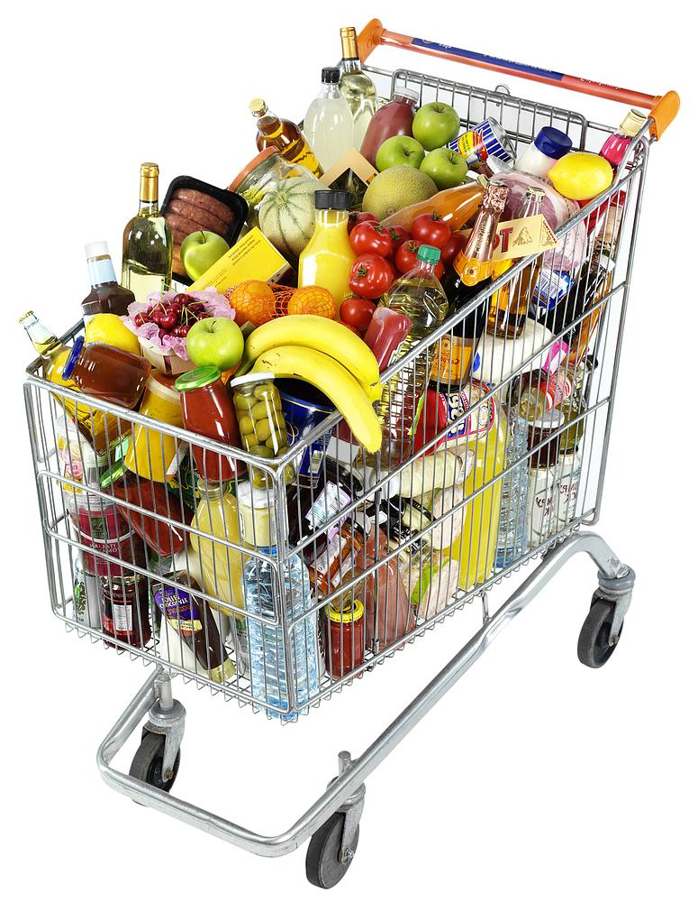
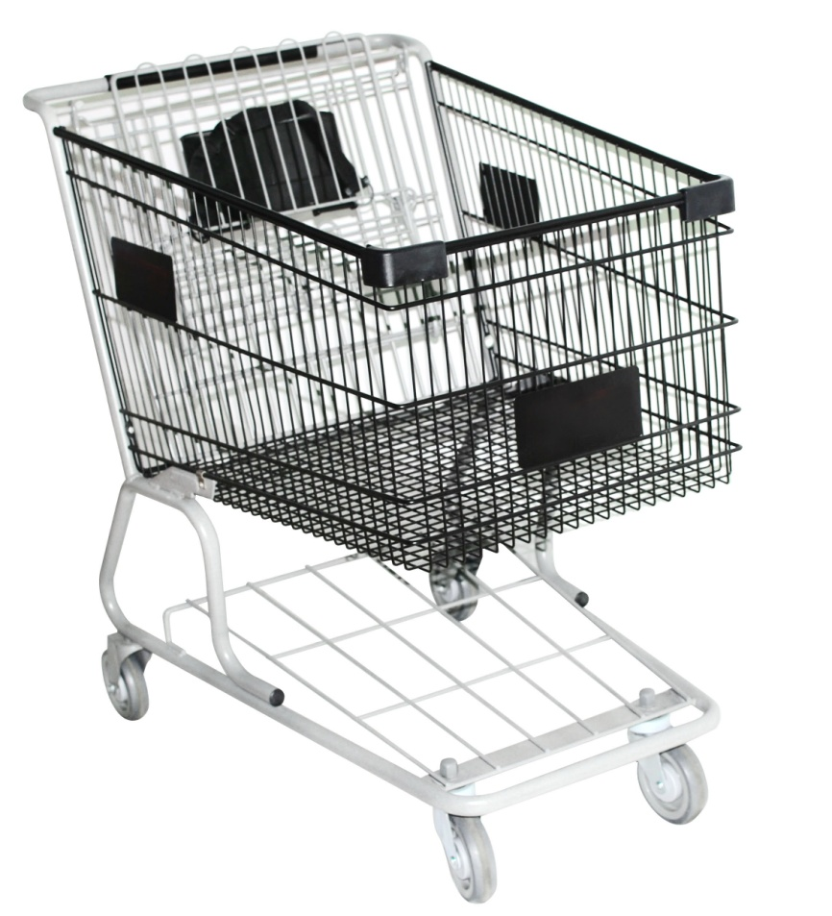
Small mass vs. Large mass
Which is easier to move?

Slide 14
FORCE
Acceleration increases as force increases
acceleration
force

Slide 15
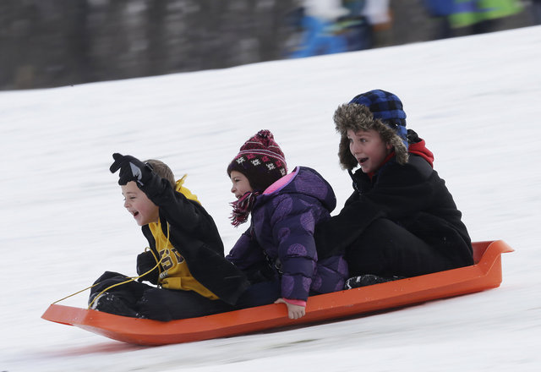
Big force = Big acceleration

Slide 16
Equation:
Acceleration = force/mass
F = m x a
F
m
a =

Slide 17
Practice
What is the acceleration of a 7 kg object if a force of 21 N is used to move it?
F
( )
( )
m
a
( X )

Slide 18
Practice
What force is needed to accelerate a 1000 kg car at a rate of 40 m/s²?
F
( )
( )
m
a
( X )

Slide 19
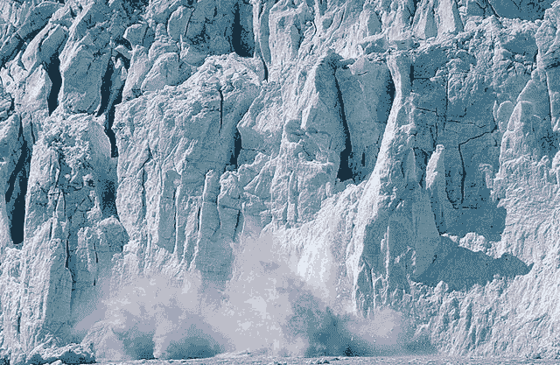
An object with a big mass and a small acceleration, can still have a big force
Example:

Slide 20
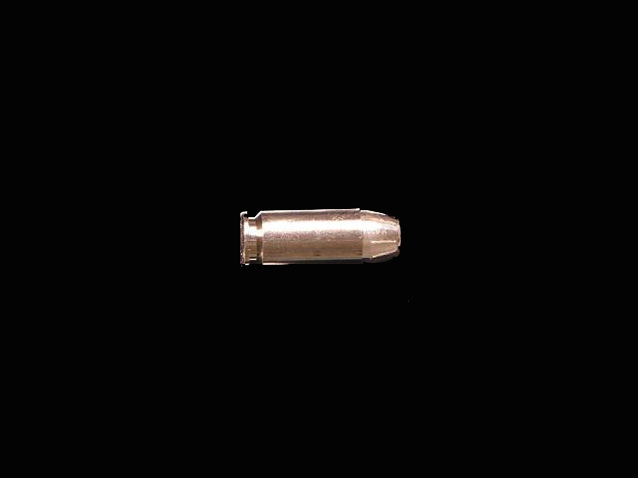
An object with a small mass and a big acceleration, can still have a big force
Example:

Slide 21
3rd Law
For every action, there is an equal and opposite reaction

Slide 22
All forces act in pairs
ACTION
REACTION

Slide 23
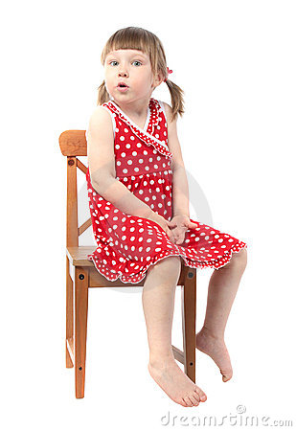
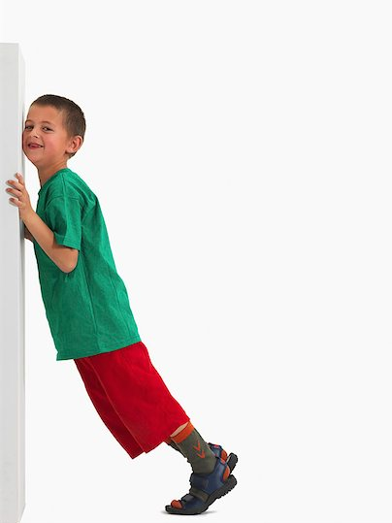
No motion:

Slide 24
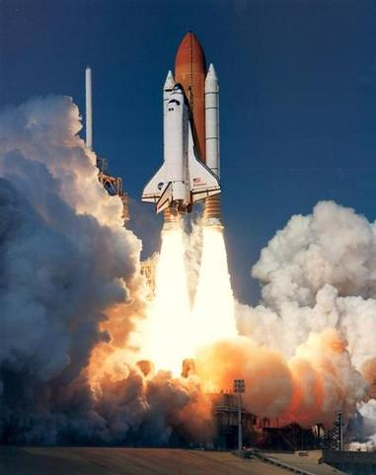
Examples:

Slide 25
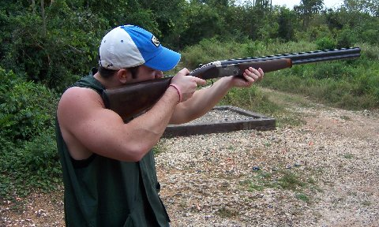
Examples:

Slide 26
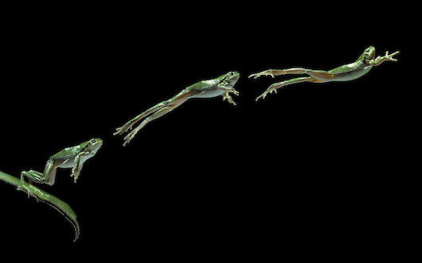
Examples:

Slide 27
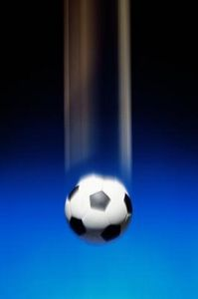
Some are difficult to see… What two forces are working in pairs?

Slide 28
Review 3 Laws:
1st Law
2nd Law
3rd Law
Object at rest stays at rest and an object in motion stays in motion unless acted upon by an unbalanced force
Acceleration depends on an objects mass and force used
For every action there is an equal and opposite reaction

Slide 29
1st, 2nd, or 3rd

Slide 30
1st, 2nd, or 3rd

Slide 31
1st, 2nd, or 3rd
F
( )
( )
m
a
( X )

Slide 32
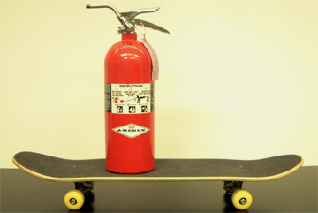
1st, 2nd, or 3rd

