Slide 1
Review
1. What are the charged parts of an atom?
Electrons Neutrons Protons

Slide 2
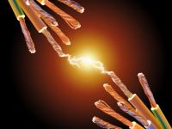
Moving Charges

Slide 3
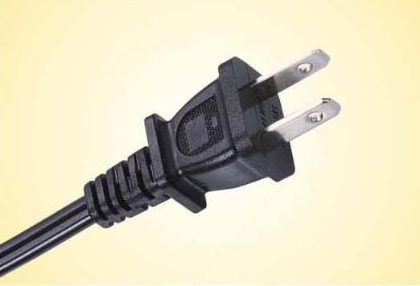
Cords are made from metal and plastic because electric charges travel through some materials easier than others
Materials are either insulators or conductors based on how easily charges move in them

Slide 4
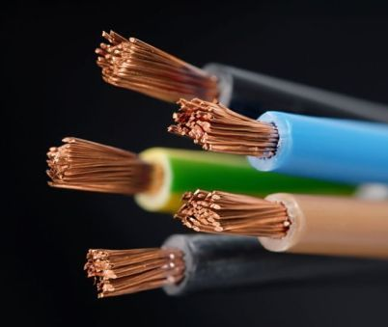
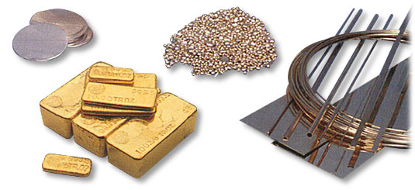
Conductors
A material in which charges can move easily

Slide 5
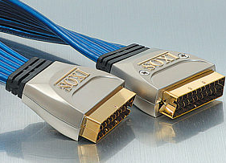
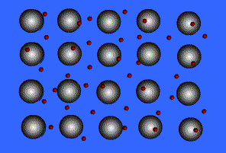
Examples: Metals
Metallic bonds

Slide 6
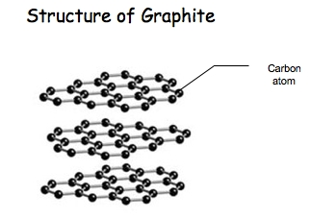
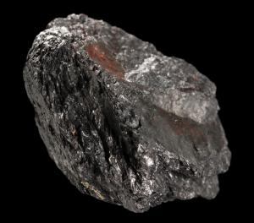
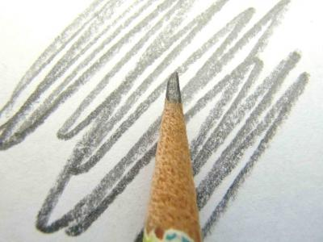
Examples: Graphite

Slide 7
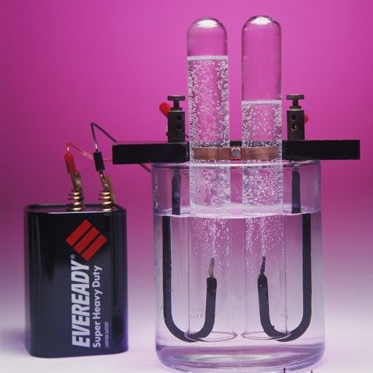
Examples: Dirty Water

Slide 8
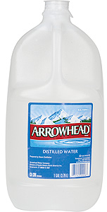
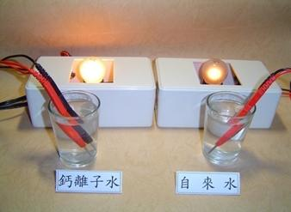
Pure water?
Salt water vs. tap water

Slide 9
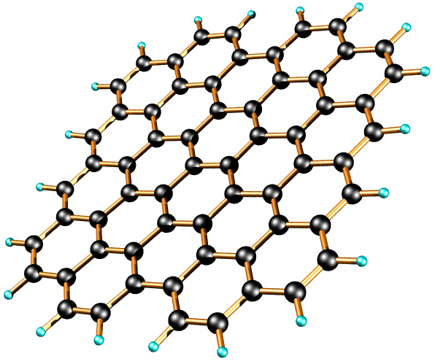
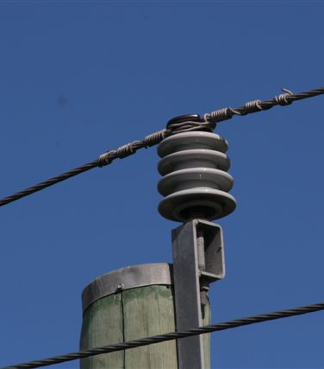
Insulators
A material in which charges can’t move easily

Slide 10
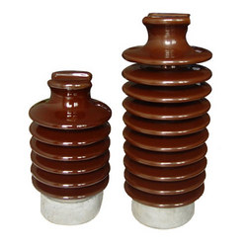
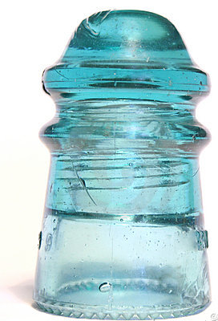
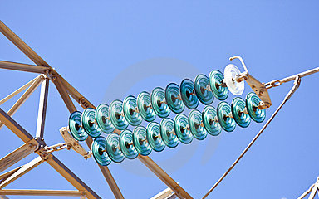
Examples: Glass and Ceramics

Slide 11
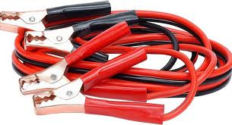
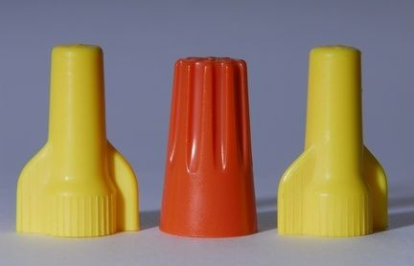
Examples: Plastic

Slide 12
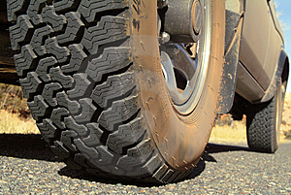
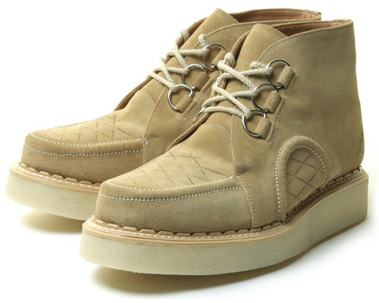
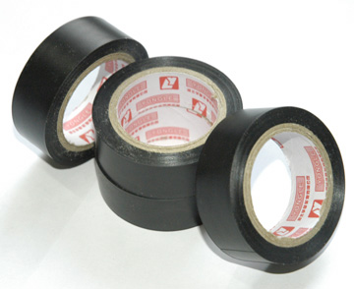
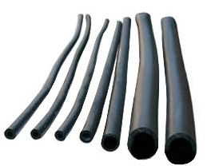
Examples: Rubber

Slide 13
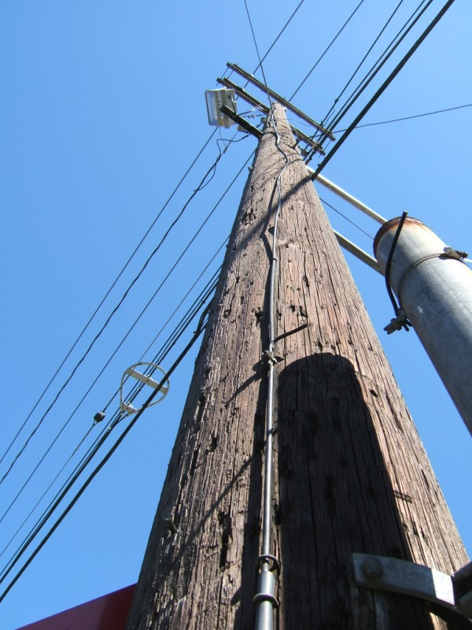
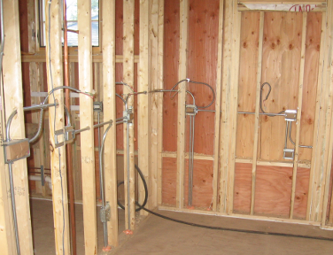
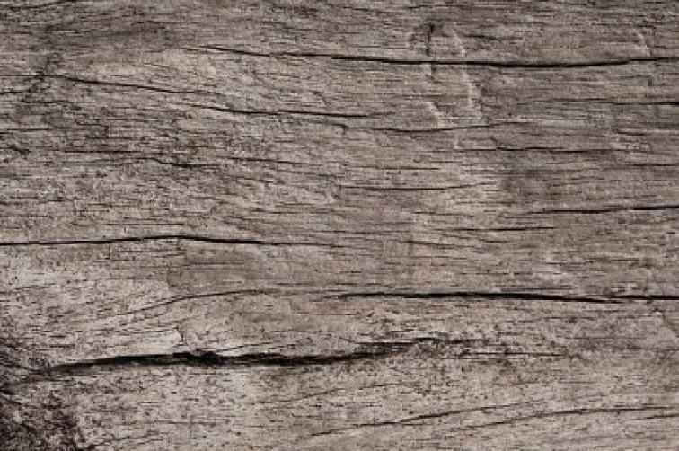
Examples: Dry wood

Slide 14
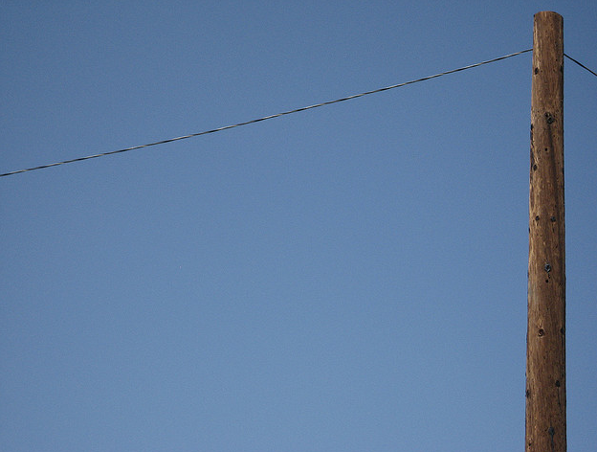
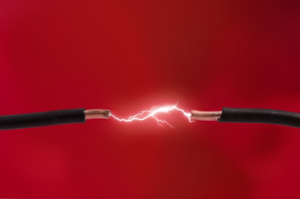
Examples: Air

Slide 15
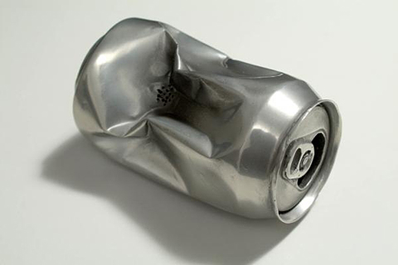
Conductor or Insulator?

Slide 16
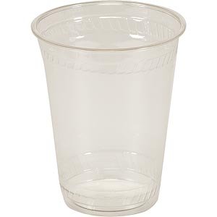
Conductor or Insulator?

Slide 17
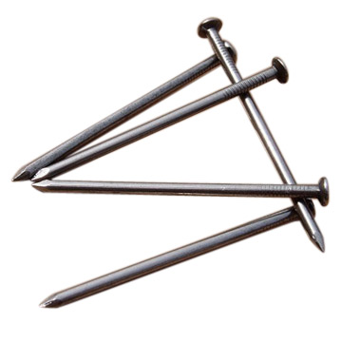
Conductor or Insulator?

Slide 18
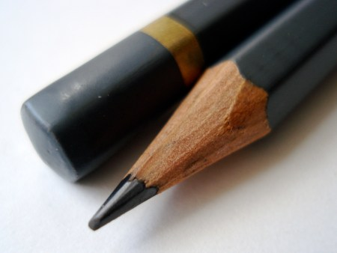
Conductor or Insulator?

Slide 19
Conductor or Insulator?

Slide 20
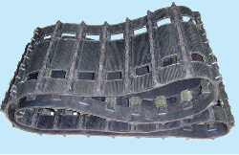
Conductor or Insulator?

Slide 21
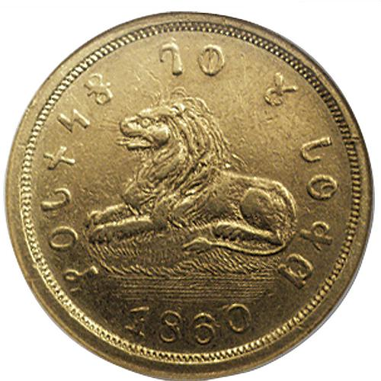
Conductor or Insulator?

Slide 22
Conductor or Insulator?

Slide 23
Why do clothes sometimes stick together when taken out of the dryer?

Slide 24
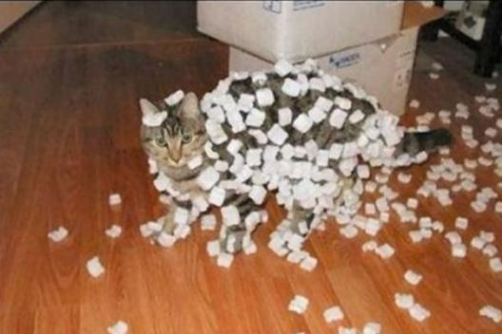
Static electricity
An electric charge at rest on an object
When something is STATIC, it is not moving

Slide 25
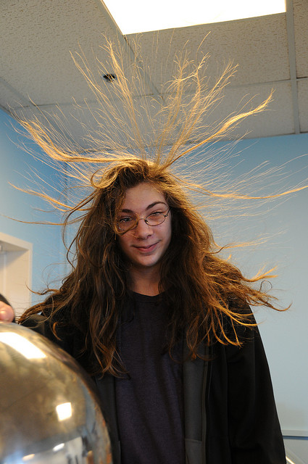
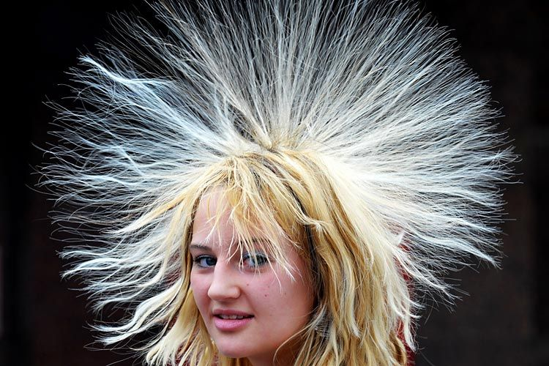
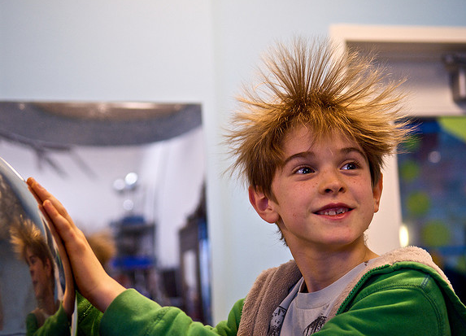
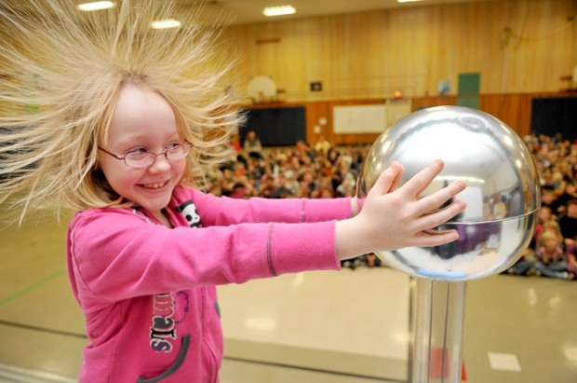

Slide 26
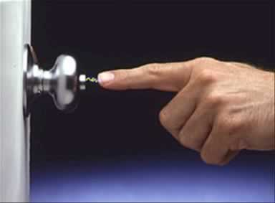
Electric Discharge
The release of electricity stored in an object

Slide 27
Can happen slowly…
Electricity in clothes eventually move to water molecules in the air

Slide 28
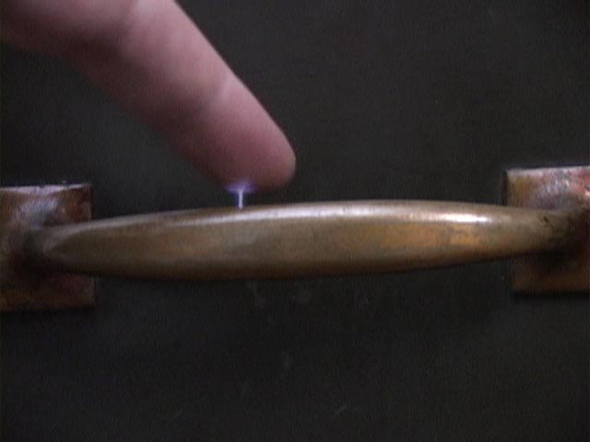
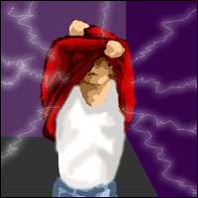
Can happen quickly…
Flash of light, shock, or a crackling noise

Slide 29
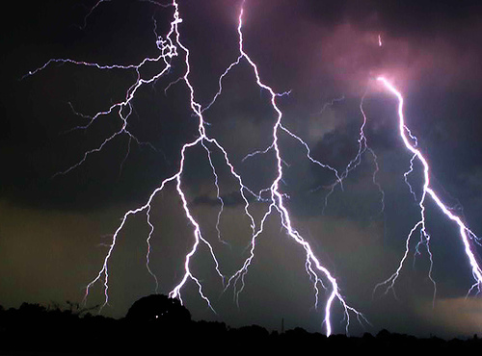
One of the most dramatic examples of electric discharge is lightning

Slide 30
How does lightning work?

Slide 31
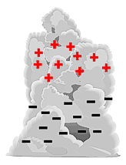
How lightning works
As water droplets, ice, and air move inside the cloud, charges separate – negative on bottom and positive on top

Slide 32
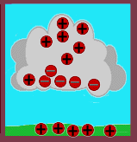
How lightning works
2. Negative charge on bottom can induce a positive charge on ground

Slide 33
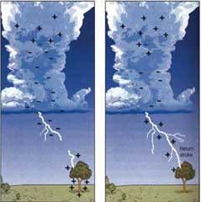
How lightning works
3. Attraction of charge differences causes a rapid electric discharge

Slide 34
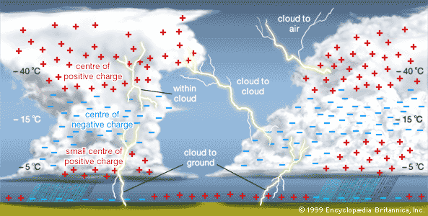
Different parts of clouds have different charges

Slide 35
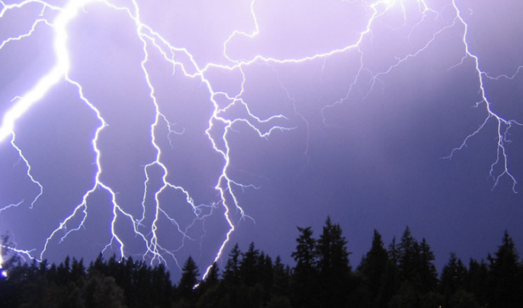
Lightning takes many different forms
Forked lightning – highly branching

Slide 36
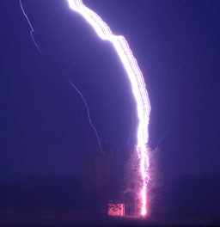
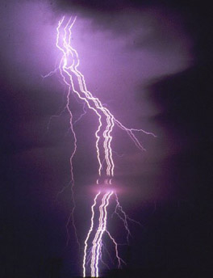
Lightning takes many different forms
Ribbon lightning – several parallel strokes make it look like ribbon

Slide 37
Lightning takes many different forms
Bead lightning – trail cooling down and breaking up into spherical sections

Slide 38
Lightning takes many different forms
Ball lightning – sometimes floats or bounces near ground

Slide 39
Lightning takes many different forms
Sheet lightning – actual bolts are hidden by clouds, lights up the whole sky

Slide 40
Lightning Rods
Rod connected to the ground by a wire, provides a safe path to Earth

