Slide 1
3 Types of Chemical Bonds
Ionic Bonds
Metallic Bonds
Covalent Bonds

Slide 2
The Ionic Bond

Slide 3
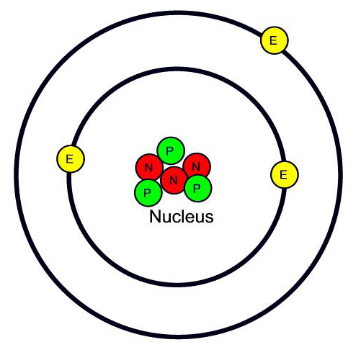
Atoms are Neutral!
They have the same number of protons and electrons

Slide 4
However…
To gain stability, an atom may give up or gain electrons to have a full outer shell
No
Longer Neutral

Slide 5
Ion
An atom with a positive or negative charge
Cation – a positive ion, loses electrons
Anion – a negative ion, gains electrons

Slide 6
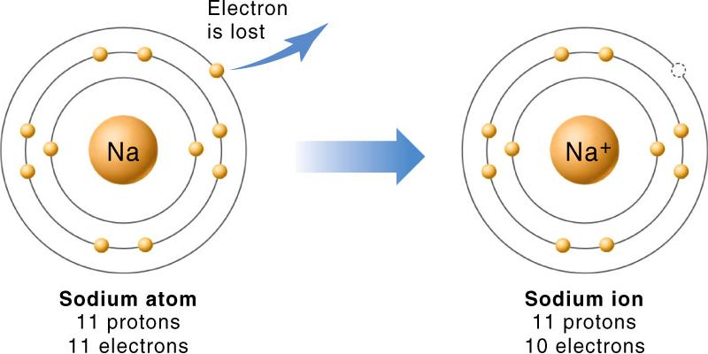
Examples:

Slide 7
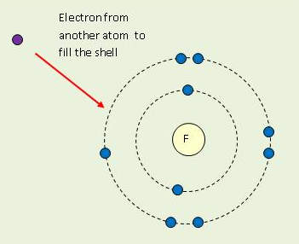
Examples:

Slide 8
Writing Ions
Superscript to the right of the atomic symbol tells the ion’s charge
Na¹⁺ F¹⁻

Slide 9
Other Examples:
Calcium atom that loses 2 electrons =
Oxygen atom that gains 2 electrons =
Ca²⁺
O²⁻

Slide 10
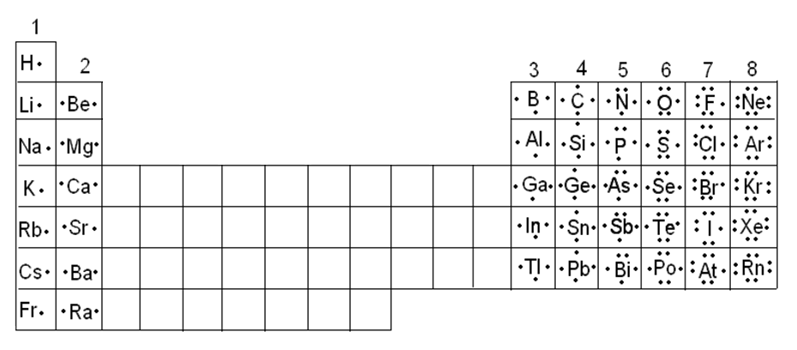
Easy way to know the charge of atoms

Slide 11
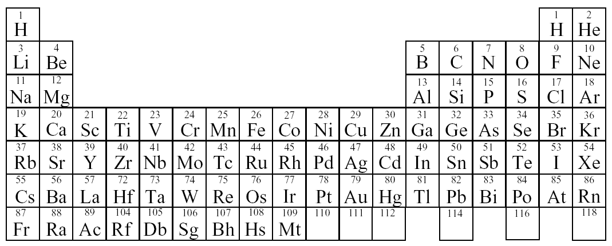
How do you know the charge?
Li
Be
B
C
2e⁻
3p⁺
4p⁺
6p⁺
5p⁺
+1
+4
IA
VIIA
VIIIA
+2
+3
-4
IIA
IIIA
IVA
VA
VIA

Slide 12
N
O
F
Ne
Na
8e⁻
2e⁻
8p⁺
10p⁺
11p⁺
7p⁺
9p⁺
+1
-1
0
IA
+4
VIIA
VIIIA
+2
+3
-4
-3
-2
IIA
IIIA
IVA
VA
VIA

Slide 13
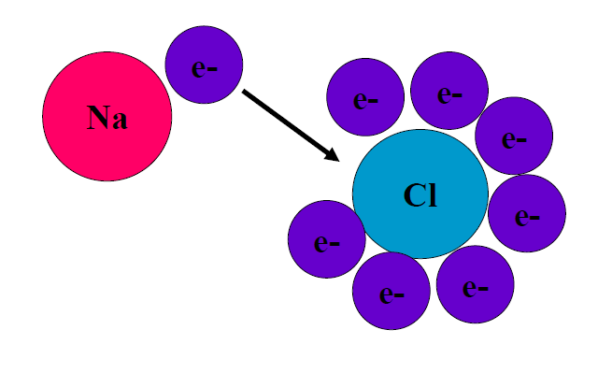
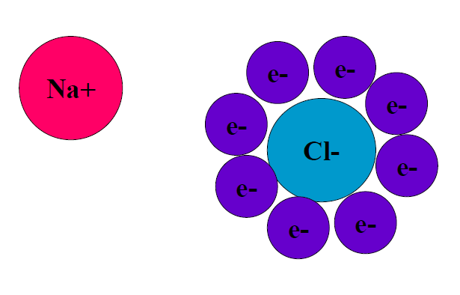
When atoms that tend to lose electrons come in contact with atoms that tend to gain them, the result is an electron transfer and the formation of two oppositely charged ions

Slide 14
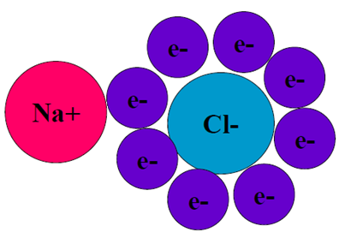
ATTRACTION!!!
These two atoms with opposite charges are now attracted to each other by the electrical force

Slide 15
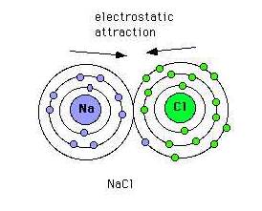
Ionic Bond
The force of attraction between two oppositely charged ions

Slide 16
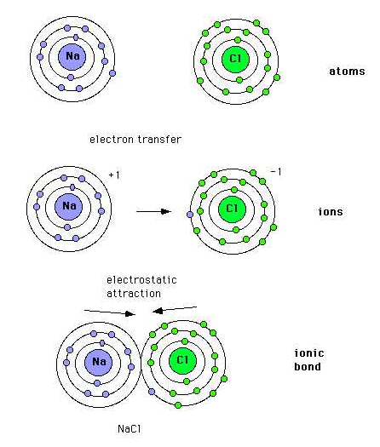
Ionic Bond
Electrons are given up and taken, not shared

Slide 17
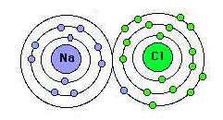
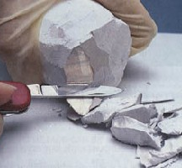
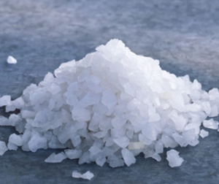
Ionic compounds
Compounds containing ions
+ =
New physical and chemical properties

Slide 18
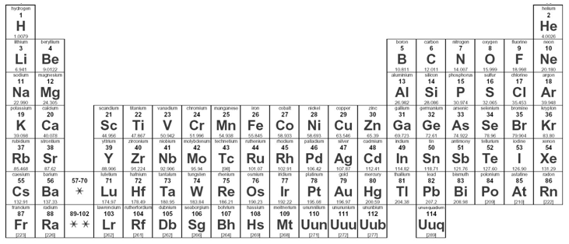
Elements that form Ionic Compounds
Those found on opposite sides of the periodic table

Slide 19
Rules for Naming Simple Ions
CATIONS
Borrow names from the element
EX: K+ = Potassium Ion
EX: Zn2+= Zinc Ion
When an ELEMENT forms two or more ions, roman numeral indicate the charge
EX: Cu+ = Copper (I) ion
EX: Cu2+ = Copper (II) ion

Slide 20
Rules for Naming Simple Ions
2. ANIONS
Name of Anion is also formed form the name of the elements name, but it ends with “IDE”!!
EX: Cl- Chloride Ion
EX: O²- Oxide Ion
EX: P³- Phosphide Ion

Slide 21
Binary (Two) Compounds
The name of ions are used to name an ionic compound.
RULE: Place the name of the CATION followed by the name of the ANION
EX: NaCl → Sodium Chloride
EX: ZnS → Zinc Sulfide
EX: CuO → Copper (II) Oxide

Slide 22
For all Ionic Compounds, Positive and Negative Charges Must Balance!
Sodium Chloride:
Sodium¹⁺ + Chloride¹⁻
Calcium Oxide:
Calcium²⁺ + Oxide²⁻

Slide 23
What if the charges differ??
Calcium²⁺
Fluoride¹⁻
Fluoride¹⁻
CaF₂

Slide 24
Make it Balanced
Aluminum³⁺
Oxide²⁻

Slide 25
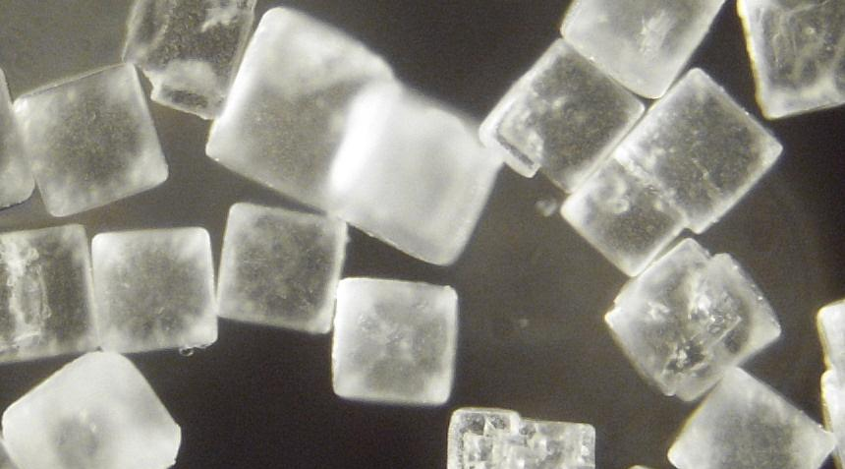
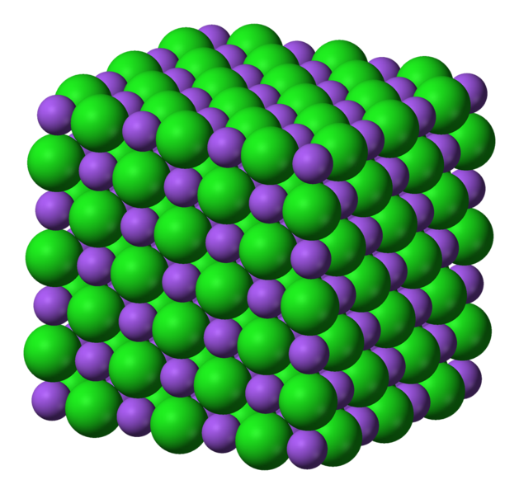
Ionic Crystals
multitude of ions grouped together in a highly-ordered, three-dimensional array
Sodium Chloride

Slide 26
Worksheet Practice
Part 1:Write the charge of each ion and circle whether it is a cation or an anion
Aluminum’s charge _____ cation or anion
Lithium’s charge _____ cation or anion

Slide 27
Worksheet Practice
Part 2:Write out the names for the following ionic compounds. Remember cations keep their name, while anions change their suffix to “ide”
SrS ___________________________
CaCl₂ ___________________________

Slide 28
Worksheet Practice
Part 3: Write out the formulas for the following ionic compounds
Cesium bromide ________________
Barium oxide ________________

