Slide 1
Classifying Chemical Reactions

Slide 2
Why classify reactions?
Help us remember and understand them
Notice patterns
Make predictions

Slide 3
5 Main Types:
Synthesis
Decomposition
Single Replacement
Double Replacement
Combustion

Slide 4
Synthesis Reaction
two or more substances combine to form another substance
Generic Formula:
A + B → AB

Slide 5
Synthetic Reaction Picture

Slide 6
Example:
2K + Cl₂ → 2KCl

Slide 7
Synthetic Reaction
2 or more simpler substances → one more complex substance

Slide 8
When forming a compound, be sure to pay attention to:
Covalent- the electron dot structure must be correct
Ca + O → CaO
#20 #8

Slide 9
When forming a compound, be sure to pay attention to:
Ionic- you must get the correct charges to cancel each other out
Na + I → NaI
+1 -1

Slide 10
Complete and Balance:
Ca + Cl₂ →
Fe + O₂ →
Al + O₂ →
Remember the first step is to write the correct formulas – you can still change the subscripts at this point, but not later while balancing!

Slide 11
Decomposition Reaction
one substance breaks down into 2 or more other substances
Generic Formula:
AB → A + B

Slide 12
Decomposition Reaction Picture

Slide 13
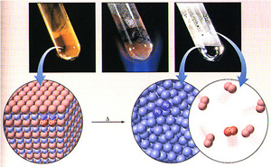
Example:
2HgO → 2Hg + O₂

Slide 14
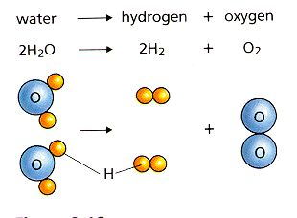
Decomposition Reaction
One compound → 2 or more simple substances

Slide 15
Predicting Products
If made of binary compounds, it separates down into each element
H₂O
HgO
electricity
heat

Slide 16
Predicting Products
If made of polyatomic compounds, you’ll be given one of the products. The other product comes from the left over pieces
NiCO₃ → CO₂ + _______
Zn(OH)₂ → H₂O + _______

Slide 17
Single Replacement Reaction
one element replaces another element in a compound
Generic Formula:
A + BC → AC + B

Slide 18
Single Replacement Picture
Either cations switch OR anions switch

Slide 19
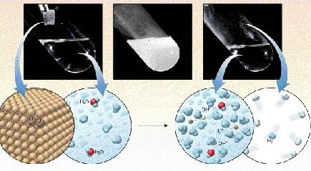
Example:
2Li + 2 H₂O → 2LiOH + H₂

Slide 20
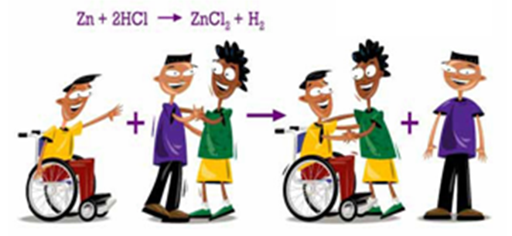
Single Replacement Reaction
Element + compound → new element + new compound

Slide 21
Single Replacement Reactions
Metals will replace other metals (and they can also replace hydrogen)
K + AlN →
Zn + HCl →
Think of water as: HOH
Metals replace the first H, and then combines with the hydroxide (OH)
Na + HOH →

Slide 22
Single Replacement Reactions
We can even tell whether or not a single replacement reaction will happen:
Because some chemicals are more “active” than others

Slide 23
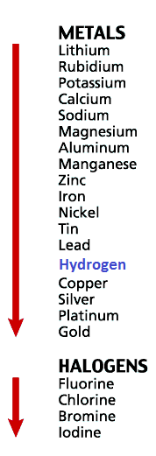
Predicting Products:
Activity series - a list of metals from most active to least active
(write these on the back of your periodic table)

Slide 24
More reactive or higher on list replaces less reactive or lower on list

Slide 25
The “Activity Series” of Halogens
Higher Activity
Halogens can replace other
halogens in compounds, provided they are above the halogen they are trying to replace.
Fluorine
Chlorine
Bromine
Iodine
Lower Activity
2NaCl_{(s)} + F_{2(g)} →
2NaF_{(s)} + Cl_{2(g)}
???
MgCl_{2(s)} + Br_{2(g)} →
No Reaction!
???

Slide 26
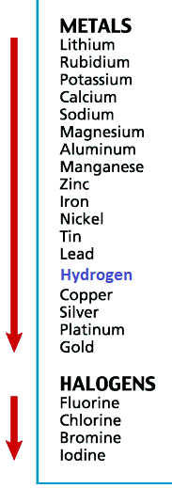
Which will replace the other?
Copper and Nickel
Tin and Calcium
Fluorine and Bromine
Silver and Lead

Slide 27
Single Replacement Reactions Practice:
Fe + CuSO₄ →
Pb + KCl →
Al + HCl →

Slide 28
Double replacement reaction
positive ion of one compound replaces the positive ion of the other
Generic Formula:
AB + CD → AD + CB

Slide 29
Double Replacement Picture

Slide 30
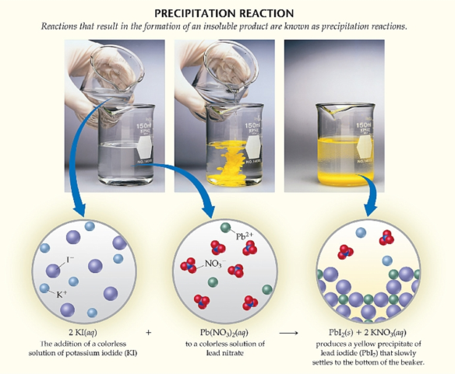
Example:
2KI + Pb(NO₃)₂ → PbI₂ + 2KNO₃

Slide 31
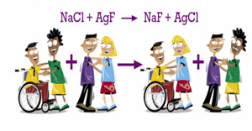
Double Replacement Reaction
2 compounds → 2 new compounds

Slide 32
All Double Replacement Reactions Produce either a:
Water
Gas
Precipitate
Precipitate – a solid that doesn’t dissolve in water

Slide 33
How do I figure out the identity of the new compounds?
Separate the compounds into their ions
NaOH + FeCl₃ →

Slide 34
How do I figure out the identity of the new compounds?
2) Switch the places of the cations
NaOH + FeCl₃ → Fe OH + Na Cl

Slide 35
How do I figure out the identity of the new compounds?
3) Match up charges to correctly write the new compounds
NaOH + FeCl₃ → Fe⁺³ OH⁻¹ + Na⁺¹ Cl⁻¹
NaOH + FeCl₃ →

Slide 36
Complete and balance:
+2 -1 +1 -1
CaCl₂ + NaOH →
CuCl₂ + K₂S →
-1 +1 -2

Slide 37
Complete and balance:
+1 -1 -1
KOH + Fe(NO₃)₃ →
(NH₄)₂SO₄ + BaF₂ →
-1 +2 +2 -1

Slide 38
How to recognize which type?
Look at the reactants:
E + E = Synthesis
C = Decomposition
E + C = Single replacement
C + C = Double replacement

Slide 39
Practice Examples:
KBr + Cl₂ →
H₂ + O₂ →
AgNO₃ + NaCl →
H₂O →
Zn + H₂SO₄ →
HgO →
Mg(OH)₂ + H₂SO₃ →

Slide 40
Combustion Reaction
Reaction of a substance with oxygen
Generic Formula:
C_{x}H_{y} + O₂ → CO₂ + H₂O

Slide 41
Example:

Slide 42
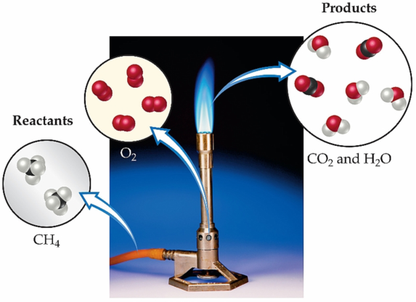
If it’s combustion of a hydrocarbon, you always get CO₂ and H₂O (both gases)

Slide 43
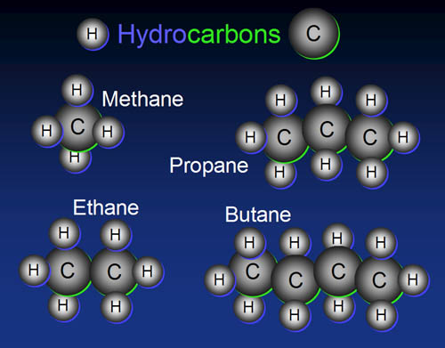
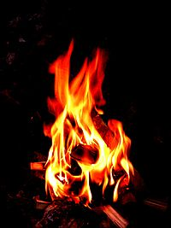
Hydrocarbon
something made of only hydrogen and carbon atoms

Slide 44
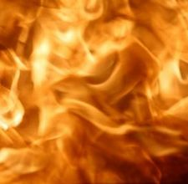
Combustion reactions are exothermic
HOT!
HOT!
HOT!

Slide 45
Combustion Reaction Examples:
C₄H₁₀ + O₂ →
C₆H₁₂O₆ + O₂ →
C₈H₈ + O₂ →

Slide 46
SUMMARY: An equation...
Describes a reaction
Must be balanced in order to follow the Law of Conservation of Mass
Can only be balanced by changing the coefficients.
Has special symbols to indicate the physical state, if a catalyst or energy is required, etc.

Slide 47
Reactions
Come in 5 major types.
We can tell what type they are by looking at the reactants.
Single Replacement happens based on the Activity Series
Double Replacement happens if one product is: 1) a precipitate (an insoluble solid), 2) water , or 3) a gas.

Slide 48
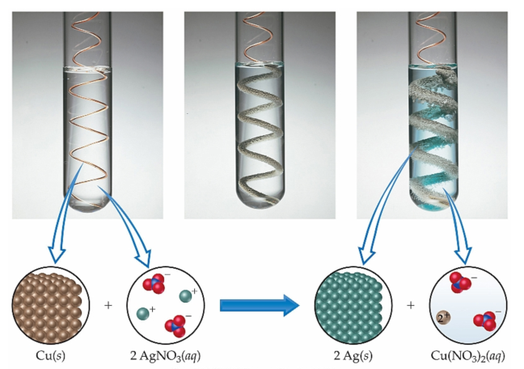
Synthesis, Decomposition, Single displacement, Double Displacement, or Combustion?

Slide 49
Synthesis, Decomposition, Single displacement, Double Displacement, or Combustion?

Slide 50
Synthesis, Decomposition, Single displacement, Double Displacement, or Combustion?

Slide 51
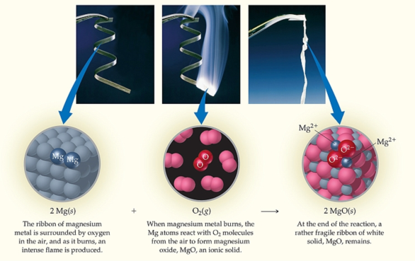
Synthesis, Decomposition, Single displacement, Double Displacement, or Combustion?

Slide 52
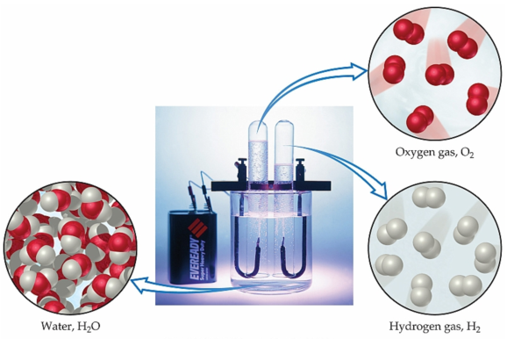
Synthesis, Decomposition, Single displacement, Double Displacement, or Combustion?

Slide 53
When are these Reactions Important?

Slide 54
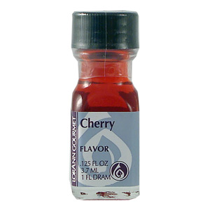
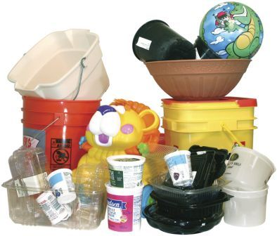
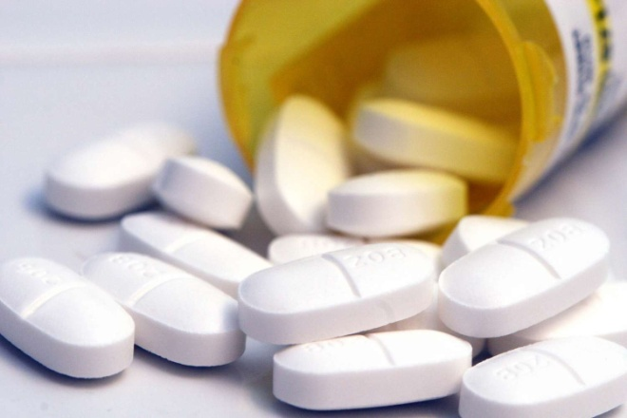
Synthesis Reactions
Medicines / Drugs Flavorings Plastics Man-made Jewels

Slide 55
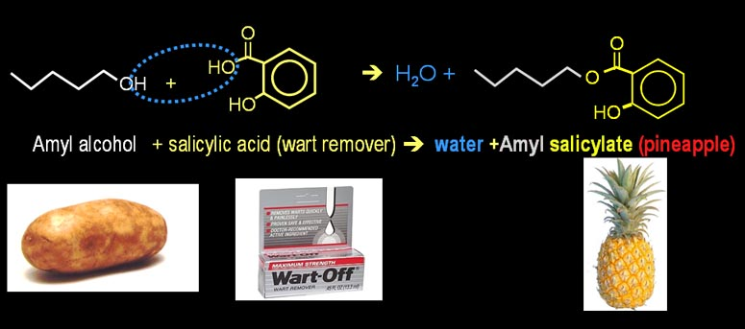
Synthesis of Pineapple Flavoring
When potatoes are fermented to make alcohol (ethanol), there's also some amyl alcohol produced (5 carbon alcohol). The smell or taste of amyl alcohol will make people instantly nauseated. The other reactant is salicylic acid, which is the active ingredient in many wart removers and anti-dandruff shampoos. Salicylic acid dissolves skin; however, when these two nasty chemicals are combined, they make a nice pineapple flavoring that you eat.

Slide 56
Decomposition Reactions
Speed up decomposition * Toxic waste * Waste * Fats * Explosives Slow down decomposition *Anti-rusting *Anti-aging

Slide 57
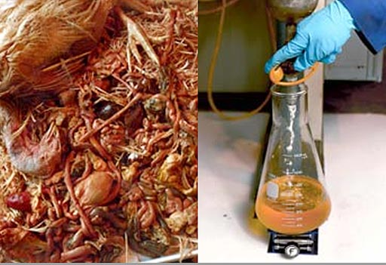
Decomposition of Turkey Waste
We don't eat turkey feathers, heads, feet, and guts, so there's a need to get rid of this waste. Some companies have figured out ways to break down all of this waste into an oil similar to diesel or biodiesel.

Slide 58
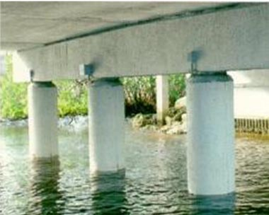
Single Replacement Reactions
One metal is sacrificed to save another
Concrete pillars have iron rebar in them for strength. However, salt water can quickly react with the iron to form iron (II) chloride. To prevent this, a metal like zinc or magnesium is attached to the rebar and will protect the iron.

Slide 59
Double Replacement Reactions
Neutralizing corrosive lye (sodium hydroxide)
Let's say you were using some drain opener (sodium hydroxide) and accidentally spilled some on the carpet. Lye is very dangerous and will cause blindness if gotten in the eye and will dissolve skin. The corrosive part of sodium hydroxide is the hydroxide. Notice that if you could replace the sodium in NaOH with hydrogen, you would get HOH, which is water. A weak acid like vinegar can supply that hydrogen. Below is the full reaction. Notice the water in the vinegar will dissolve the sodium hydroxide. The neutralization takes place when the H⁺ from the acetic acid bumps into the OH⁻ from the sodium hydroxide. At that point they form water (HOH or written as H₂O).

Slide 60
Combustion Reactions
We are interested in combustion reactions for two opposite reasons. Sometimes we want to speed it up and sometimes slow it down.
Speed up: Better fireworks
Slow down: Controlled heat

Slide 61
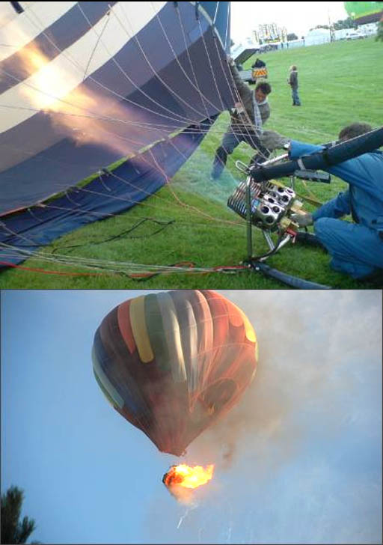
Combustion Reaction Example
Hot air balloons use large propane torches to heat the air in the balloon. Unfortunately, that much flame can cause a catastrophic fire (see bottom image). Fortunately, the 11 people in this balloon survived.

