Slide 1
Evidences for Evolution

Slide 2
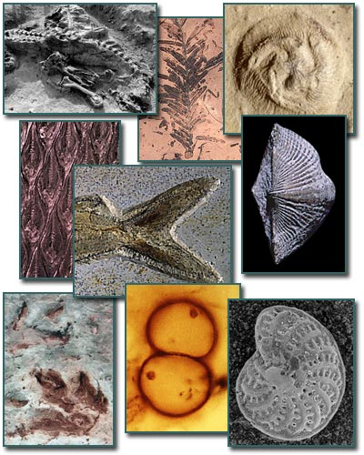
Evidences for Evolution
Fossil Records – shows relationships between species and how structures have changed

Slide 3
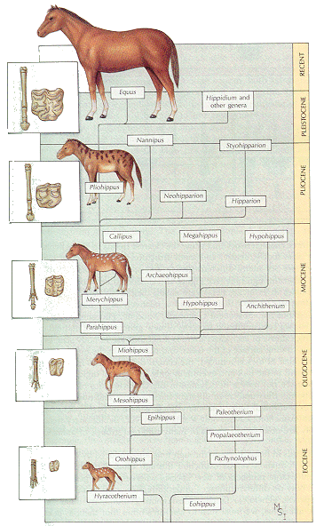

Slide 4
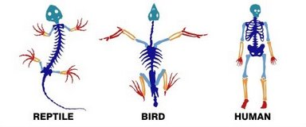
Evidences for Evolution
Anatomy

Slide 5
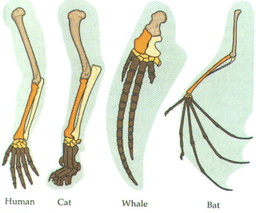
Anatomy
Homologous structures – traits that are similar because of a common ancestor
Ex. Arm, fin, wing

Slide 6
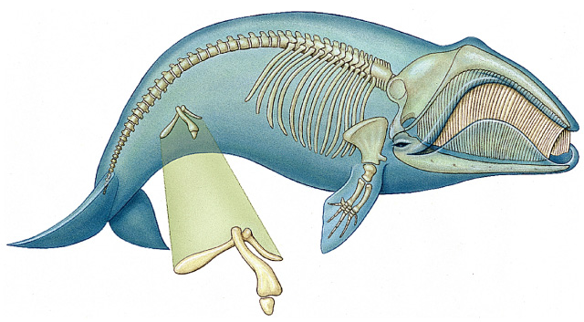
Anatomy
Vestigial structures – inherited traits that are reduced in size and often unused
Ex. – whale pelvic and leg bones

Slide 7
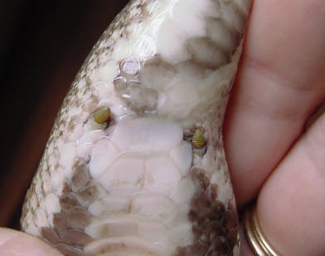
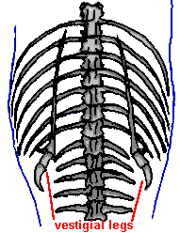
Python pelvic and leg bones

Slide 8
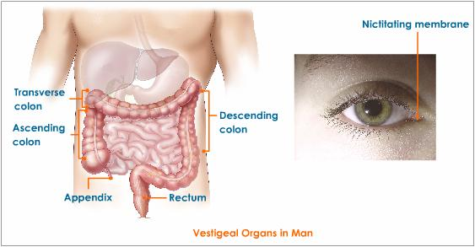
What vestigial organs do humans have?

Slide 9
Anatomy
Analogous structures – traits similar in function but don’t come from a common ancestor
Insect wings and bird wings

Slide 10
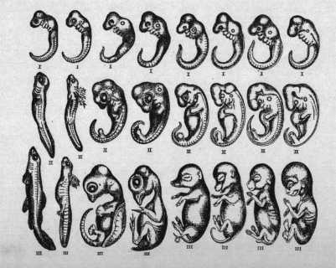
Evidences for Evolution
Embryology – related organisms develop in similar ways

Slide 11
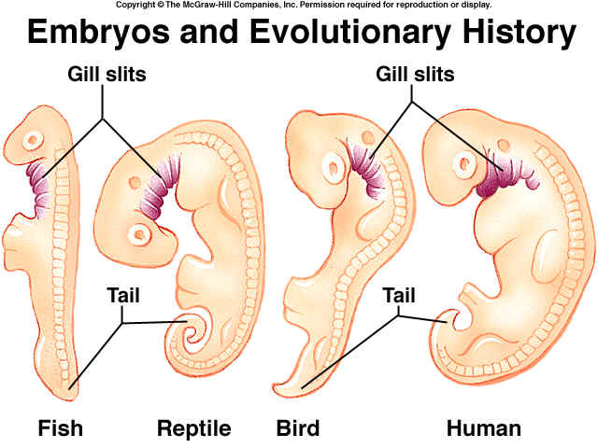
Ex. – gill pouches

Slide 12
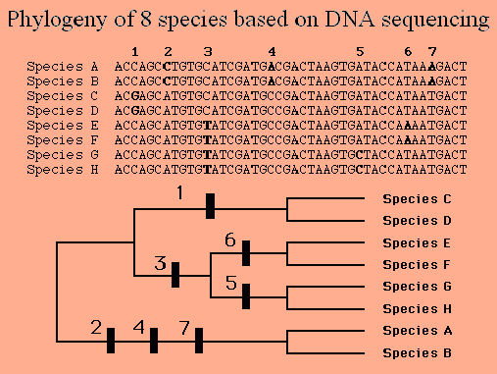
Evidences for Evolution
Biochemistry – closely related species share more base sequences

Slide 13
Evolution Genetic Tool Kit

