Slide 1
Review Punnett Squares

Slide 2
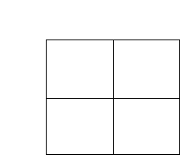
Crossing one trait
In rabbits, black fur is dominant over white fur.
A hybrid black fur rabbit is crossed with a purebred white fur rabbit
What is the genotypic ratio?
What is the phenotypic ratio?

Slide 3
Crossing two traits
In rabbits, black fur is dominant over white fur and short fur is dominant over long fur.
A purebred black fur, hybrid short fur is crossed with a purebred white fur, purebred long fur.

Slide 4
Crossing two traits
BBSs
x
bbss
What is the genotypic ratio?
What is the phenotypic ratio?

Slide 5
Heredity in Humans

Slide 6
Pedigrees
Unlike Mendel’s pea plants that produced seeds every 90 days, patterns of human inheritance aren’t easy to study.
Mature slowly
Many years pass between generations
Few offspring

Slide 7
Pedigrees
What we do have to aid in the study of human inheritance are family trees and family histories.

Slide 8
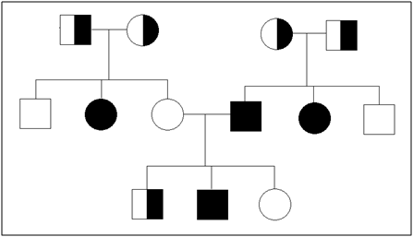
Pedigrees
Geneticists study family trees or pedigrees to learn about human inheritance patterns.
Pedigree – a chart that shows how a trait and the genes that control it are inherited within a family.

Slide 9
Symbols of a Pedigree
Circle – female
Square – male
Horizontal line between circle and square – marriage

Slide 10
Symbols of a Pedigree
Not shaded – don’t have the trait
Completely shaded – have the trait
Half shaded – they are a carrier

Slide 11
Carrier – an individual who has the recessive trait but it is not expressed
Remember, recessive alleles (lower case letters) are not expressed if there is a dominant allele (capital letter)present.

Slide 12
Two kinds of genetic triats:
Recessive traits
Dominant traits

Slide 13
Recessive Traits
It takes two recessive alleles for a recessive trait to show up
While a recessive allele that can produce a genetic disorder does not affect a carrier’s health, the carrier can pass it on to their offspring.

Slide 14
Tay-Sachs disease
A person with two recessive alleles for Tay-Sachs disease is not able to break down a certain type of lipid and so it accumulates in the brain. This accumulation eventually results in blindness and brain damage. Those who have this disease usually do not survive more than a few years.
Carriers don’t show any effects and so it is passed on and kept in the population.

Slide 15
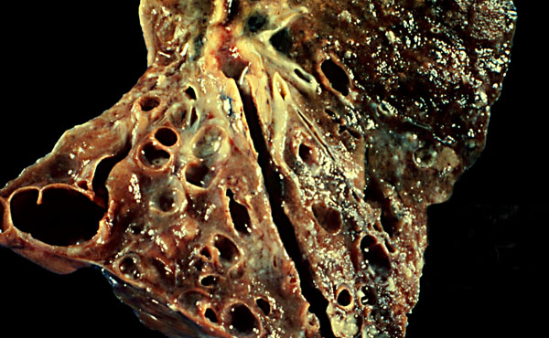
Cystic Fibrosis
This recessive disease results in an excessive secretion of thick mucus. The mucus accumulates in the digestive tract and in the lungs. If left untreated, children with cystic fibrosis die at a very young age. However, current treatments are prolonging life into young adulthood and beyond.

Slide 16
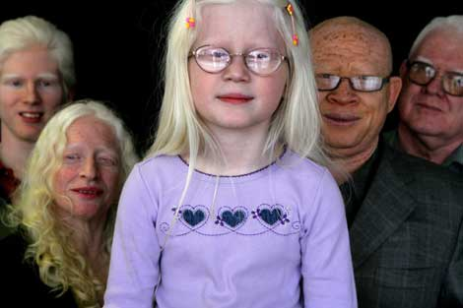
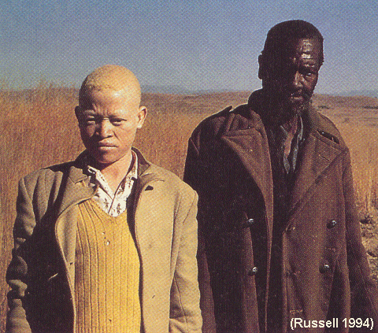
Albinism
True albinos have no skin pigment. People with albinism typically have very pale skin and whitish blond hair and can be of any racial background.

Slide 17
Dominant Traits
Dominant alleles are always expressed
They control many human traits:
- freckles
- widow’s peak
- free earlobe
- hitchhiker’s thumb

Slide 18
Dominant traits
In many cases, if a dominant allele produces a fatal disorder, the person is likely to die before passing that allele on to offspring.
For this reason disorders caused by dominant alleles are much less common than those caused by recessive alleles.

Slide 19
Huntington disease
Fatal genetic disorder that results in deterioration of the nervous system, particularly the brain.
People with this disease typically do not develop the symptoms until they are in their late thirties or early forties. By that time, they may have already passed it on to their offspring.

Slide 20
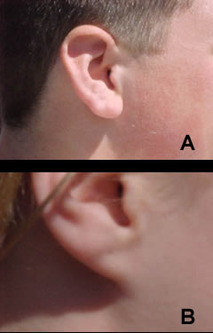
Solve the Genetic Puzzle!
The gene for free hanging earlobes is dominant, and the gene for attached earlobes is recessive.
Can you figure out these people’s genotypes based on the phenotype information (whether or not they have free hanging lobes) and genetic relationships described next?

Slide 21
Solve the Genetic Puzzle!
Clues:
Mary is the only one in her immediate family who has attached lobes.
Both of Mary's parents have free hanging lobes.
Mary's brother Fred also has free hanging lobes.
Questions:
1. If Mary has attached lobes, what must her genotype be?
2. If both Mary’s parents have free hanging earlobes, but they had a daughter who has attached lobes, what must their genotypes be?
3. What are the possible genotypes for Fred, Mary’s brother? Is it possible to identify his exact genotype? Why or why not?

Slide 22
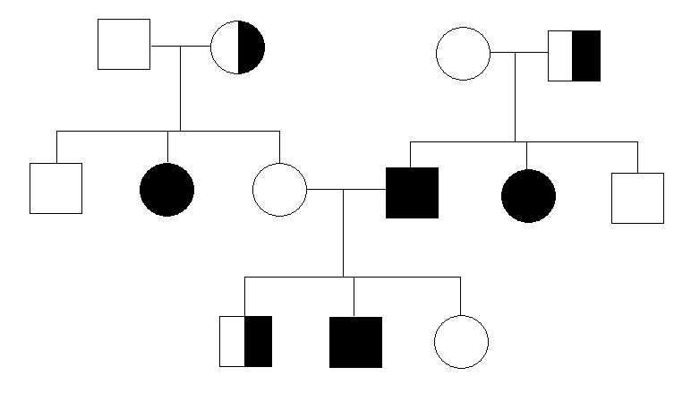
Genetic Counseling
Couples who may have genetic disorders in their families, and are planning to have children may seek genetic counseling.
Genetic counselors prepare pedigrees for parents showing the probabilities of passing genetic disorders on to their offspring.

Slide 23
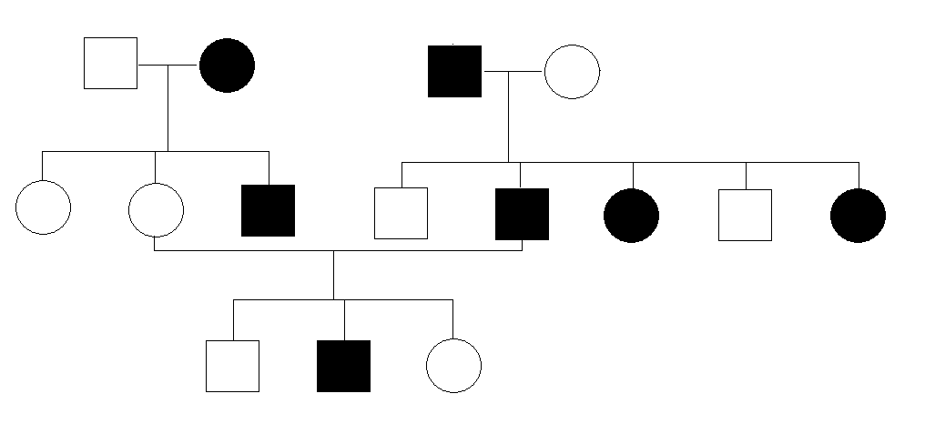
Pedigree for Huntington disease
Use H for the genotype – find the genotypes for each family member

Slide 24
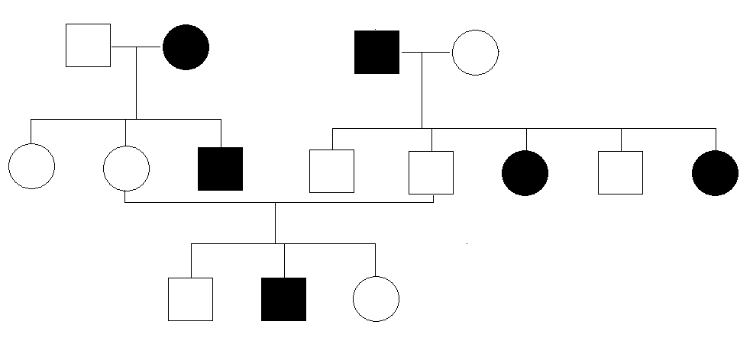
Pedigree for Albinism
Use A for the genotype – find the genotype for each family member

Slide 26
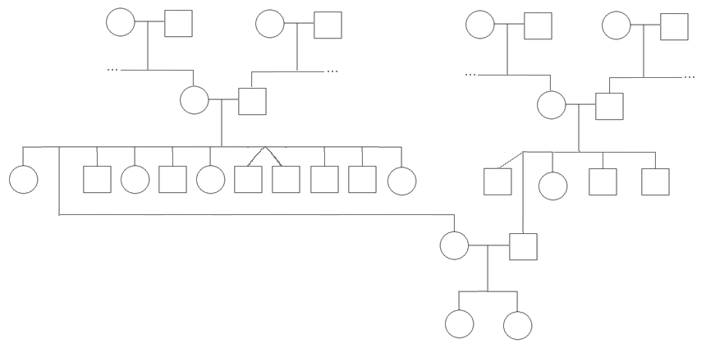
What does your pedigree chart look like?

Slide 27
Purpose of a pedigree cart
Scientists or a genetic counselor would find out about your family history and make this chart to analyze it.
Probability

Slide 28
Interpreting a pedigree chart
Determine if the pedigree chart shows an autosomal or X-linked disease.
if most of the males are affected, it is X-linked
if it is 50/50, it is autosomal

Slide 29
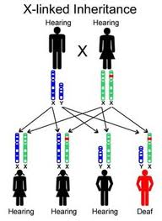
23 pairs of Chromosomes
Sex chromosomes – determine whether the offspring is male or female
Females: XX
Males: XY

Slide 30
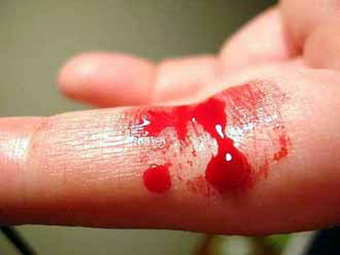
X-linked Examples:
Hemophilia

Slide 31
Father unaffected, Mother carrier

Slide 32
Father affected, Mother unaffected

Slide 33
Father affected, Mother carrier

Slide 34
X-Linked Example: Colorblindness

Slide 35
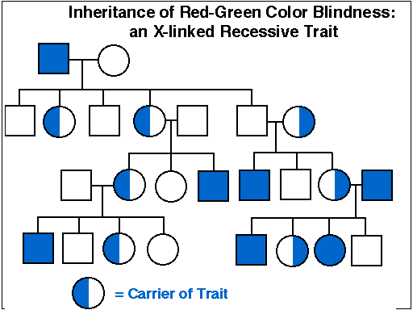

Slide 36
Interpreting a pedigree chart
Determine if the pedigree chart shows an autosomal or X-linked disease.
if most of the males are affected, it is X-linked
if it is 50/50, it is autosomal

Slide 37
Example of Pedigree Charts
Is it Autosomal or X-linked?
Notes:
Take a minute and try to decide if this slide is autosomal or X-linked.

Slide 38
Example of Pedigree Charts
Is it Autosomal or X-linked?
Notes:
Take a minute and try to decide if this slide is autosomal or X-linked.

Slide 39
Interpreting a pedigree chart
Determine if the pedigree chart shows an dominant or recessive disease.
if dominant, one parent must always have the disorder
if recessive, neither parent has to have it, can skip generations

Slide 40
Example of Pedigree Charts
Dominant or Recessive?
Notes:
Is this pedigree dominant or recessive?

Slide 41
Example of Pedigree Charts
Dominant or Recessive?
Notes:
Is this pedigree dominant or recessive?

Slide 43
Beyond Mendel’s “Laws”

Slide 44
Mendel worked with peas….
Dominant and recessive
Only two alleles
However, most genetics are a lot more complicated…
Some alleles are neither dominant nor recessive, and many traits are controlled by multiple alleles

Slide 45
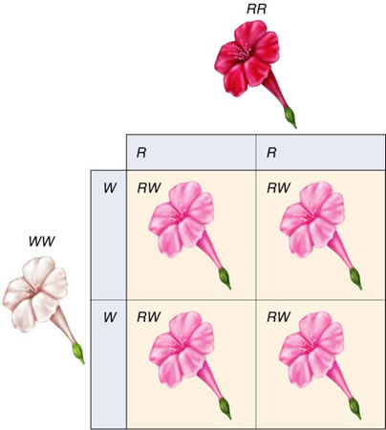
Incomplete Dominance
One allele is not dominant over another
Example:
Red flowers X White flowers = Pink flowers
Heterozygous is a mix!

Slide 46
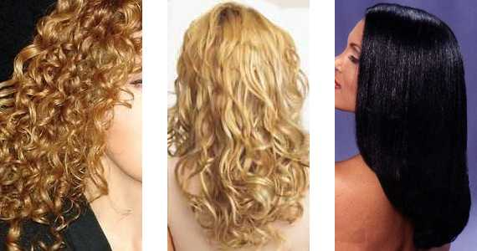
Human example of incomplete dominance
Hair texture
CC CS SS

Slide 47
What would be the phenotypic ratio of the offspring of cross between a white mouse and a black mouse in incomplete dominance?

Slide 48
Codominance
The prefix “Co” means “together”
Cooperate = work together.
Coexist = exist together.
Cohabitat = habitat together.

Slide 49
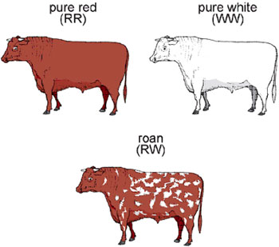
Codominance
Both alleles are dominant and expressed in phenotype together
Example:
Red hair in cows X White hair in cows = Roan (red and white) hair

Slide 50
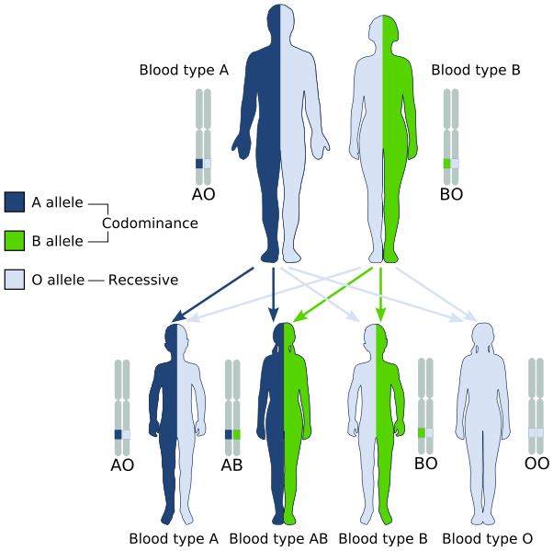
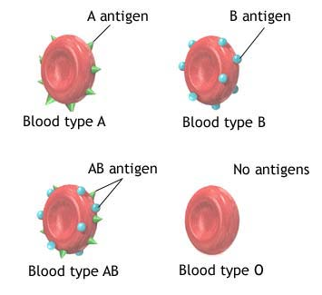
Human example of Codominance
Blood type

Slide 51
Predict the outcome if two roan cattle were crossed.

Slide 52
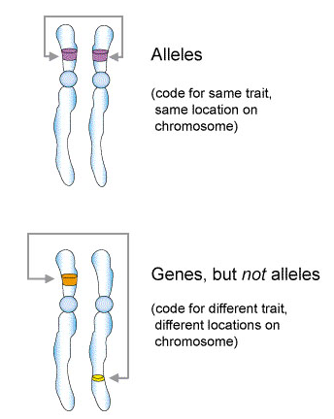
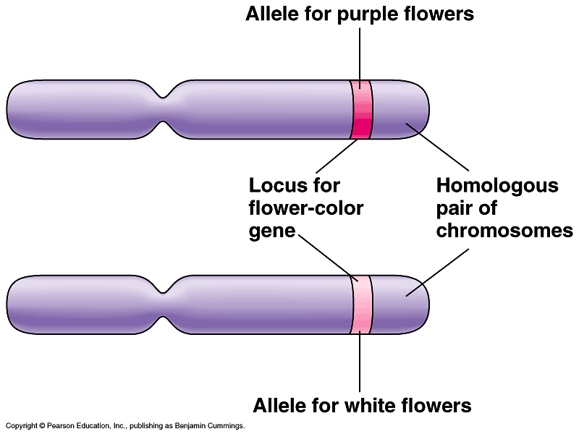
Multiple Alleles
Genes – sections of a chromosome that code for a trait
Allele – distinct form of a gene

Slide 53
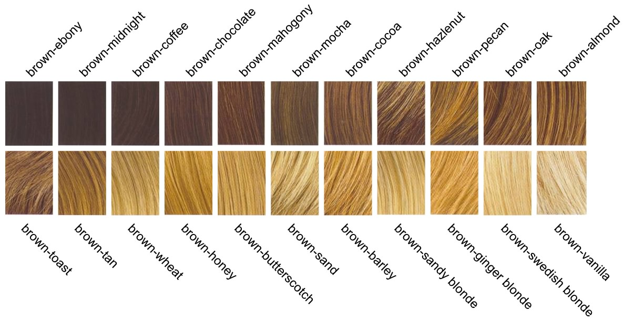
Multiple Alleles
More than 2 alleles exist for a trait

Slide 54
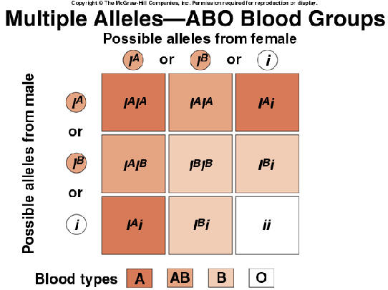
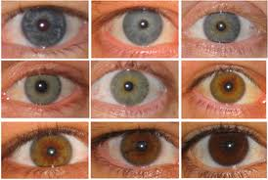
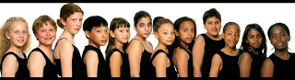
Multiple Alleles
Examples: Hair color, eye color, blood type…

Slide 55
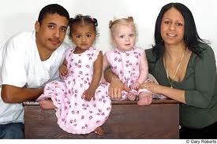
Twins

