Slide 1
Review

Slide 2
What are the 2 properties of matter?

Slide 3
A graduated cylinder is used to measure…
Weight
Volume
Mass
Inertia

Slide 4
The volume of a solid is measured in…
Liters
Grams
Cubic centimeters
All of the above

Slide 5
Mass is measured in…
Kilograms
Liters
Centimeters
Newtons

Slide 6
What is the relationship between mass and inertia?

Slide 7
A nugget of gold is placed in a graduated cylinder that contains 80 mL of water. The water level rises to 225 mL after the nugget is added to the cylinder. What is the volume of the gold nugget?

Slide 9
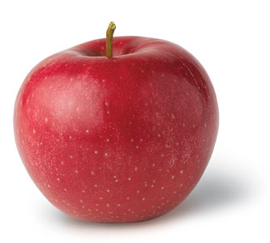
Physical property
a characteristic of a substance that can be observed without changing its identity

Slide 10
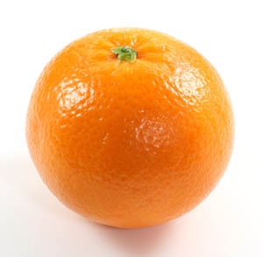
Examples:
Color, odor, mass, volume
Magnetism
Strength
Ability to conduct a current

Slide 11
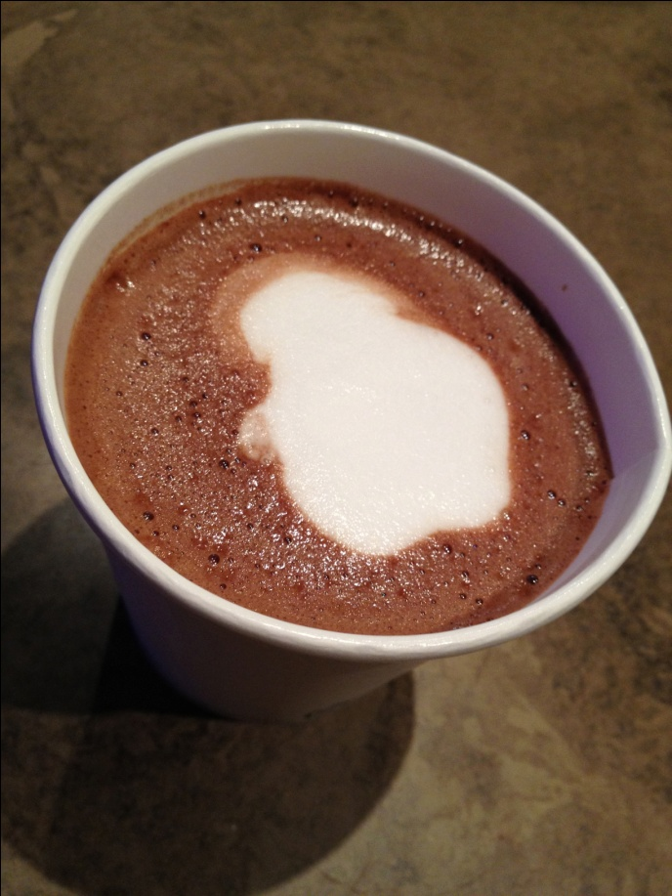
Other physical properties
Conductivity – rate at which it transfers heat
Plastic Foam is a poor conductor

Slide 12
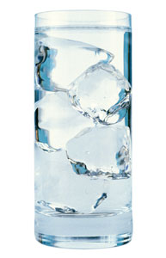
Other physical properties
State – physical form it is in such as solid, liquid, or gas
Ice is water in the solid state

Slide 13
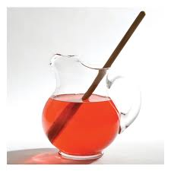
Other physical properties
Solubility – ability to dissolve in another substance
Flavored drink mix dissolves in water

Slide 14
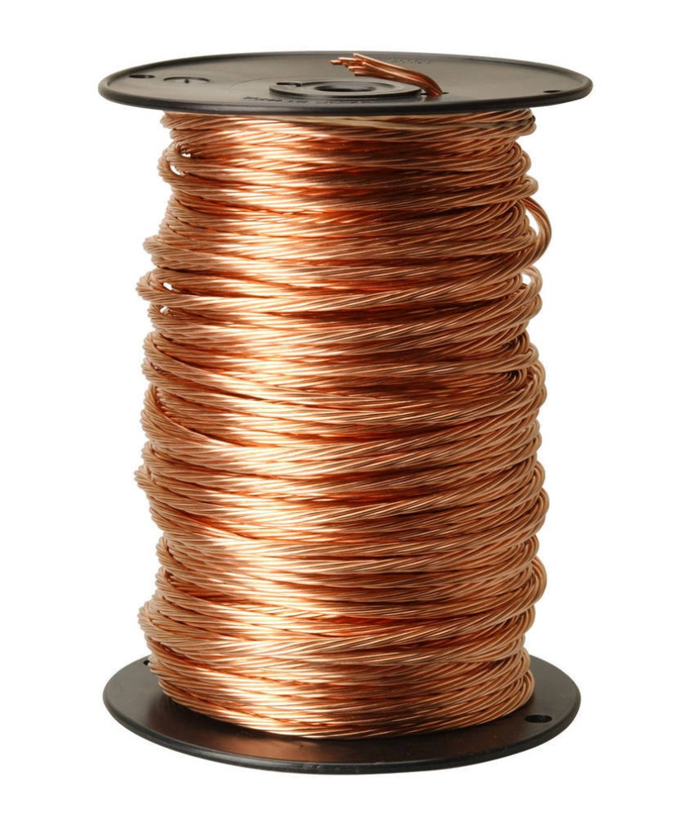
Other physical properties
Ductility – ability to be drawn into wires

Slide 15
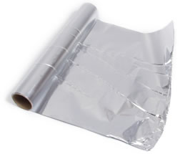
Other physical properties
Malleability – ability to be rolled or pounded into sheets

Slide 16
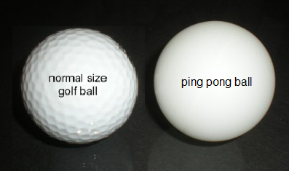
Other physical properties
Density – amount of matter in a given volume
Lead is very dense, so it makes a good sinker for a fishing
46 g 2 g

Slide 17
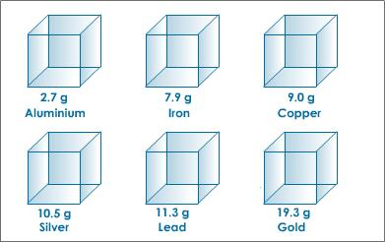
Density is a useful tool for identifying a substance

Slide 18
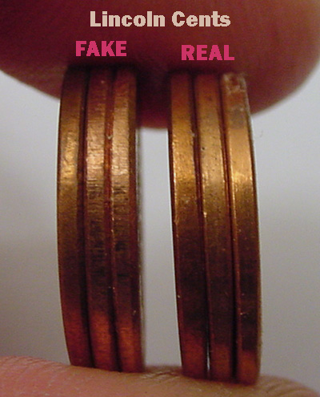
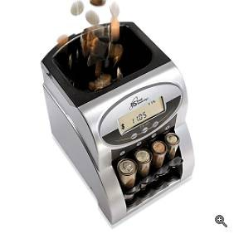
No Wooden Nickels!
Electronic coin testers in vending machines can instantly identify the properties of real coins and reject fake coins.

Slide 19
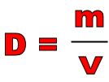
Equation for Density:

Slide 20
Density
Measured in g/cm³, g/mL, kg/m³, and kg/L

Slide 21
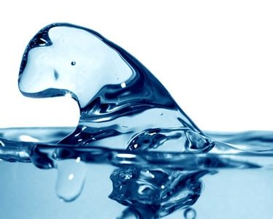
Density
Water has a density of 1.00 g/mL

Slide 22
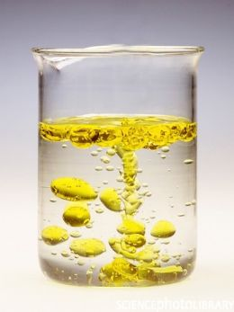
Density
Anything with a higher density than water will sink, and anything with a lower density will float

Slide 23
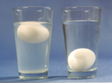
How to tell if an egg has gone bad

Slide 24
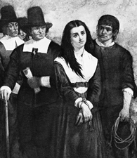
Salem Witch Trials
If she floated, she was a witch
If she sank, she wasn’t

Slide 25
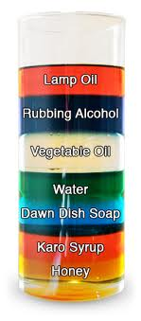
Fun With Density

