Slide 1
Empirical and Molecular Formulas

Slide 2
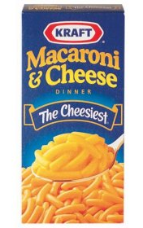
Mac and Cheese
How many calories are in a whole box of Mac and Cheese?

Slide 3
Percent Composition
% by mass of each element in a compound
Equation:
% by mass (element) = mass of element
X 100
mass of compound

Slide 4
Na makes up what % of NaCl?
Na’s atomic mass = 22.99
Cl’s atomic mass = 35.45
NaCl’s mass = 58.44
22.99 / 58.44 = .3934 x 100 = 39.34%
What is Cl’s % mass?

Slide 5
H₃PO₄
H = __________%
P = __________ %
O = __________%

Slide 6
Question
Which has a larger % by mass of Sulfur?
H₂SO₄ or H₂S₂O₈

Slide 7
Once the % composition is known, then we can find the compound’s empirical formula.

Slide 8
Empirical formula
Smallest whole number ratio of elements in a compound
H₂O 2:1
Empirical formula
Sometimes the empirical formula does not match the molecular formula

Slide 9
Empirical formula of hydrogen peroxide
H₂O₂ 2:2→1:1
HO = empirical formula

Slide 10
Steps for determining the empirical formula:

Slide 11
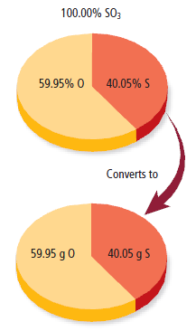
Find number of grams of each element
If % is given, assume that total mass is 100 g so that the mass of each element = % given

Slide 12
2. Convert mass to moles using the molar mass from periodic table
g/molar mass
Moles Mass

Slide 13
3. Divide each mole value by the smallest number of moles calculated
4 mol X 20 mol Y
________
4
________
4

Slide 14
4. Round to the nearest whole #. This is the mole ratio of the elements and is represented by subscripts in the empirical formula
4 mol X 20 mol Y
________
4
________
4

Slide 15
Whole numbers
If the number is too far to round, multiply each solution by same factor to get the lowest whole number
Example: 1.5 x 2 = 3
Example: 1.33 x 3 = 4
Example: 1.25 x 4 = 5

Slide 16
5. Write empirical formula with whole numbers as subscripts for elements
1 mol X 5 mol Y
XY₅

Slide 17
Try It!
Cinnamon contains cinnamaldehyde. A molecule of cinnamaldehyde contains:
81.79% C
6.10% H
12.11% O
What is the empirical formula?

Slide 18
Steps
1. Find grams
81.79% C
6.10% H
12.11% O
= 81.79g
= 6.10g
= 12.11g

Slide 19
Steps
2. Mass to moles (divide g by molar mass)
81.79g C
6.10g H
12.11g O
/12.01 = 6.81 mol
/1.01 = 6.04 mol
/15.99 = 0.76 mol

Slide 20
Steps
3. Divide by smallest mol amount
6.81 mol C
6.04 mol H
0.76 mol O
/ 0.76 = 8.96
/ 0.76 = 7.94
/ 0.76 = 1

Slide 21
Steps
4. Round to whole number
C - 8.96
H - 7.94
O - 1
= 9
= 8
= 1

Slide 22
Steps
5. Use numbers as subscripts for formula
C - 9
H - 8
O - 1
C₉H₈O

Slide 23
Assignment!
Empirical formula worksheet

