Slide 1
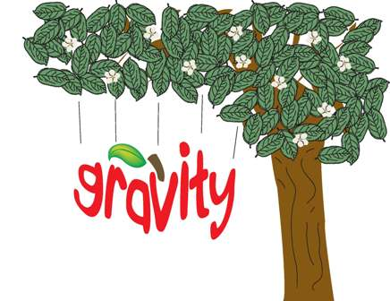

Slide 2
Gravity – force of attraction between objects due to their mass
Can change speed, direction, or both

Slide 3
All objects experience an attraction toward all other objects
Why don’t you notice objects moving toward each other?

Slide 4
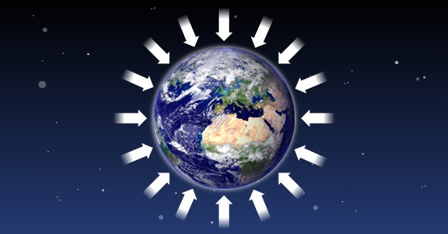
Compared to all objects around you, Earth has a HUGE mass

Slide 5
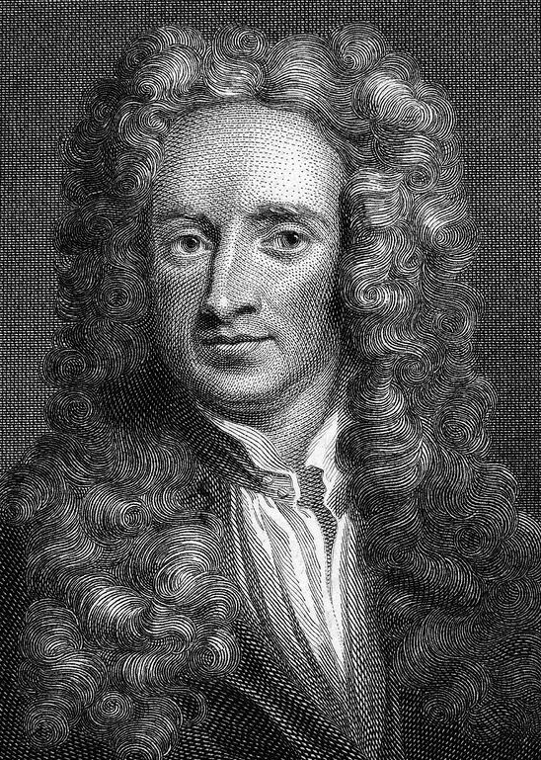
Discovered by
Sir Isaac Newton in 1665
British scientist

Slide 6
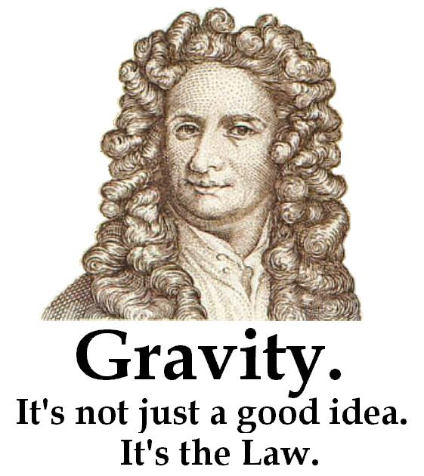
The Law of Universal Gravitation – all objects in the universe attract each other through gravitational force
Masses of objects
Distance between objects

Slide 7
Universal Law of Gravitation:
1. Gravitational force increases as mass increases

Slide 8
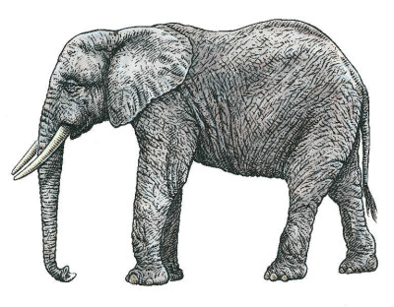
Cat vs. Elephant

Slide 9
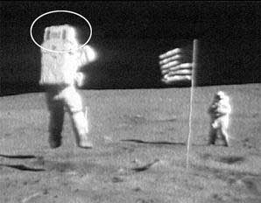
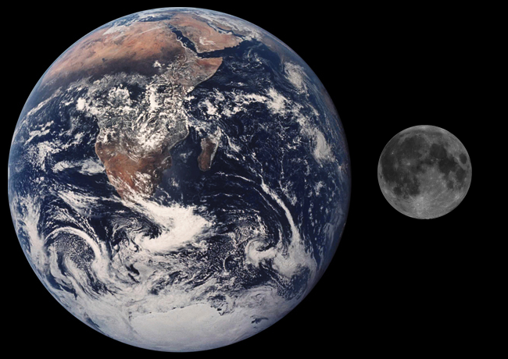
Moon and Earth

Slide 10
Universal Law of Gravitation:
2. Gravitational force decreases as distance increases

Slide 11
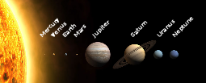
You and Sun vs. You and Earth
Why doesn’t the Sun’s gravitational force affect you more than Earth’s?

Slide 12
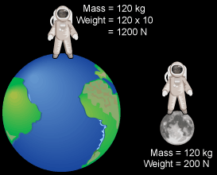
Weight – measure of gravitational force on an object
Can change with location

Slide 13
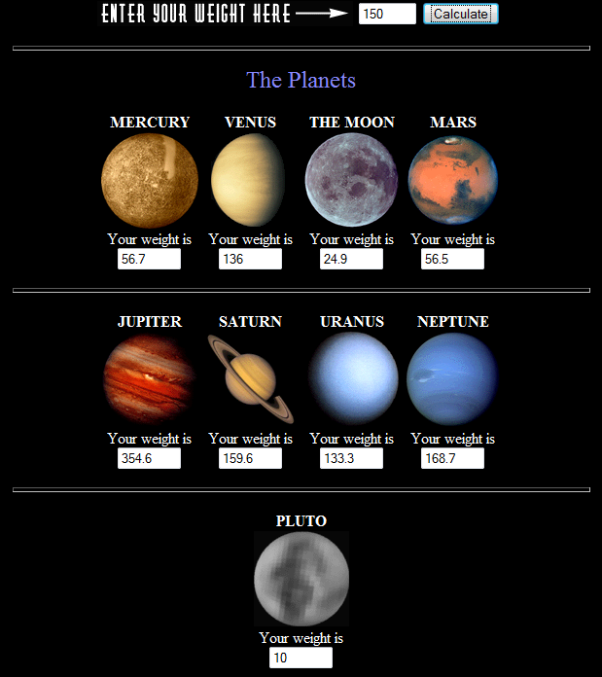
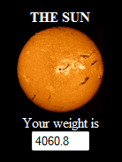
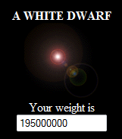
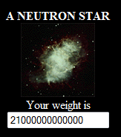
Your weight on other planets & 3 different types of stars

Slide 14
Weight
Measured in: Newtons
1 Newton = 0.22 lbs

Slide 15
Mass – amount of matter in an object
Does not change with location

Slide 16
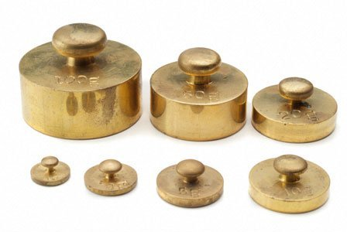
Mass
Measured in: grams

Slide 17
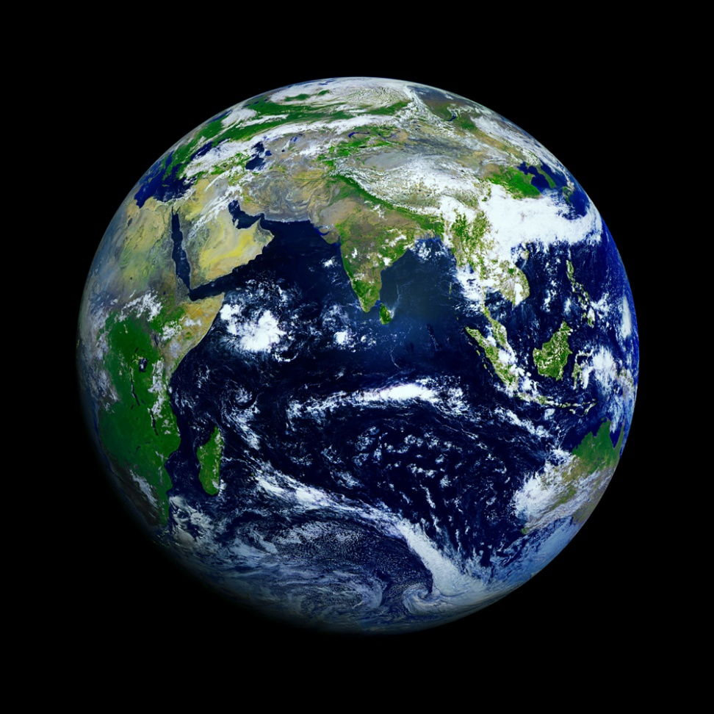
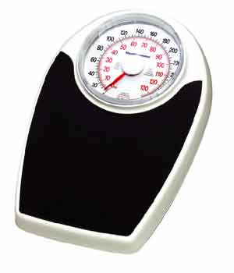
Why are Mass and Weight often confused?

Slide 18
Questions
Where would you weigh the most?
On a boat
On the space shuttle
On the moon

Slide 19
Questions
If Earth’s mass doubled without changing its size, your weight would:
Decrease because gravitational force decreases
Increase because gravitational force increases
Increase because gravitational force decreases
Not change because you are still on the Earth

Slide 20
Questions
The gravitational force on Jupiter is approximately 2 times the gravitational force on Earth. If an object has a mass of 70 kg and a weight of 600 N on Earth, what would the object’s mass and weight on Jupiter be?

Slide 21
Questions
Your friend thinks that there is no gravity in space. How would you explain to your friend that there must be gravity in space?

