Slide 1
Quick Review

Slide 2
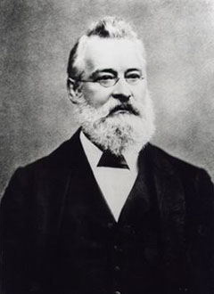
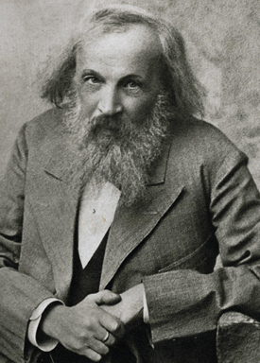
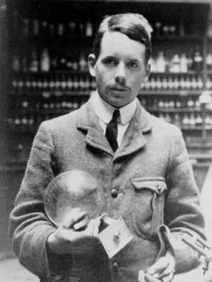
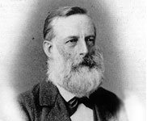
Newlands Mendeleev and Meyer Moseley
Arranged the elements by increasing atomic mass?
Predicted elements that had not been discovered yet?
Arranged the elements by increasing atomic number?
Came up with the law of octaves?

Slide 3
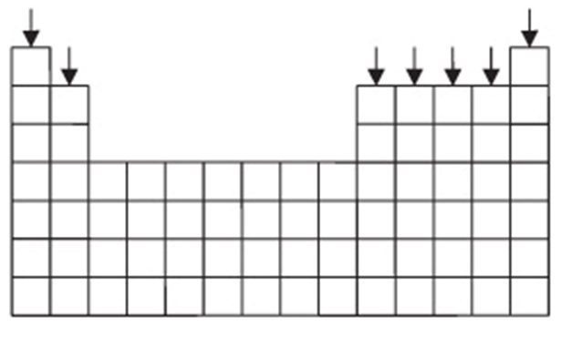
Vertical Columns?

Slide 4
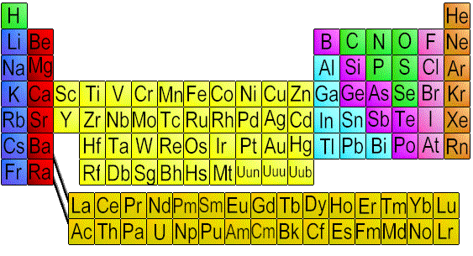
Copper, Silver, and Gold
3 of the few that are found naturally in elemental state
Used in currency and jewelry because of colors and resistance to corrosion
How does the table show that they have similar characteristics?

Slide 5
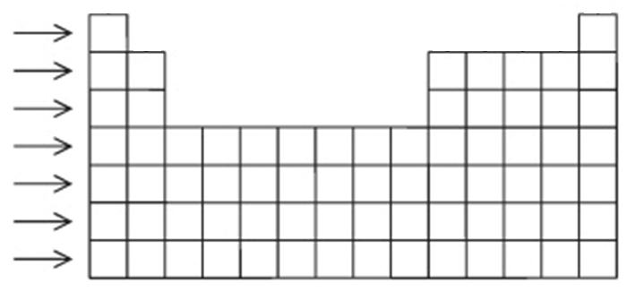
Horizontal Rows?

Slide 6
Classification

Slide 7
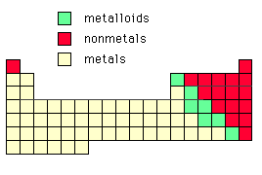
Metals make up most of the elements

Slide 8
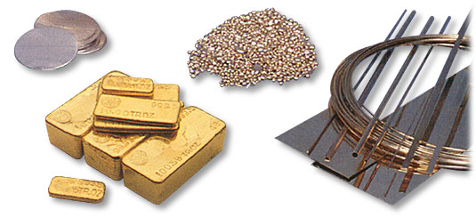
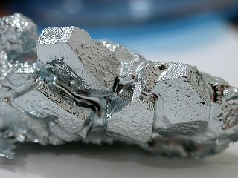
METALS
Shiny

Slide 9
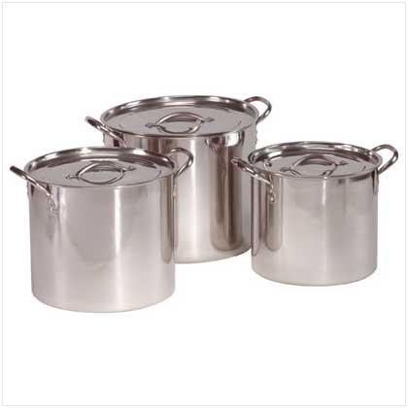
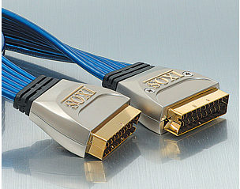
METALS
Good conductors of heat and electricity

Slide 10
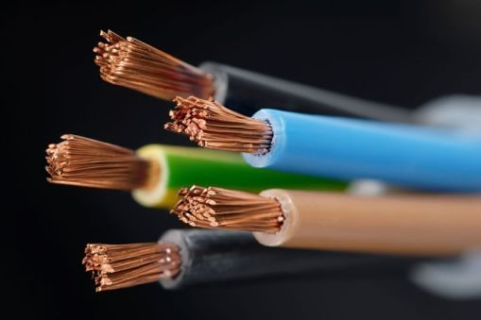
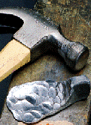
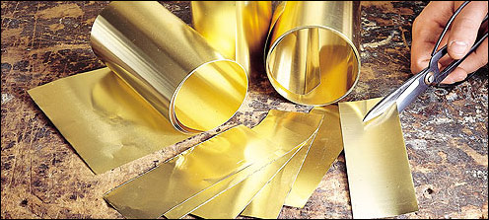
METALS
Malleable and Ductile

Slide 11
METALS
Found on left side of periodic table

Slide 12
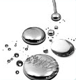
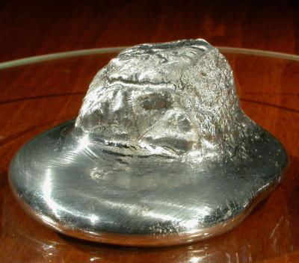
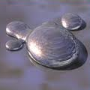
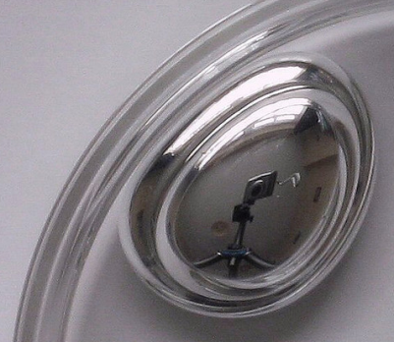
Metals are solids at room temp.
Exceptions:
Mercury (Hg)
Gallium (Ga)
Cesium (Cs)
Francium (Fr)
Warm room temp.

Slide 13
Classification
METALS
NONMETALS
METALLOIDS

Slide 14
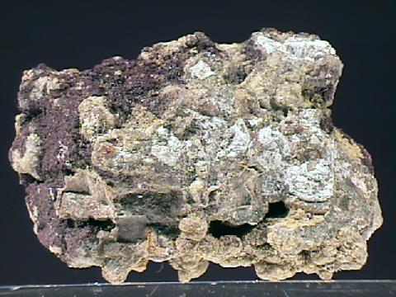
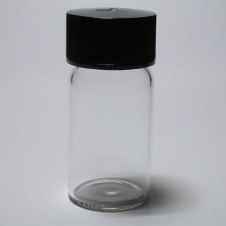
NONMETALS
Dull or transparent

Slide 15
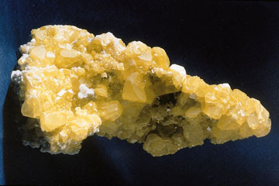
NONMETALS
Poor conductors of heat and electricity

Slide 16
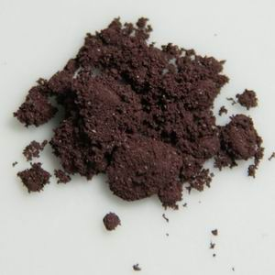
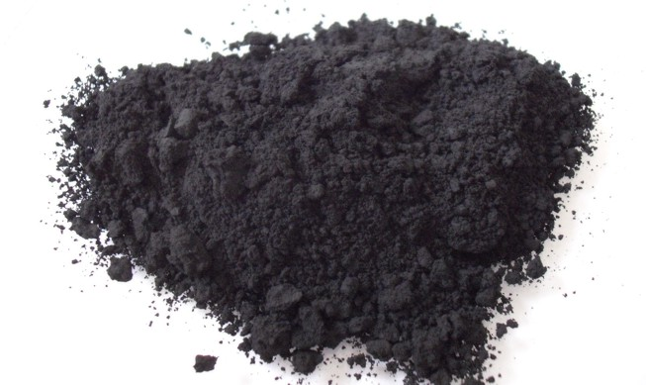
NONMETALS
Brittle and not ductile
C
P

Slide 17
NONMETALS
Found on upper right of periodic table

Slide 18
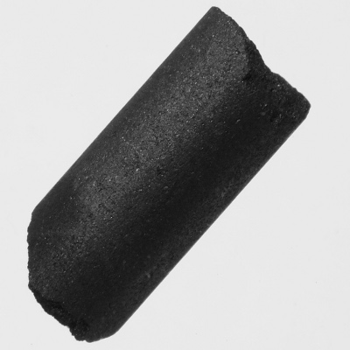
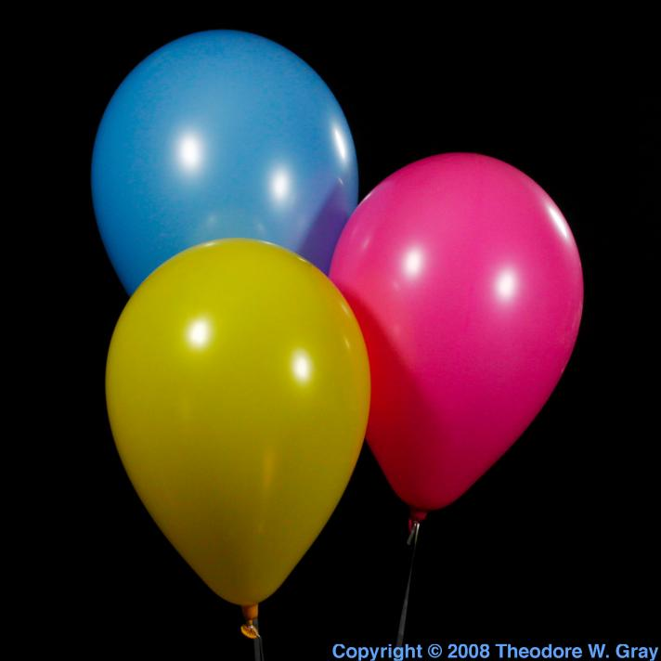
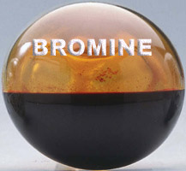
Nonmetals include all phases
Solid = Carbon (C)
Liquid = Bromine (Br)
Gas = Helium (He)

Slide 19
Classification
METALS
NONMETALS
METALLOIDS

Slide 20
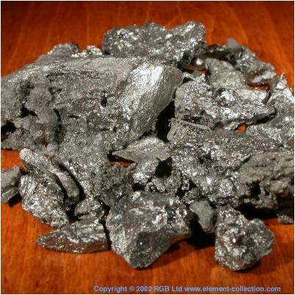
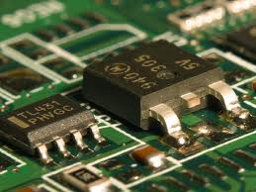
METALLOIDS
Contains properties of both metals and nonmetals
Weak conductors of heat and electricity

Slide 21
METALLOIDS
Found along the stair steps of periodic table
Boron
Silicon
Germanium
Arsenic
Antimony
Tellurium
Polonium
Astatine

Slide 22
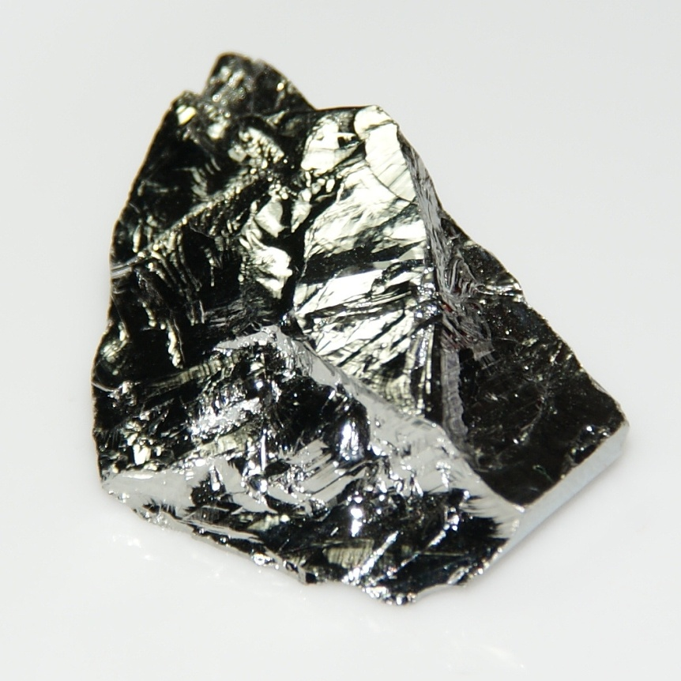
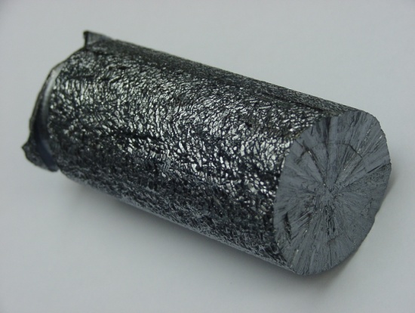
Germanium vs. Silicon
Because of position, Germanium has more metallic properties
But silicon is more abundant and cheaper to manufacture

Slide 23
Metal, Nonmetal, or Metalloid?
If you found a substance that was dull and brittle and couldn’t conduct heat, you have most likely found …

Slide 24
Metal, Nonmetal, or Metalloid?
If you found a substance that was shiny but brittle and could sort of hold a current, you have most likely found …

Slide 25
Metal, Nonmetal, or Metalloid?
If you found a substance that was shiny and malleable and could be formed into wires to hold heat and an electric current, you have most likely found …

