Slide 1
Review Meiosis and Mitosis

Slide 2
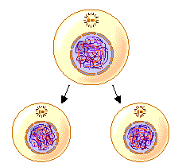
Mitosis or Meiosis
1 division

Slide 3

Mitosis or Meiosis
4 daughter cells produced

Slide 4
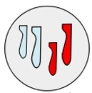

Mitosis or Meiosis
Daughter cells different from parent

Slide 5
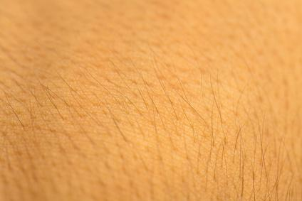
Mitosis or Meiosis
Asexual reproduction

Slide 6
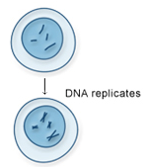
Mitosis or Meiosis
Duplicates chromosomes

Slide 7
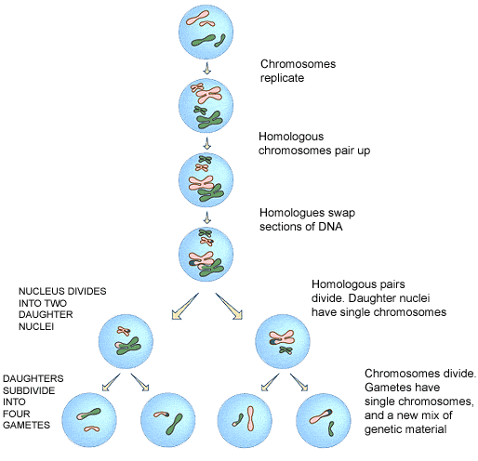
Mitosis or Meiosis
Chromosome # stays same

Slide 8
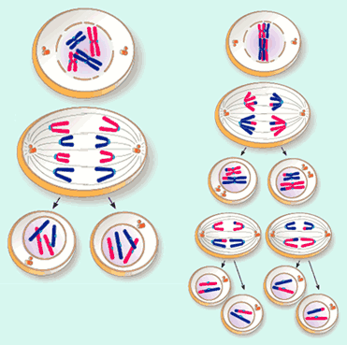
Mitosis or Meiosis
2 daughter cells produced

Slide 9
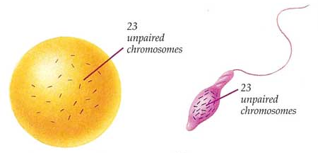
Mitosis or Meiosis
Sexual reproduction

Slide 10
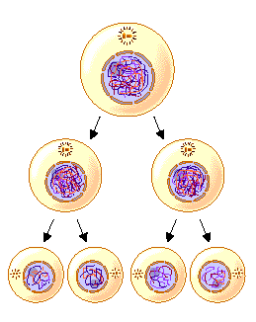
Mitosis or Meiosis
2 divisions

Slide 11
Mitosis or Meiosis
Chromosome # is halved

Slide 12


Mitosis or Meiosis
Daughter cells identical to parent

Slide 14
Regulating the Cell Cycle

Slide 15
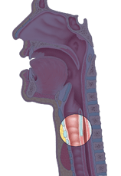
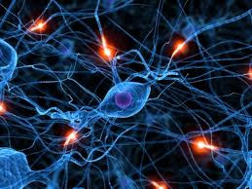
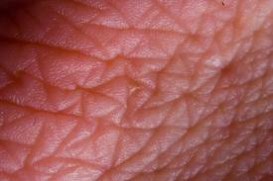
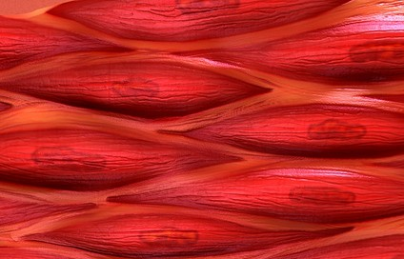
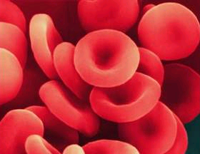
Not all cells move through the cell cycle at the same rate
Nerve cells – long lived, most don’t divide
Skin cells – every 28 days
Cells of Digestive Tract – 2-5 days
Red blood cells – under 120 days, can’t divide
Most Muscle cells – long lived, can’t divide

Slide 16
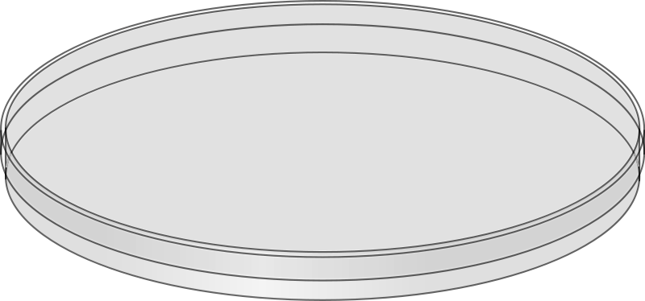
Observing Controlled Cell Growth
Few cells
When cells come in contact with other cells, they respond by not growing
Eventually fill the entire area

Slide 17
Observing Controlled Cell Growth
If cells are removed
Until the entire space is filled again and then they stop
Cells next to the space will begin growing

Slide 18
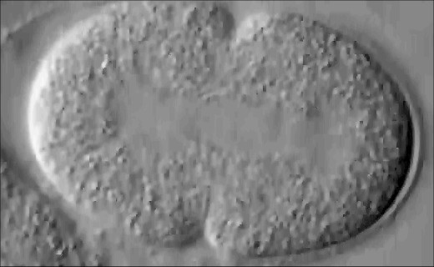
What did they learn?
Controls on cell growth and cell division can be turned on and off

Slide 19
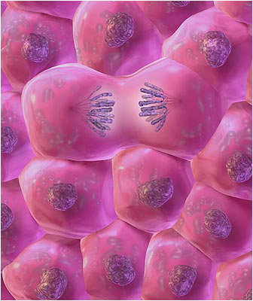
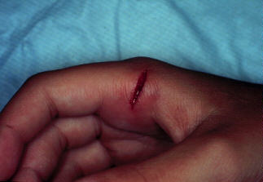
Healing Process
Cells next to the wound are stimulated to start dividing rapidly

Slide 20
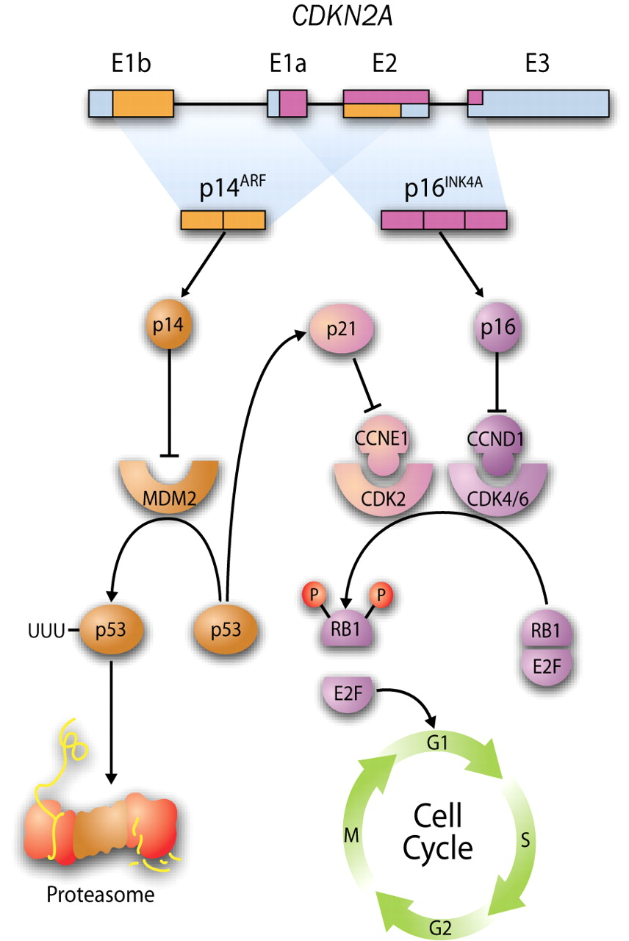
Cell Cycle Regulators
Scientists searched for a substance that would “tell” cells when it was time to duplicate
In early 1980’s they found it

Slide 21
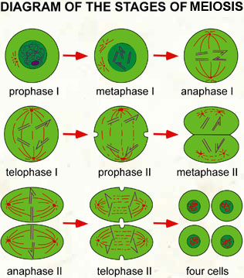
Experiment
Sample of cytoplasm is taken from a cell in mitosis
It is injected into a new cell in Interphase
The new cell begins mitosis
The cytoplasm contained certain proteins

Slide 22

Cyclins – proteins that tell the cell when to duplicate
Since then we have discovered many different types of cyclins

Slide 23
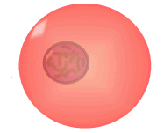
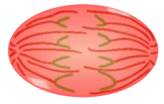
Internal Regulators
Proteins that respond to events inside the cell
Makes sure cell doesn’t enter mitosis until all the chromosomes have replicated
Prevents cell from going into Anaphase until all the chromosomes are attached to mitotic spindles

Slide 24
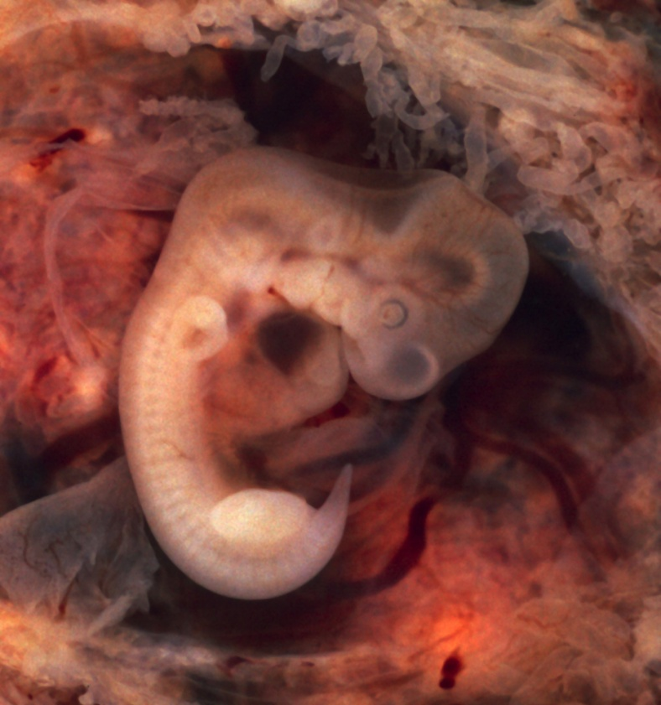
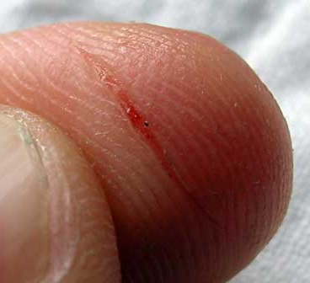
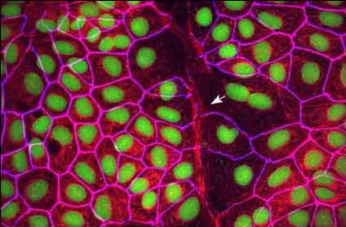
External Regulators
Proteins that respond to events outside the cell
Growth hormones that tell cells to start growing – embryonic development
Wound healing process
Molecules on neighboring cells are slowed down to prevent excess cell growth in the area

Slide 25
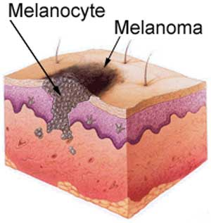
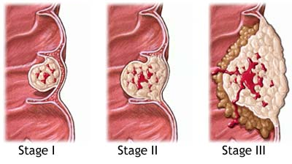
What happens if cell growth isn’t regulated?

Slide 26
Cancer cells do not respond to the signals that regulate the growth of most cells. As a result, they form masses of cells called tumors that can damage the surrounding tissues.

Slide 27
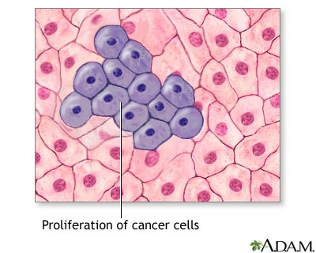

Slide 28
Cancer – abnormal growth of cells
  Benign (kindly) – grow slowly, push around cells, localized
  Malignant (bad) – grow quickly, invade other cells, and travel

Slide 29
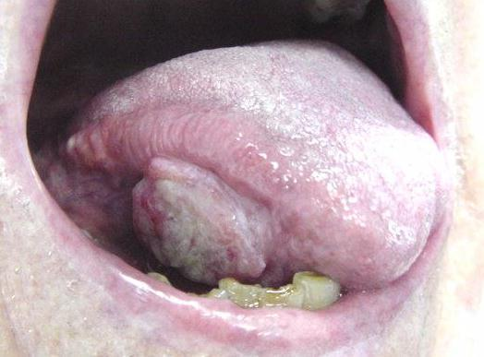

Slide 30
What causes cells to lose control over growth?
radiation
trauma
certain viral infections
chemicals (tobacco tars)
:

Slide 31
Curing Cancer?
Cancer is a disease of the cell cycle, and conquering cancer will require a much deeper understanding of the processes that control cell division.

Slide 32
Why study cells?
Why is understanding cell division important?

