Slide 1
Atomic Spectra

Slide 2
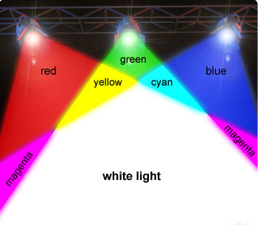
Visible Light
When all frequencies (colors) of visible light reach our eye at the same time, we see white light

Slide 3
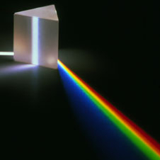
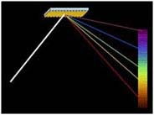
Separating white light
Prisms
Diffraction Grating

Slide 4
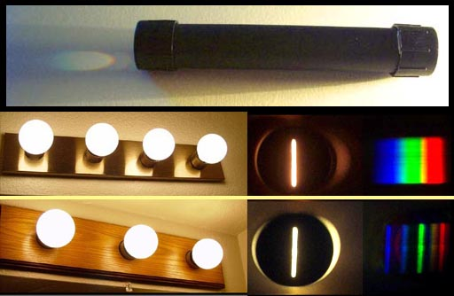
Spectroscope
an instrument used to see the color components of any light source
Lets us analyze the light given off by elements when they are made to glow

Slide 5
Making atoms glow
When heat or electricity is added to an element, the atoms absorb the energy and become excited

Slide 6
Making atoms glow
To go back to a normal state, the atom emits light to release the energy

Slide 7
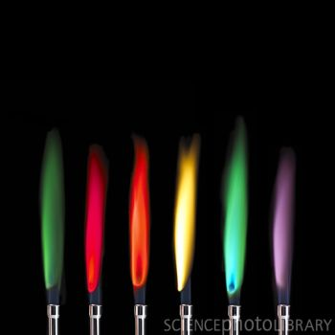
The atoms of each element emit only certain frequencies of light, giving each element a distinctive glow when energized
Copper, Lithium, Strontium, Sodium, Boron, and Potassium

Slide 8
Spectroscope
Potassium
Sodium
Lithium

Slide 9
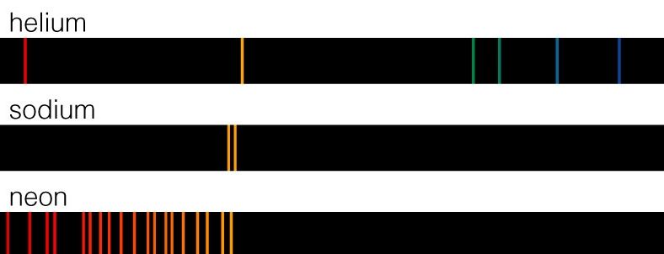
Atomic Spectrum
pattern of individual frequencies formed by an element

Slide 10
Atomic Fingerprints
Can identify the elements of a light source by matching the patterns in the atomic spectrum

Slide 11
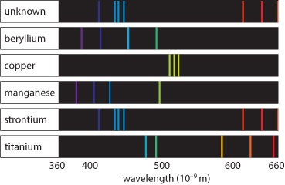
Based on this spectral analysis it can be concluded that the rock sample contains:
a. Strontium, but none of the other four metals
b. All of the five metals
c. Strontium and beryllium, but none of the other three metals
d. None of the five metals

Slide 12
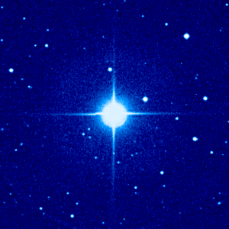
Stars?

Slide 13
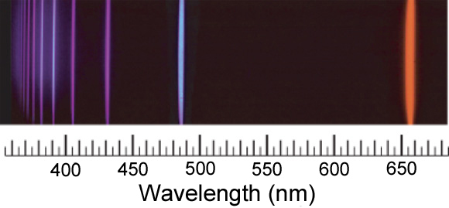
Hydrogen
Atomic spectrum is more orderly – creates a set pattern

Slide 14
Questions?
Why should such orderliness exist?
Why are the atomic spectrums lines rather than continuous?

Slide 15
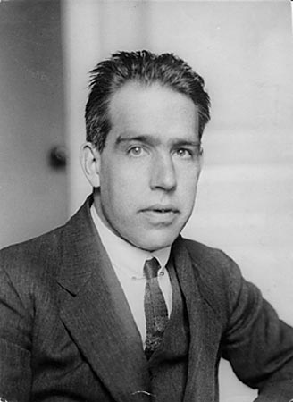
Niels Bohr
Atoms give off energy in levels
Energy can’t exist in between those levels

Slide 16
Rungs of a Ladder
You can’t step in between the rungs, just like electrons can’t stay in between the levels

Slide 17
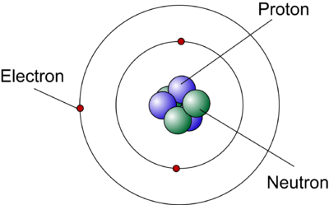
Bohr’s Planetary Model
Showed electrons orbiting the nucleus much like the planets orbit the sun

Slide 18
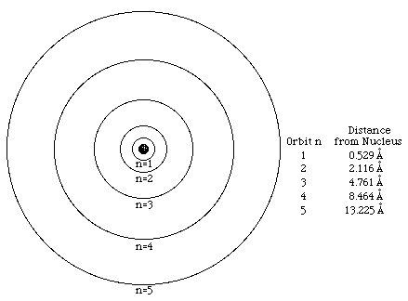
Bohr’s Planetary Model
Each level was assigned a quantum number (n)
n=1 is the lowest or closest level to the nucleus

Slide 19
Excited Electrons
When electrons are excited, they jump to higher energy levels
As they drop back to lower energy levels, they give off certain light frequencies

Slide 20
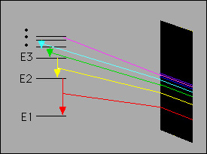
The distance between levels is not evenly spaced like the rungs of a ladder and each distance the electron travels gives off a different frequency of light

Slide 22
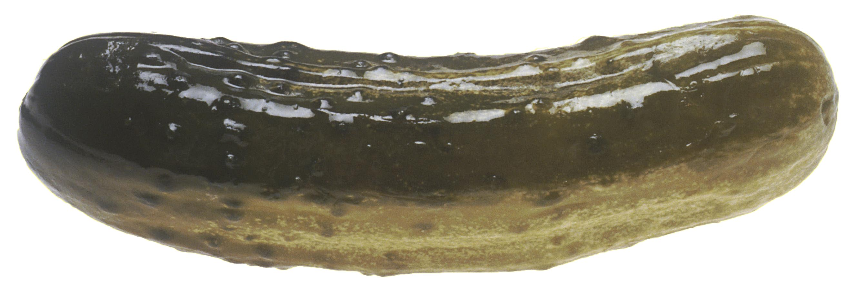
Glowing Pickle!
What element is found in pickles?

