Slide 1
Food Chains and Food Webs

Slide 2
Food Chain
animals feeding on other animals or plants

Slide 3
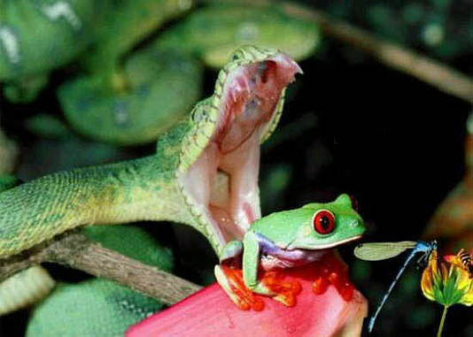
Food Chain

Slide 4
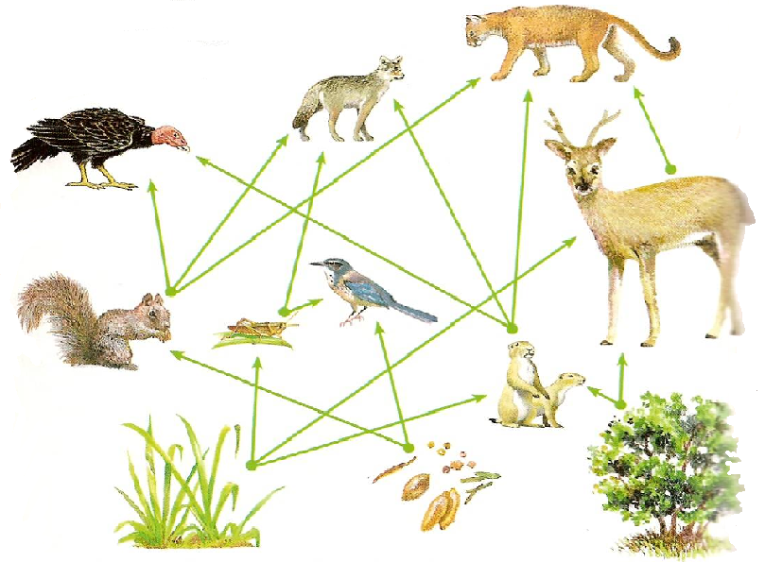
Food Web
group of food chains related together

Slide 5
3 Main Parts of the food chains and webs
Producers
Consumers
Decomposers

Slide 6
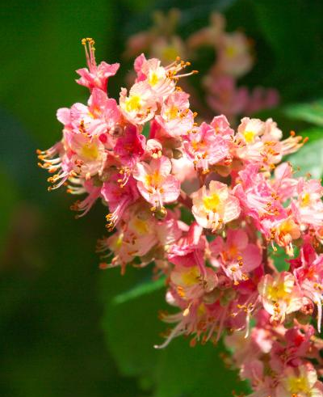
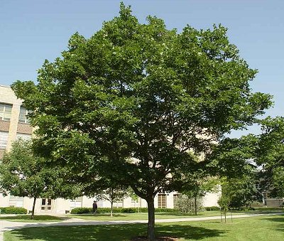
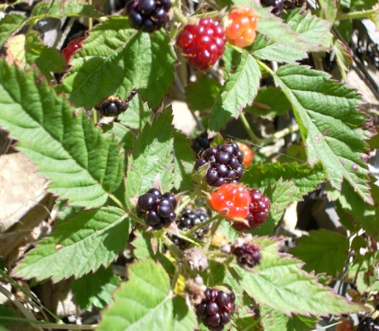
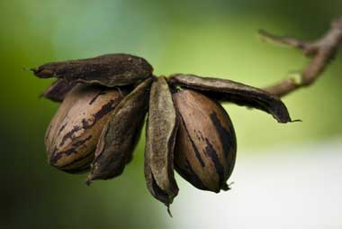
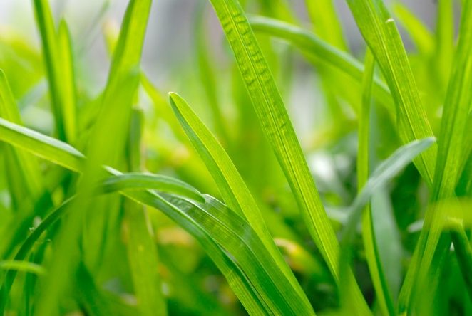
Producers – also called autotrophs
make their own food (plants)

Slide 7
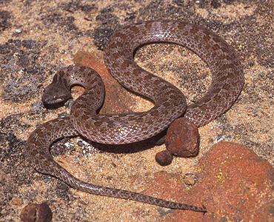
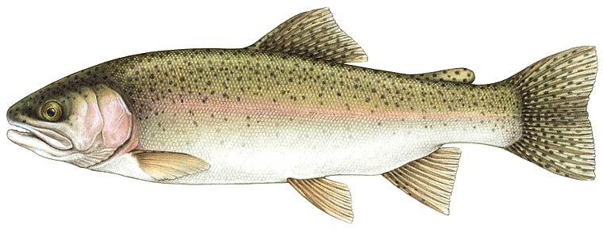
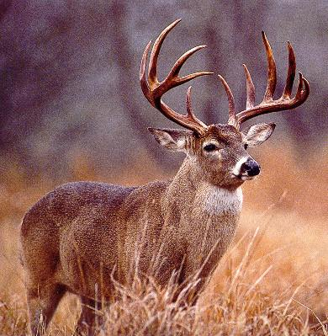
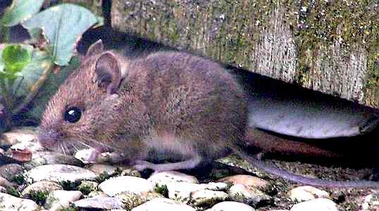
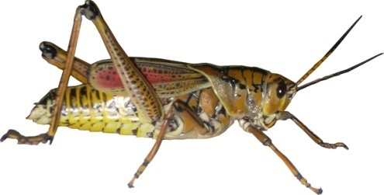
Consumers – also called heterotrophs
feed on other organisms

Slide 8
Consumers described partly on how they obtain their food
Herbivores – eat only plants
Carnivores – eat only animals
Omnivores – eat both plants and animals

Slide 9
Consumers described partly on where they fit in a food chain/food web
1st Order Consumer
2nd Order Consumer
3rd Order Consumer
animals that eat plants
animals that eat 1st order consumers
animals that eat 2nd order consumers

Slide 10
3rd Order Consumer
2nd Order Consumer
1st Order Consumer
Producer

Slide 11
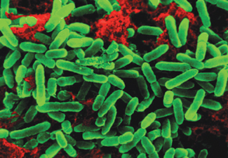
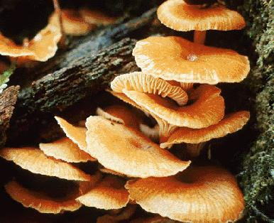
Decomposers
change dead producers and consumers into minerals for producers (fungi, bacteria, tubifex worms)

Slide 12
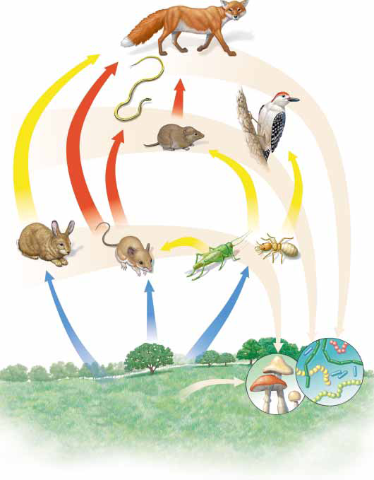

Slide 13
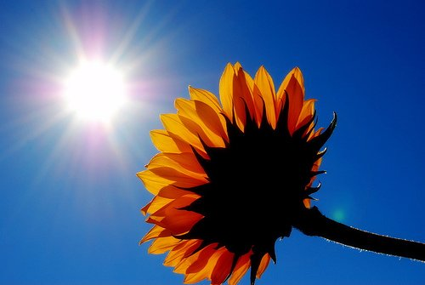
Energy flow in an Ecosystem
The sun - the ultimate source of energy for all organisms

Slide 14
Energy is:
Used in life’s processes
Lost to the environment as heat
Stored in body tissues
Only stored energy is passed on to the next consumer in the food chain

Slide 15
At each step in the food chain, only 10% is passed on
Because of this loss of energy, most of the original stored energy is lost in just 5 steps of the food chain. (a food chain will never be larger than 5 steps, because all the energy is lost by that point)
Sun

Slide 16
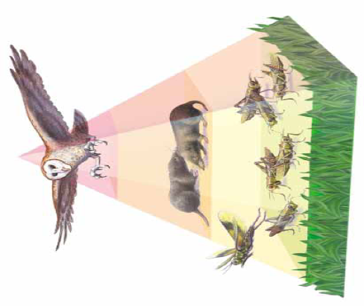
Energy Pyramid
diagram that shows how energy is lost as it moves through food chains

Slide 17
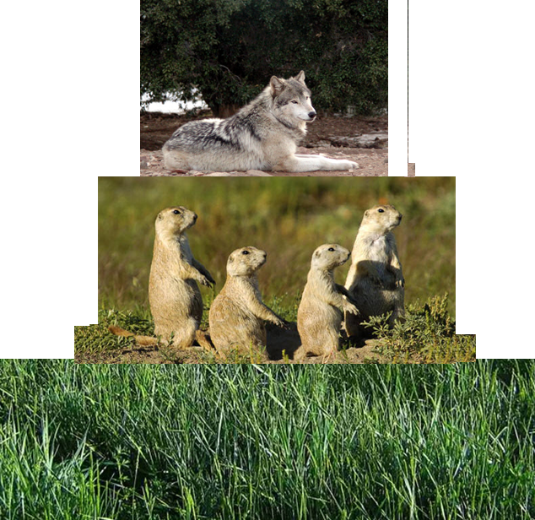
Decreasing number of organisms
Decreasing amount of energy
wolf
prairie dogs
grass

Slide 18
