Slide 1
Molecular Formulas

Slide 2
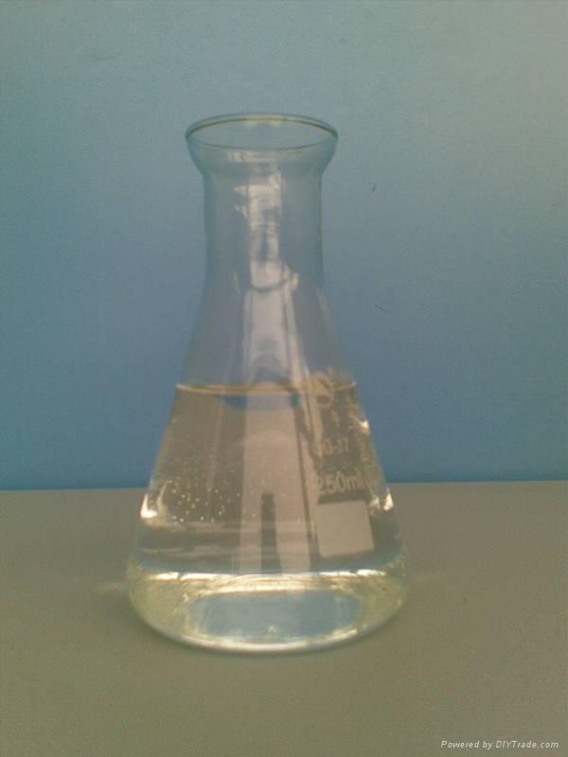
How can two different substances have the same empirical formulas?
CH CH
Acetylene Benzene
Gas used Liquid
in welding

Slide 3
Molecular Formula
Tells the actual number of atoms in a compound
HO H₂O₂

Slide 4
How can you find the molecular formula from empirical formula?

Slide 5
A few steps…
1. Divide experimental molar mass by mass of empirical formula
Molar mass of acetylene = 26.04 g/mol
Empirical formula = CH
C = 12.01 H = 1.01 CH = 13.02
26.04/13.02 = 2

Slide 6
Because the molar mass of acetylene was 2 times the mass of the empirical formula, the molecular formula must contain twice the amount of C and H represented in empirical formula

Slide 7
A few steps…
2. Multiply the subscripts by amount from step 1
CH
amount = 2

Slide 8
A few steps…
Use the subscripts to write the molecular formula
C₂H₂

Slide 9
Remember
The molecular formula is a whole number multiple of the empirical formula
HO H₂O₂

Slide 10
Practice
A molecule of nicotine contains 74.0% C, 8.65% H, and 17.35% N. The molar mass of nicotine is 162.26 g/mol. What is the empirical and molecular formula of nicotine?

Slide 11
1. Convert mass to moles
Divide mass by molar mass
74.0g / 12.01 g/mol = 6.16 mol C
8.65g / 1.01 g/mol = 8.56 mol H
17.35g / 14.01 g/mol = 1.24 mol N

Slide 12
2. Divide all by smallest mole #
6.16 mol C
8.56 mol H
1.24 mol N
/ 1.24 = 4.97
/ 1.24 = 6.90
/ 1.24 = 1
Round to nearest whole number and write empirical formula

Slide 13
C₅H₇N
Experimental molar mass = 162.26
Find molar mass of empirical formula
5(12.01) = 60.05
7(1.01) = 7.07
1(14.01) = 14.01
81.13

Slide 14
Divide experimental molar mass by molar mass of empirical formula
162.26/81.13 = 2
Multiply subscripts by 2 to get molecular formula
C₅H₇N

