Slide 1
Separating Mixtures

Slide 2
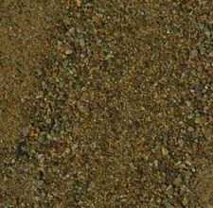
Mixtures are physically combined
Processes to separate them are physical processes
Sand and iron fillings
Look at physical properties to separate them

Slide 3
A few common methods…
Filtration
Distillation
Crystallization
Chromatography

Slide 4
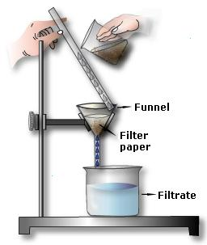
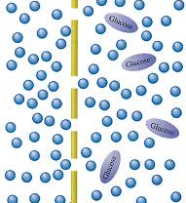
Filtration
Uses a porous barrier to separate a solid from a liquid

Slide 5
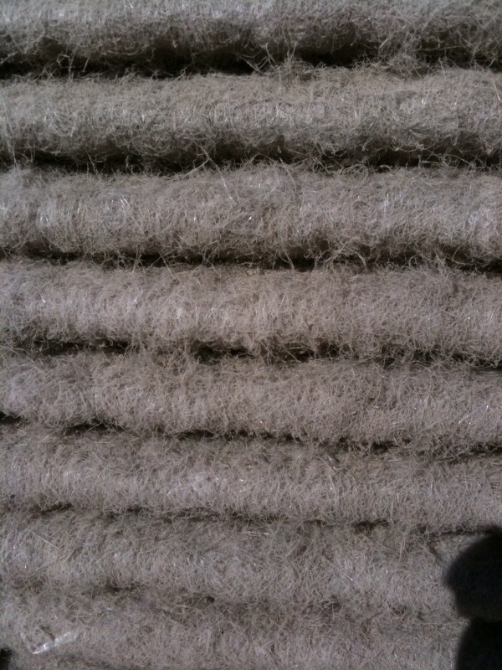
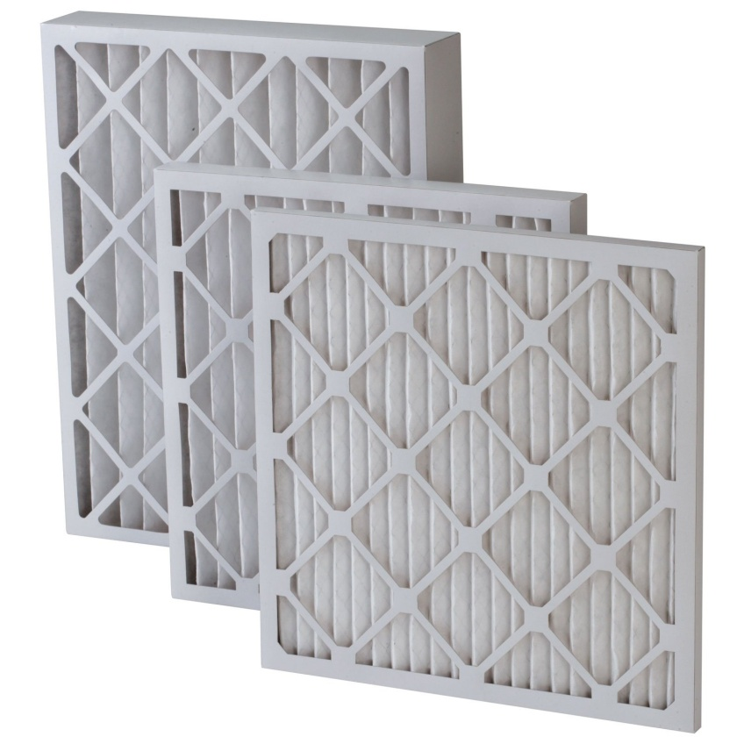
Filtration Examples
Heater and AC

Slide 6
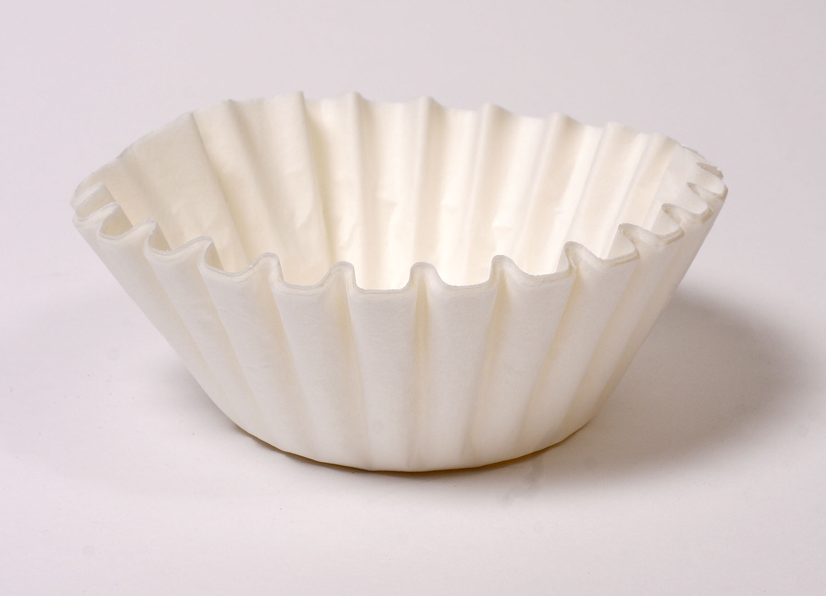
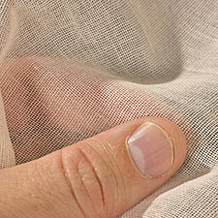
Filtration Examples
Coffee Filter or Cheesecloth

Slide 7
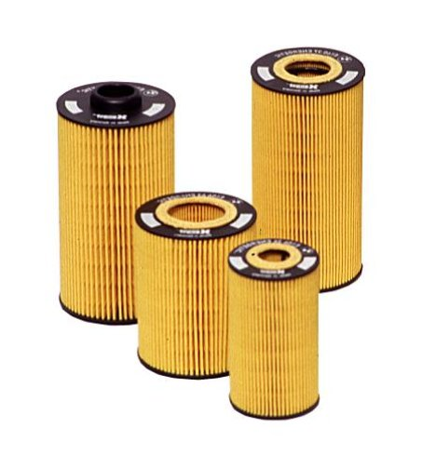
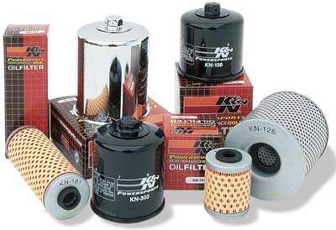
Filtration Examples
Air and oil filters for vehicles

Slide 8
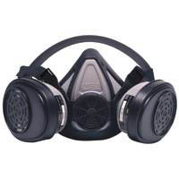
Filtration Examples
Filters germs or chemicals from the air

Slide 9
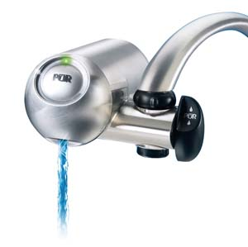
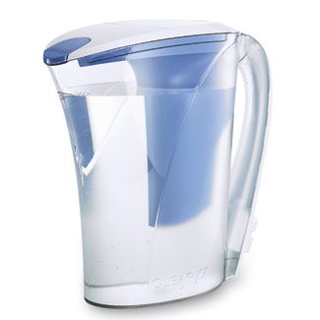
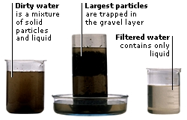
Filtration Examples
Water filter

Slide 10
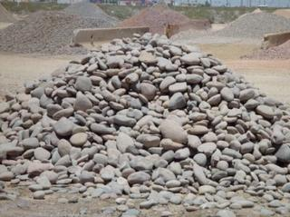
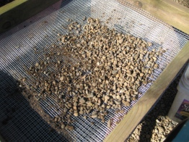
Filtration Examples
Gravel pits

Slide 11
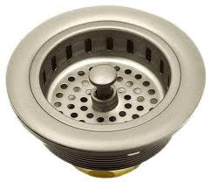
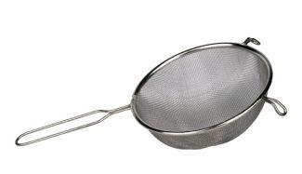
Filtration Examples
Kitchen Drain or Sieve

Slide 12
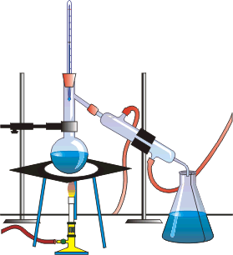
Distillation
Uses the different boiling points of the substances

Slide 13
Distillation
The substance with the lowest boiling point will vaporize first

Slide 14
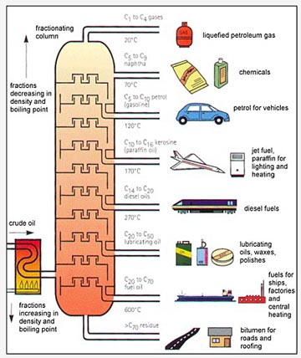
Distillation to get gasoline

Slide 15
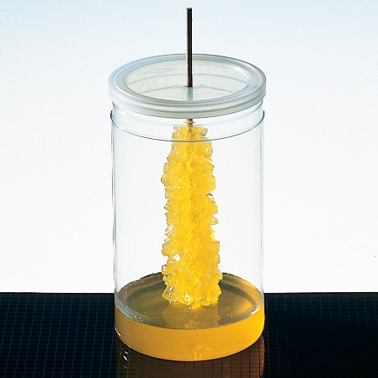
Crystallization
Forms pure solid crystals from a solution

Slide 16
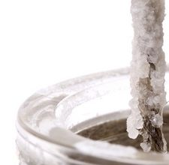
When a solution contains as much of a solute as it can possible hold, adding even the tiniest amount can cause the solvent to come out of the solution and collect as crystals on any available surface.

Slide 17
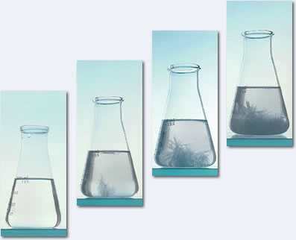
Salt water solution

Slide 18
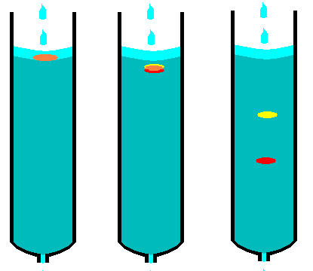
Chromatography
Separates and identifies parts of a mixture by how they travel across a substance

Slide 19
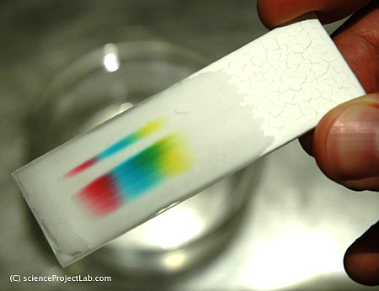
Chromatography Examples
Inks or Dyes

Slide 20
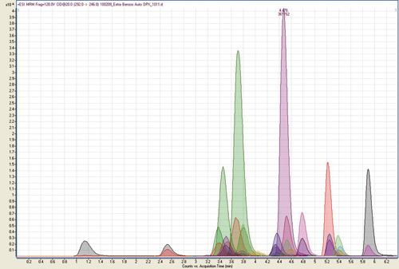
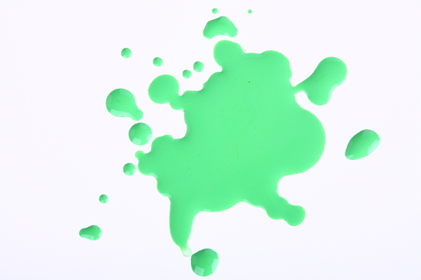
Chromatography Examples
Forensics!!!
Mystery substance

Slide 21
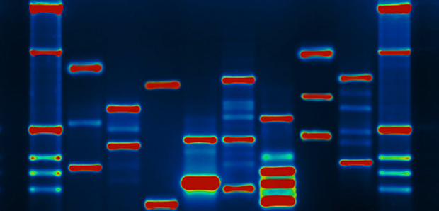
Chromatography Examples
Mapping DNA

Slide 22
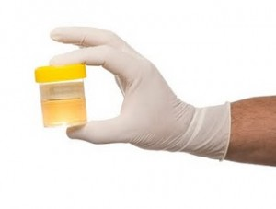
Chromatography Examples
Detecting drugs in urine

