Slide 1
Review for Test!

Slide 2
Parts of the microscope

Slide 3
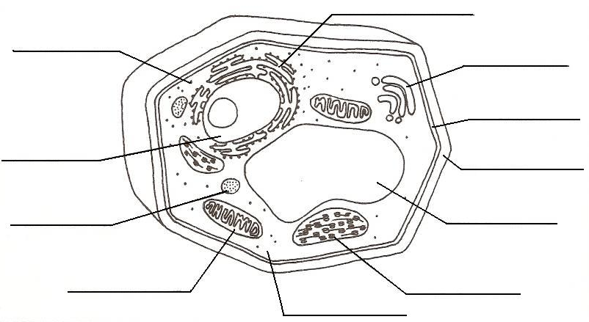
Parts of the cell

Slide 4
