Slide 1
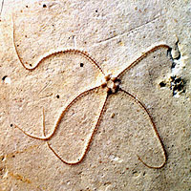
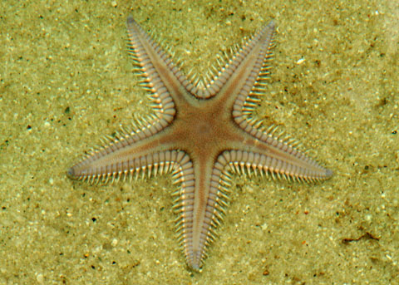
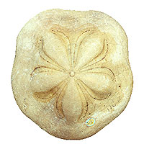
Phylum Echinodermata
“spiny skin” animals
Examples: sea stars, sea urchins, sea cucumbers

Slide 2
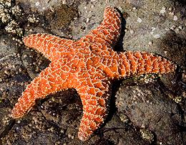
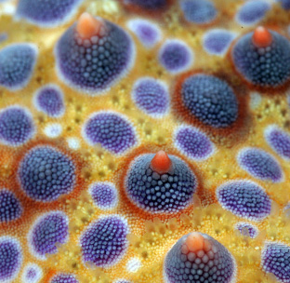
Traits
Leathery skin with ossicles (bony plates)

Slide 3
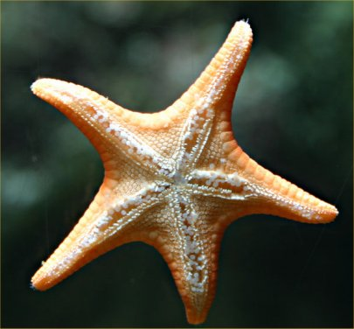
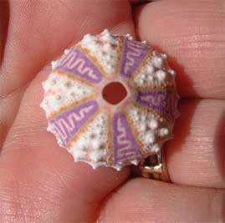
Traits
Radial symmetry

Slide 4
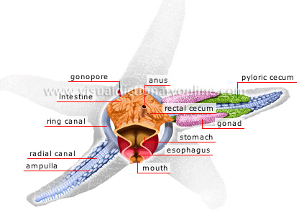
Traits
Complete digestive system

Slide 5
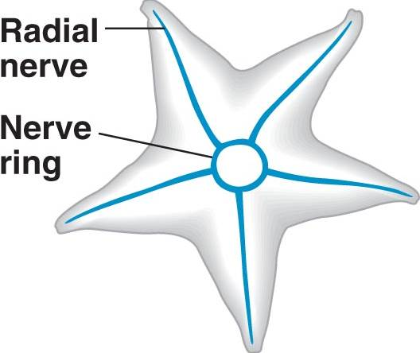
Traits
Nerve ring with radial nerves

Slide 6
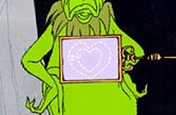
Traits
No circulatory system

Slide 7
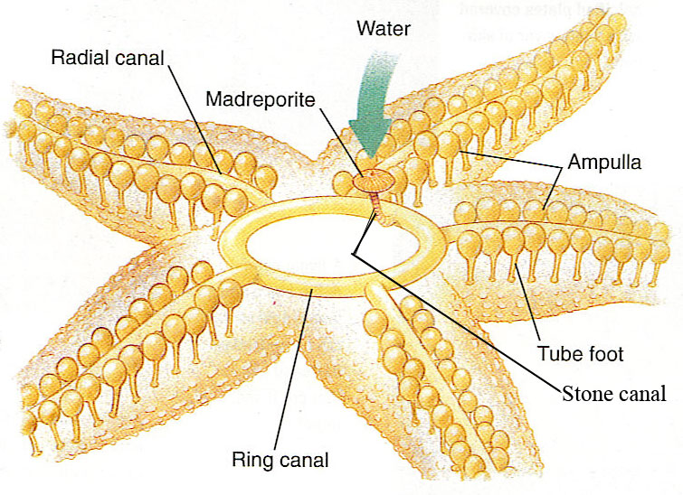
Traits
Water vascular system with tube feet

Slide 8
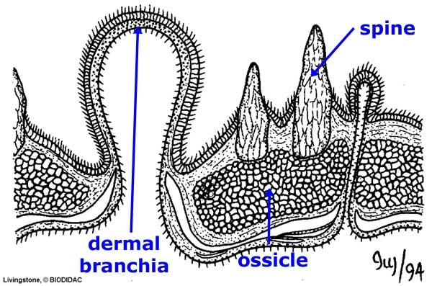
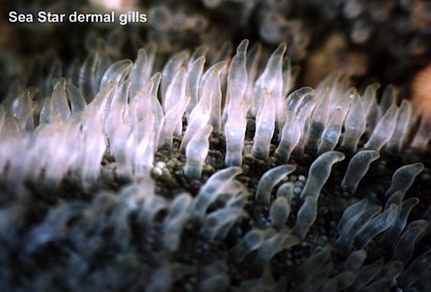
Traits
Dermal gills

Slide 9
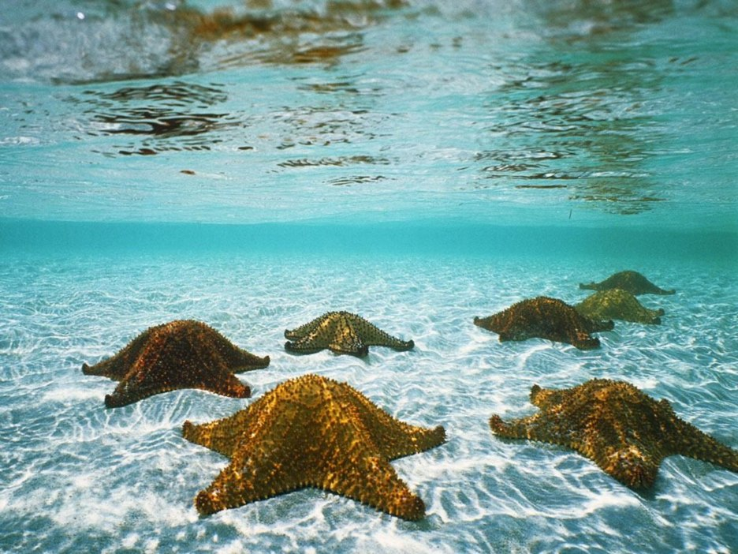
Traits
marine

Slide 10
Relationship to Vertebrates
Vertebrates are considered to be more closely related to echinoderms than other invertebrates because of similarities in early embryology

Slide 11
Water Vascular System
Series of tubes through which they pump water to use their tube feet

Slide 12
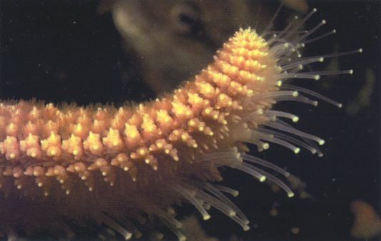
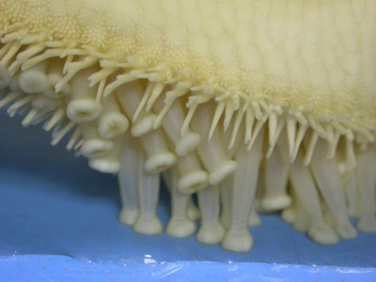
Tube feet
Suckers use to move and capture prey

Slide 13
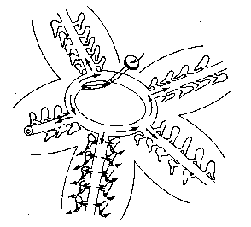
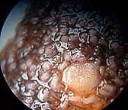
Madreporite
Sieve plate, opening to the water vascular system

Slide 14
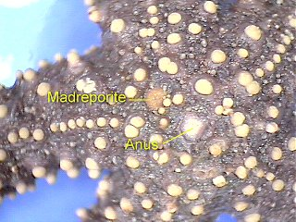

Slide 15
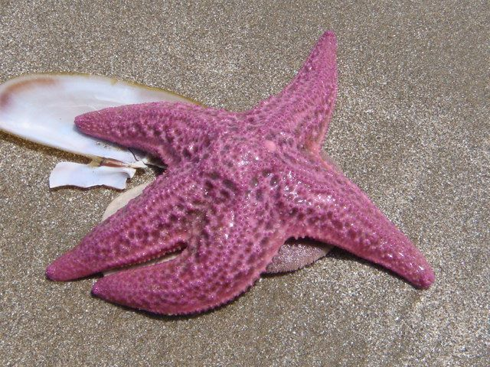
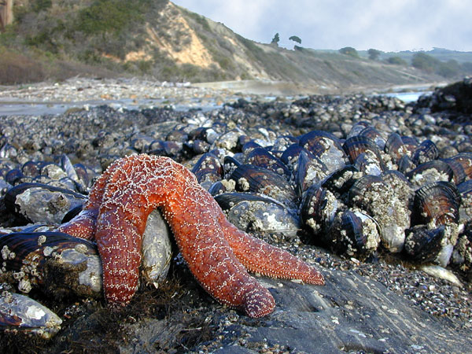
Sea stars
carnivores

Slide 16
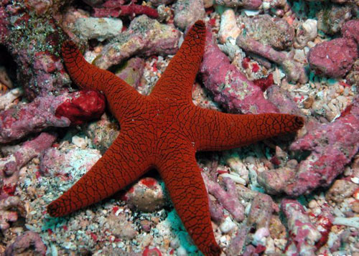
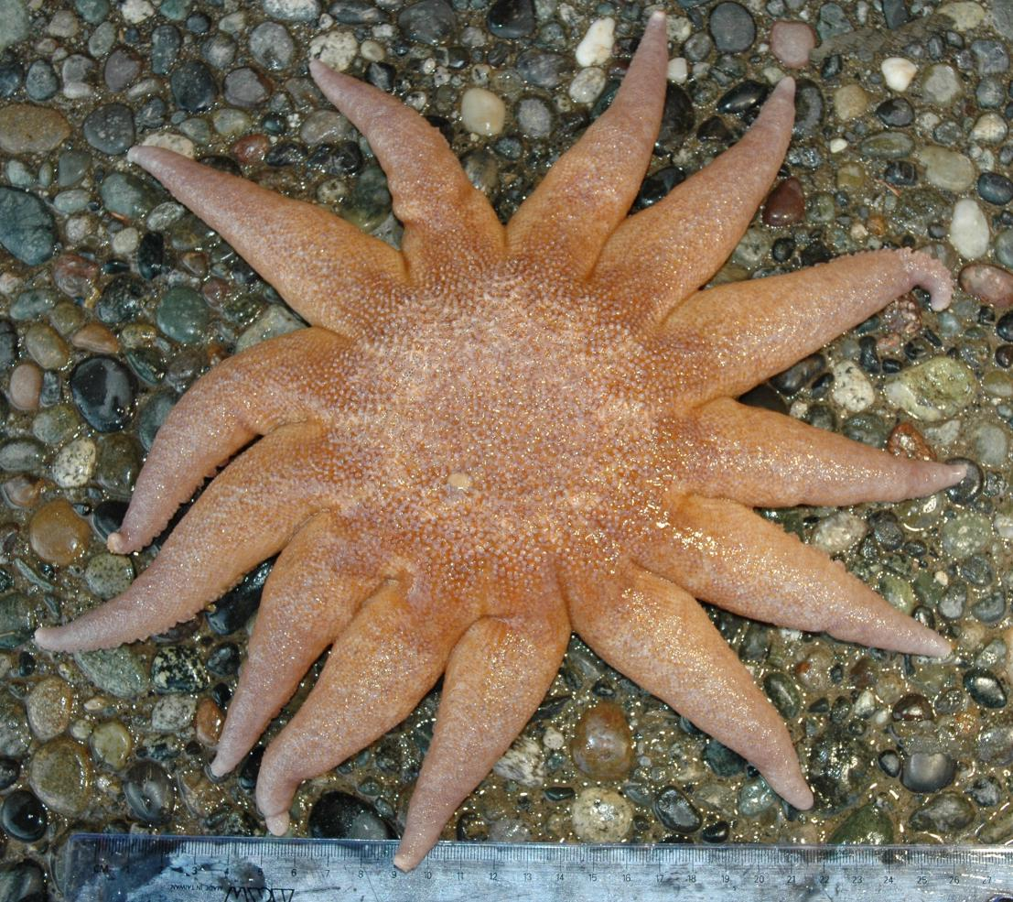
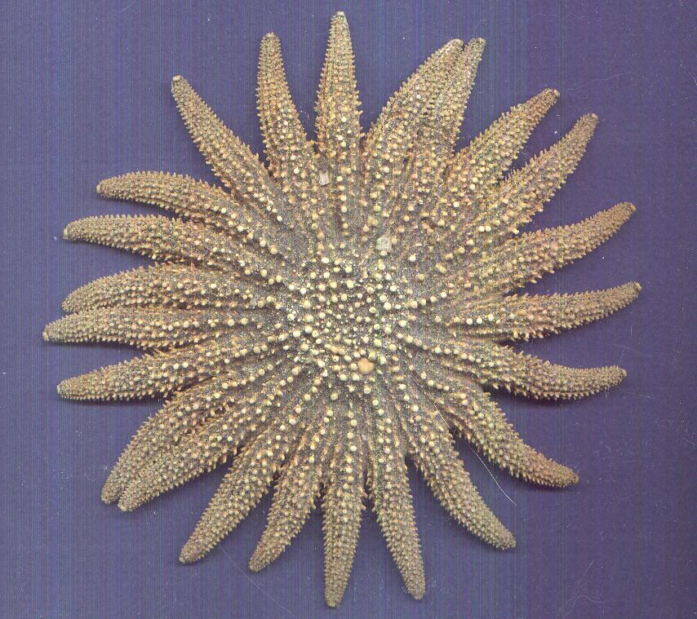
Most have 5 legs but some can have up to 20 or more

Slide 17
Feeding method
Attach to clam shell with tube feet and pull until clam opens a crack
Turn stomach inside out into the clam shell and secrete enzymes to liquefy the clam
Suck their stomach back in and finish digestion

Slide 18
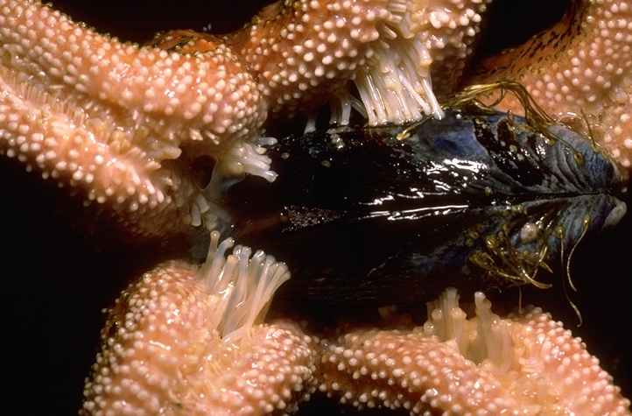

Slide 19
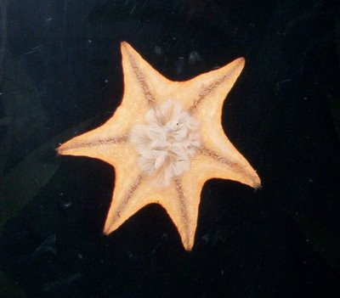
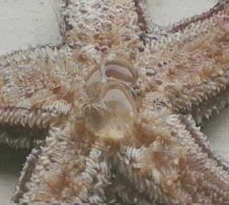

Slide 20
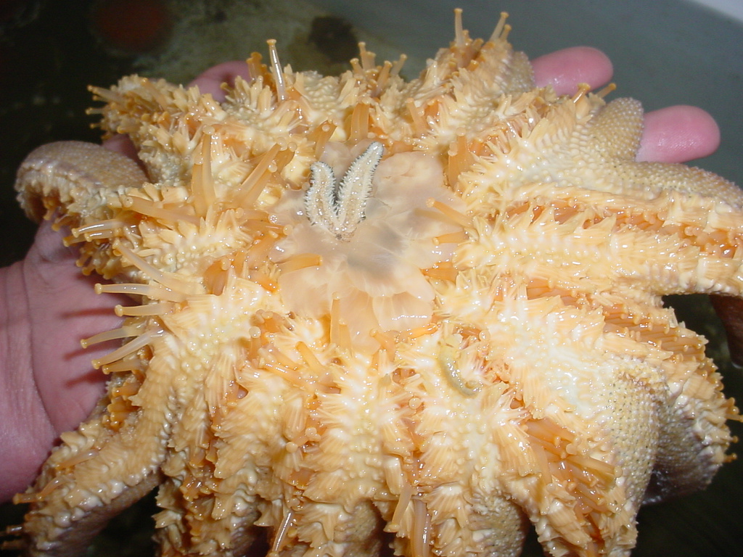

Slide 21
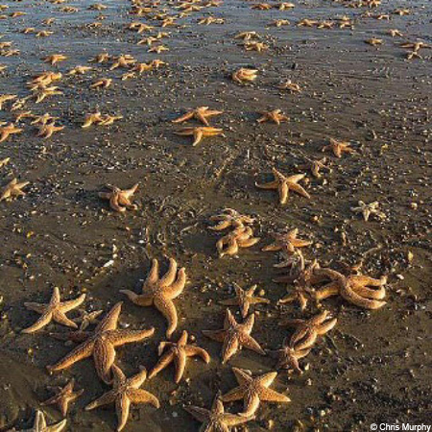
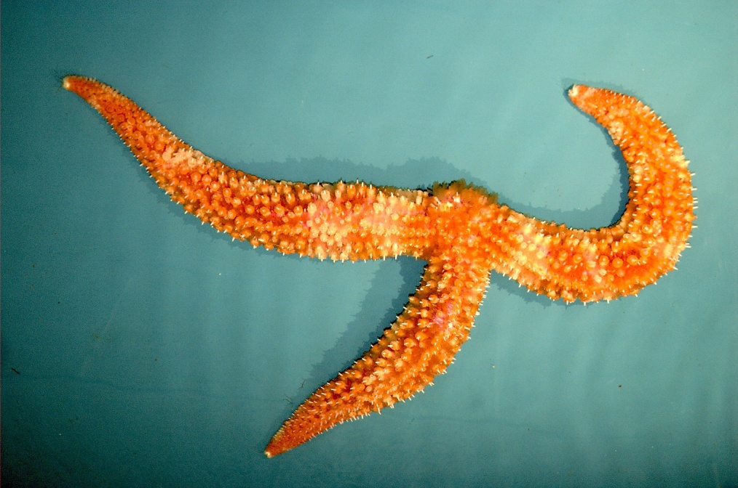
Regeneration
As long as they have part of the central disk, they can regrow all the missing parts

Slide 22
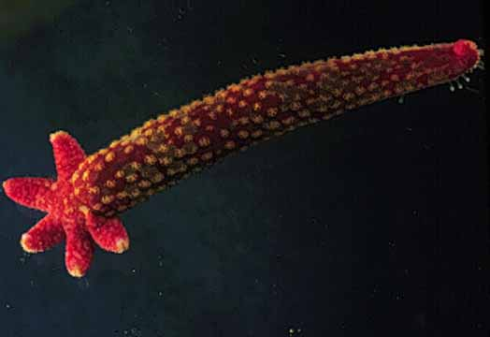

Slide 23
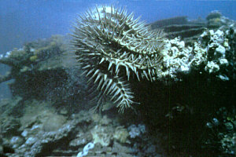
Reproduction
Females release eggs and males release sperm into the water where they fertilize and develop into larvae and adults

Slide 24
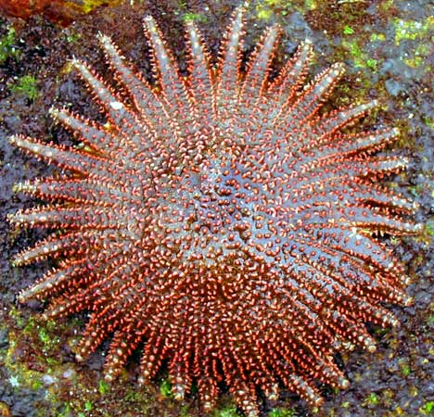
Sunflower Starfish
Largest Echinoderms
Up to 3 ½ feet across

Slide 25
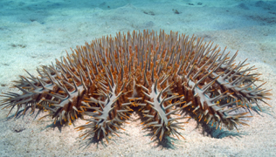
Crown of Thorns Starfish
Venomous spines, 2nd largest

Slide 26
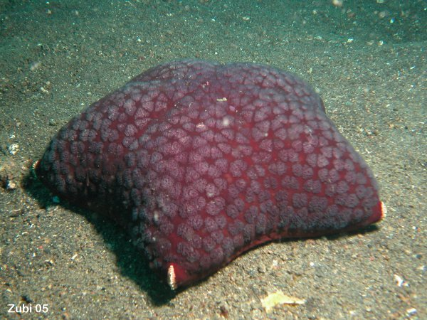
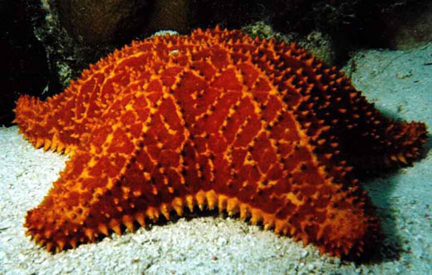
Cushion Star

Slide 27
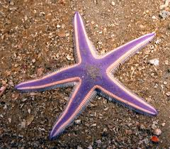
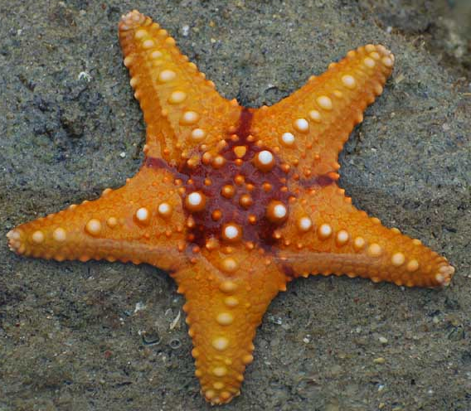
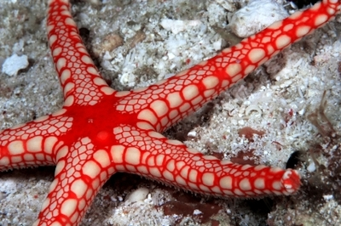
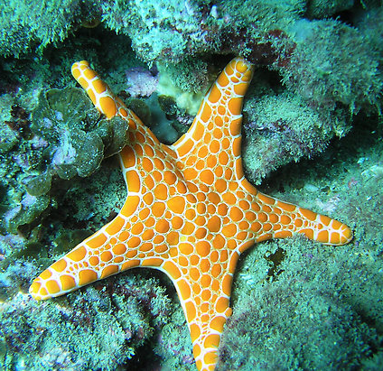
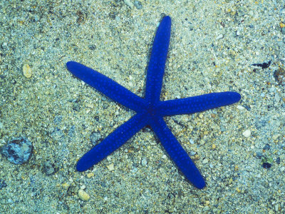
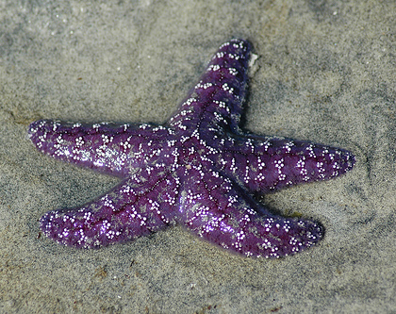
Pretty…

Slide 28
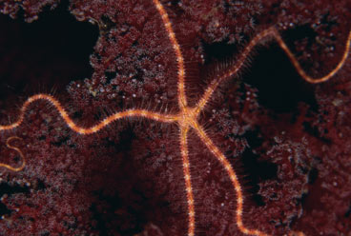
Brittle stars
Scavengers and carnivores
5 long thin arms to move around quickly
Tube feet lack suction cups

Slide 29
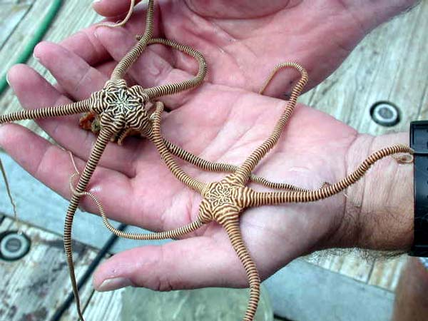
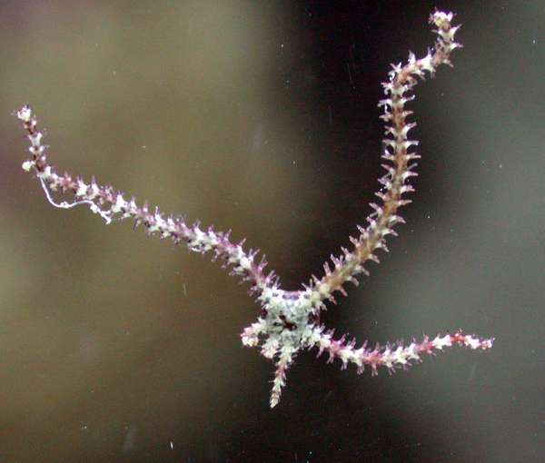
Brittle star legs are easily detached for defense and quickly grown back

Slide 30
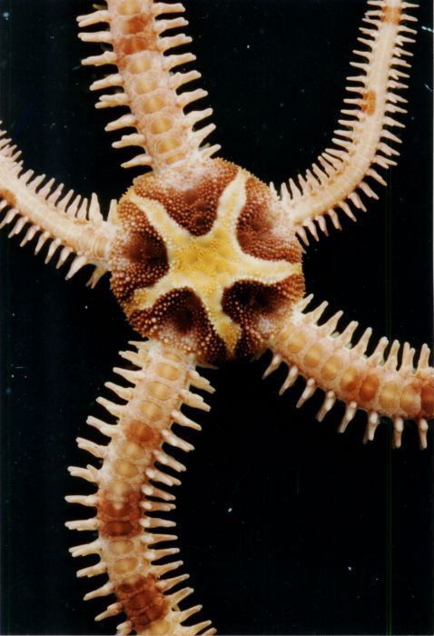
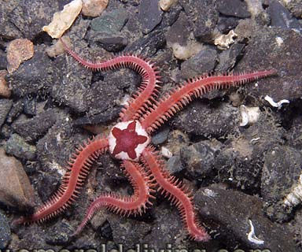
Daisy Brittle Star

Slide 31
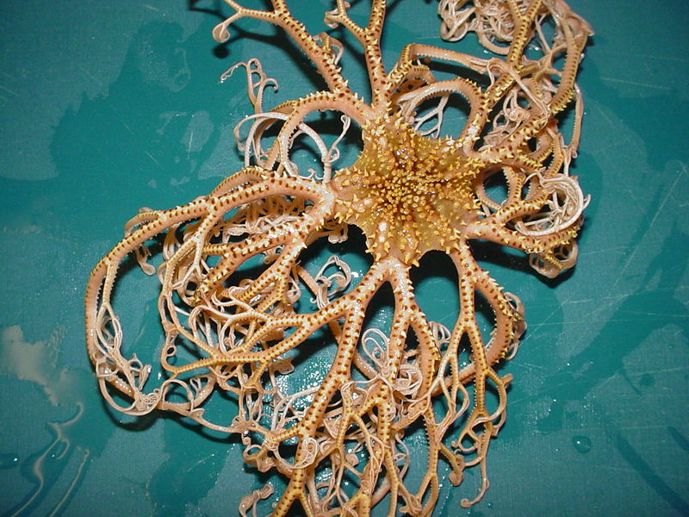
Basket star

Slide 32
Sea urchins
herbivores (eat algae or seaweed)

Slide 33
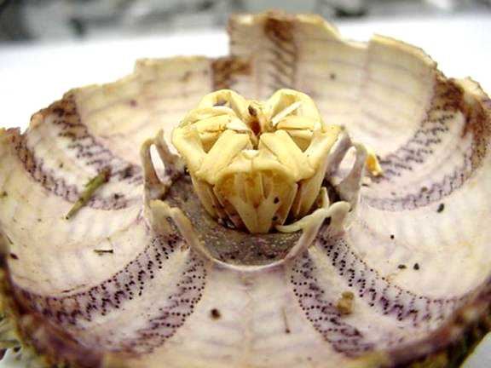
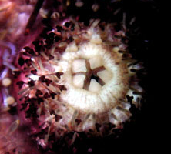
Aristotle’s lantern
Set of 5 teeth of an urchin used to chomp algae from rocks

Slide 34
Sea Urchin Anatomy

Slide 35
Tend to live in large groups

Slide 39
The spines are toxic and can leave a nasty sting and cause the skin to welt

Slide 40
Sea Urchin Skeletons

Slide 41
Sand dollars

Slide 43
Sea cucumbers
Filter microscopic organisms and particles from water or mud
Nature’s pooper-scoopers

Slide 44
Sea Cucumber Anatomy

Slide 47
Feeding Tentacles out

Slide 49
Sea Cucumber defense

Slide 51
Human uses for Echinoderms
Food
Possible source of medicines
Decoration
Study embryology

Slide 52
Echinoderm Embryology
Early stages are similar to vertebrates (us)
vertebrates and echinoderms, the original opening of the G.I. tract becomes the anus
In other invertebrates, the opening becomes the mouth

Slide 53
Echinoderm Embryology
Zygote – a fertilized egg

Slide 54
Echinoderm Embryology
Cleavage – dividing zygote and resulting cells

Slide 55
Echinoderm Embryology
Morula –solid sphere of cells

Slide 56
Echinoderm Embryology
Blastula – hollow sphere of cells

Slide 57
Echinoderm Embryology
Gastrula – embryo once the digestive system starts to form

Slide 58
Echinoderm Embryology
Bipinnaria – larval stage of an echinoderm

